Slide 1
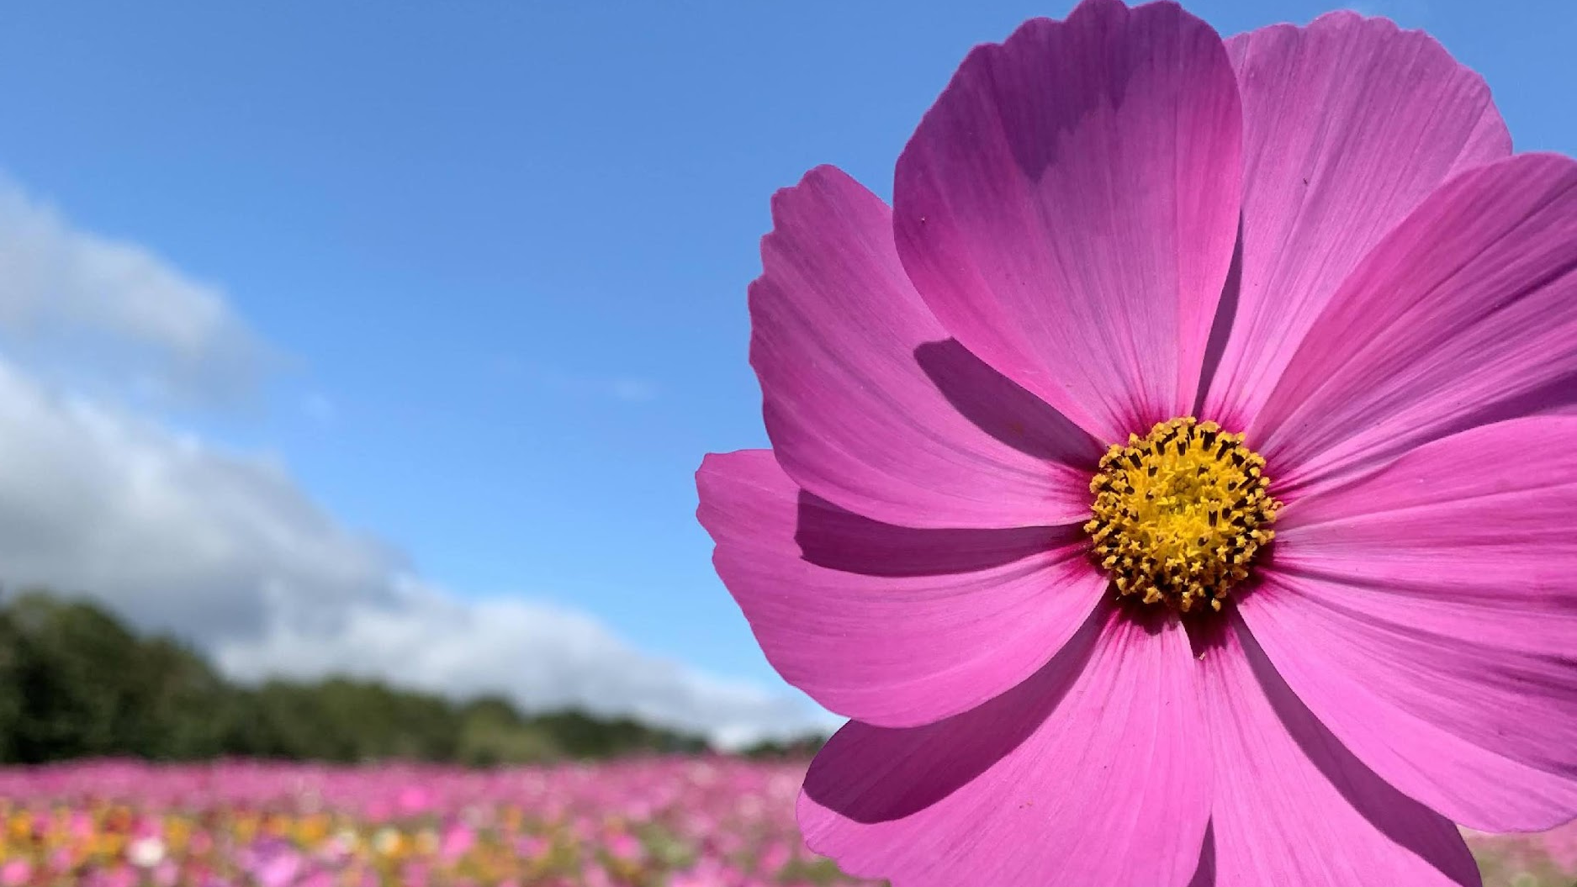
Welcome to the 2023 GCMGA Photo Contest Awards Night
Featuring our special guest and contest judge: Eric Bowles

Slide 2
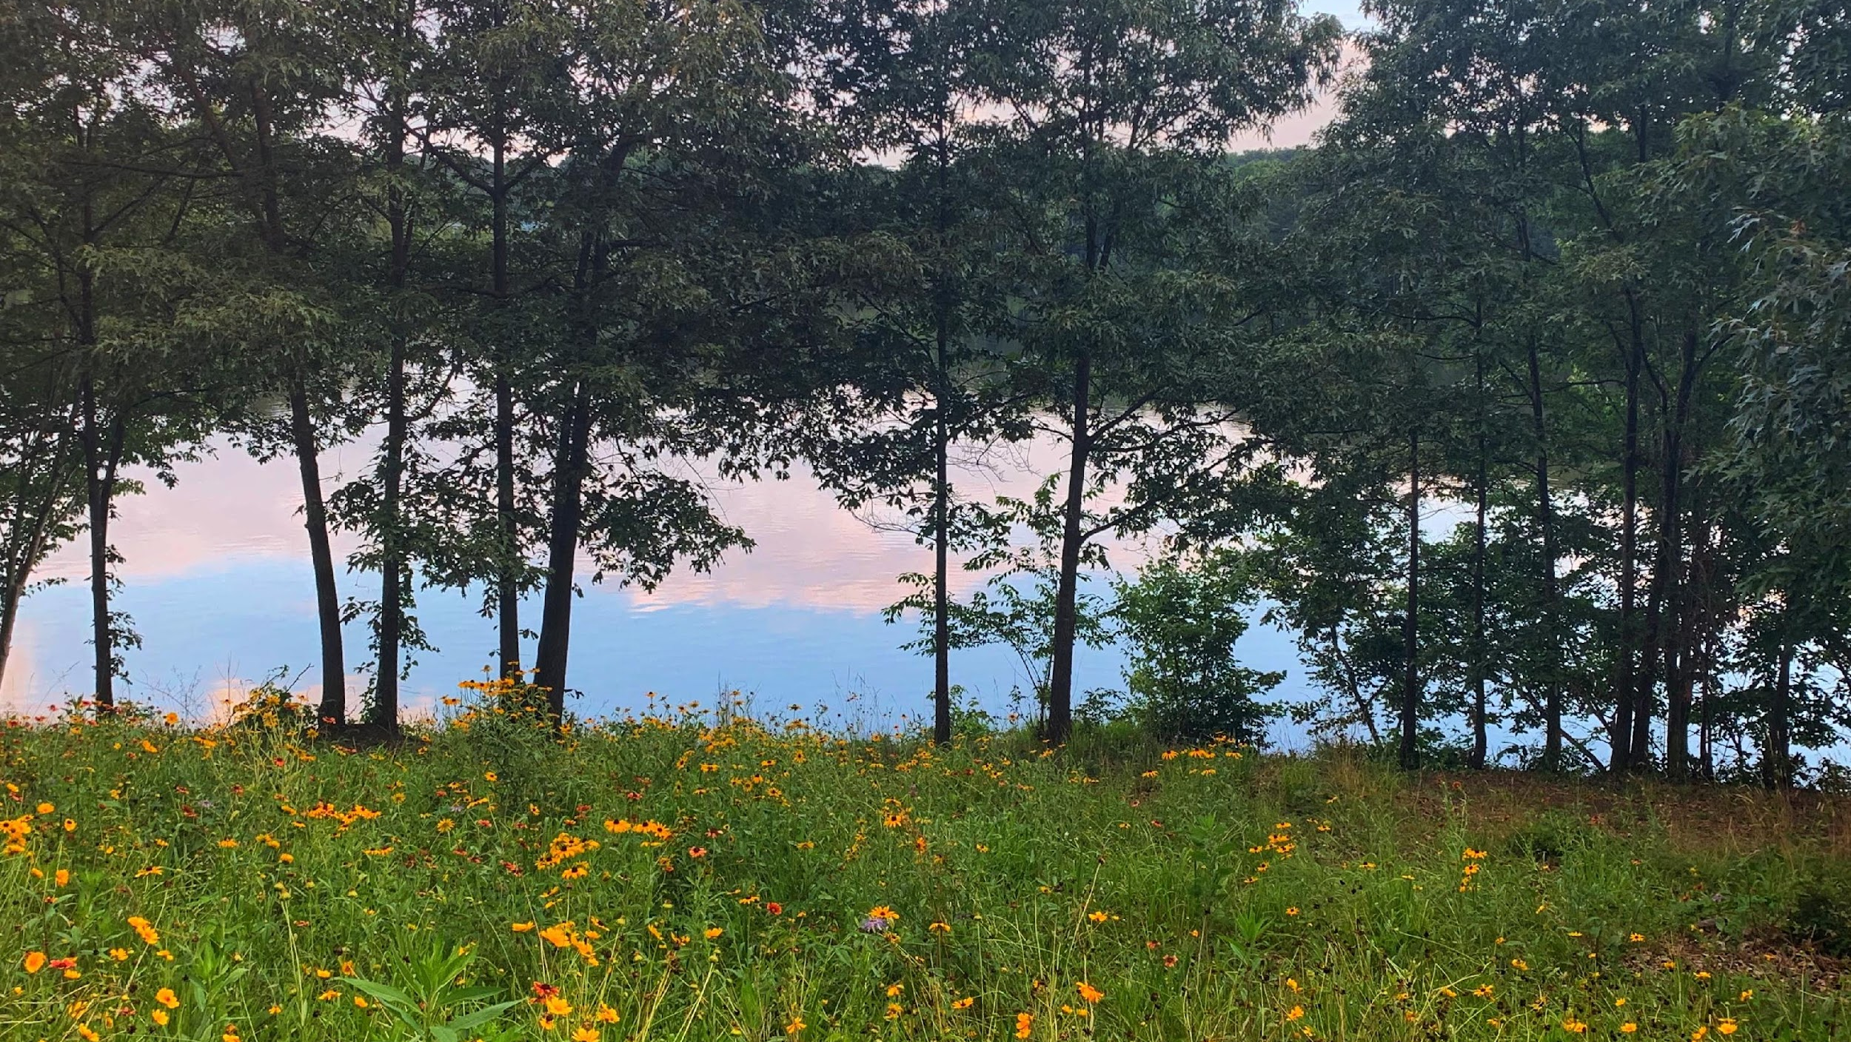
Landscapes and Hardscapes
Broad views of gardens including lawns, trees, walls, pathways, and the way weather and light interact with the landscape
11 entries in this category
  One international location
  Two out-of-state locations
  Eight locations in Georgia

Slide 3
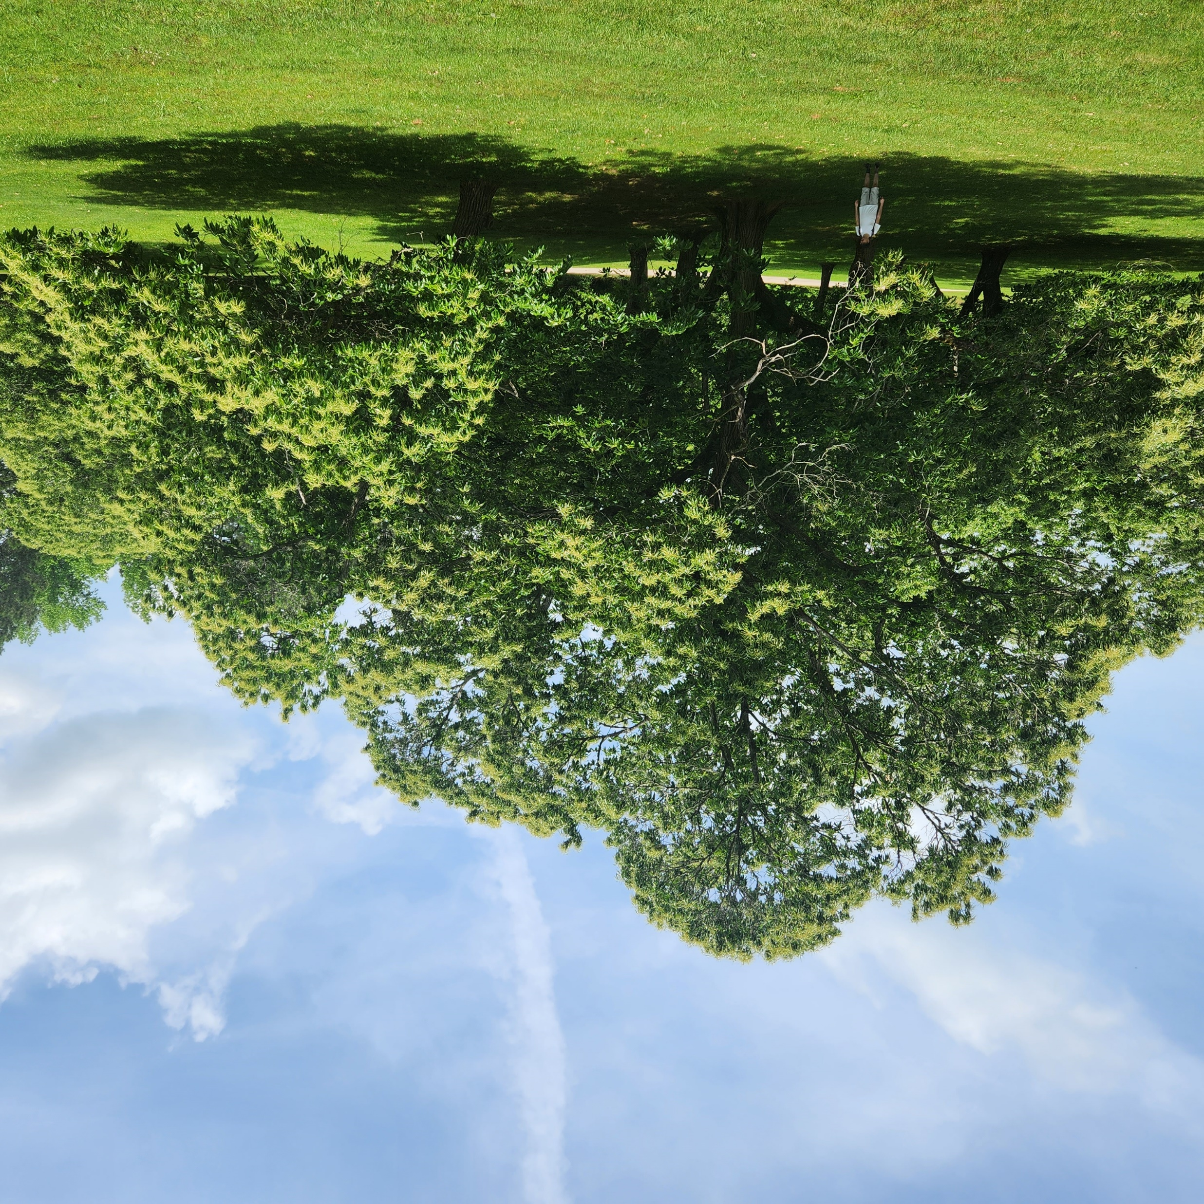
Mother's Day at the Monastery
Photo by Jane Trentin
Monastery of the Holy Spirit
Conyers, GA
My son and I happened upon a grove of Chestnut trees in full bloom.

Slide 4
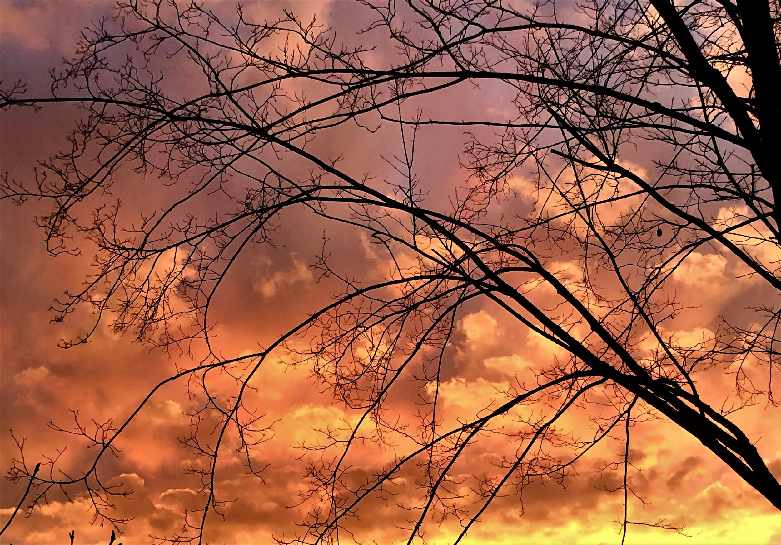
After the Storm
Photo by Kate K. Foxwell
Snellville, GA
Stormy sky at sunset.
Taken with iPhone.

Slide 5
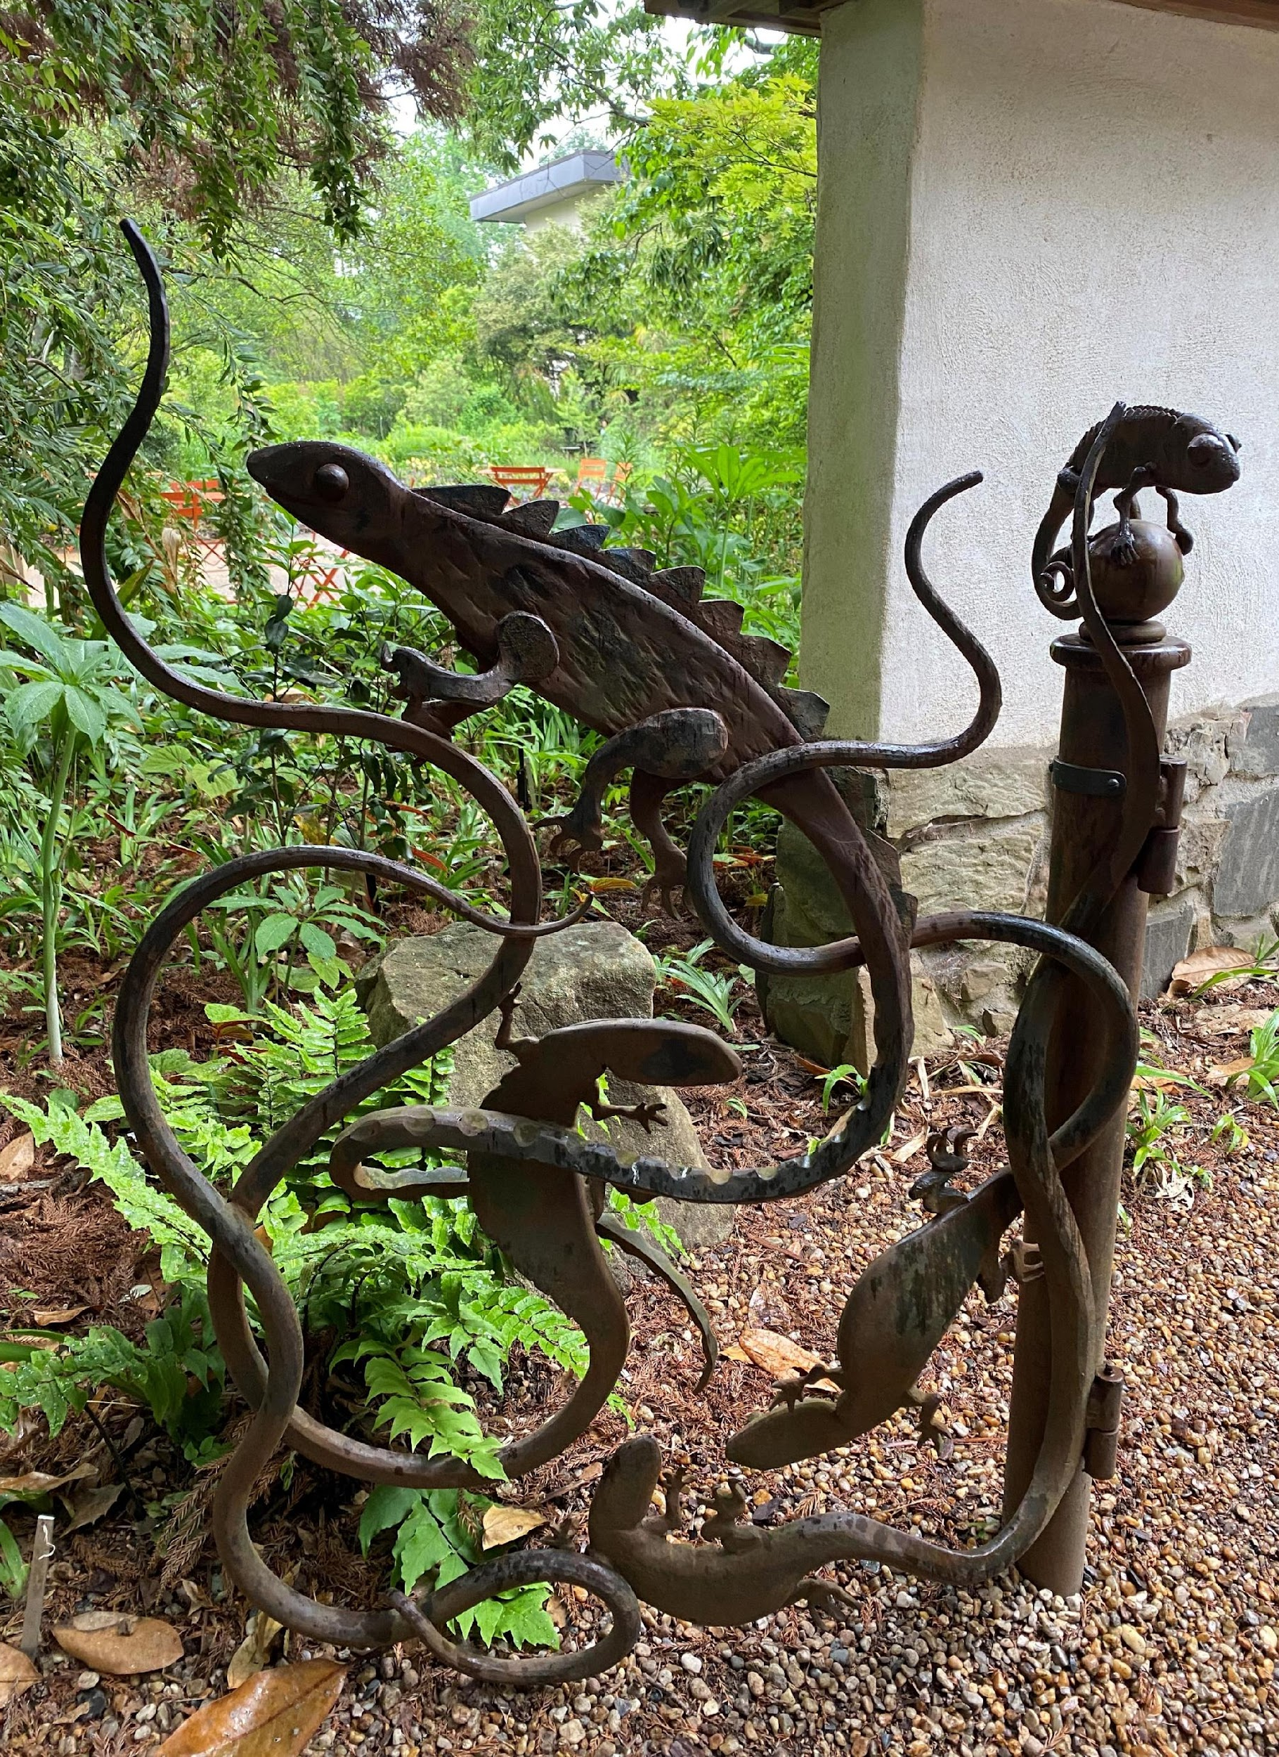
Lizard Paradise
Photo by Barbara Geier
Atlanta Botanical Gardens
This gorgeous iron sculpture seemed to draw one’s eye to the lovely landscape in the background. I thought it was brilliant placement by whoever designed this area of the Atlanta Botanical Gardens.
Taken with iPhone.

Slide 6
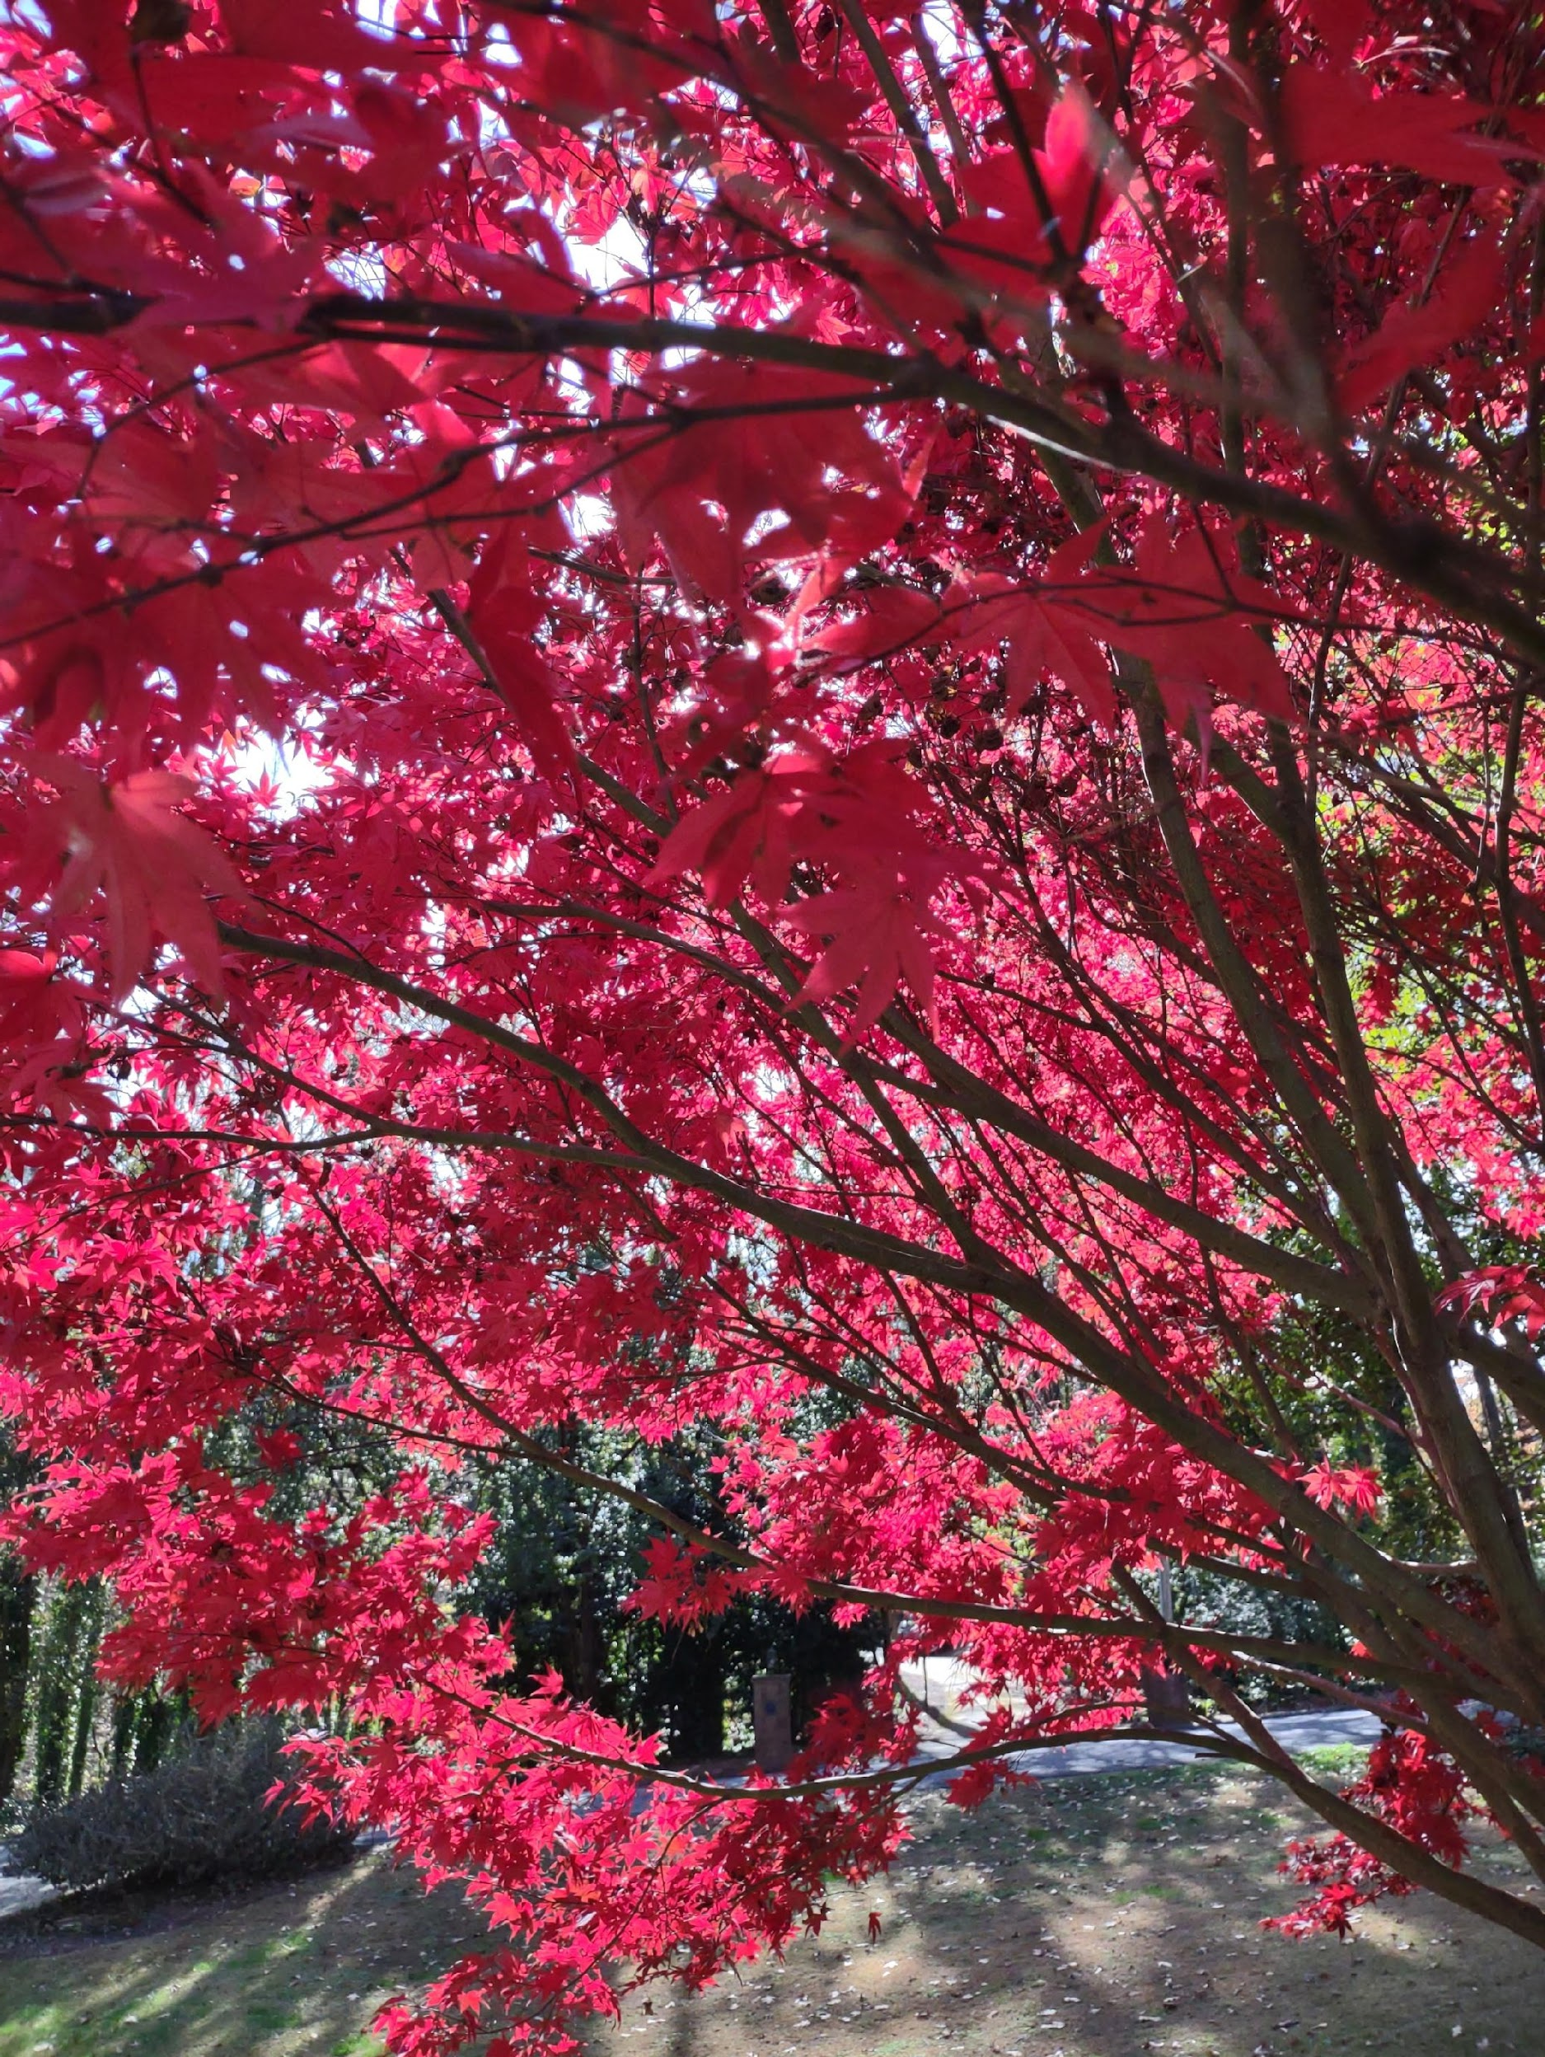
Maple in Fall
Photo by Diane Krish
My front yard
Sun light through Maple leaves in Fall.
Taken with Motorola one 5G.

Slide 7
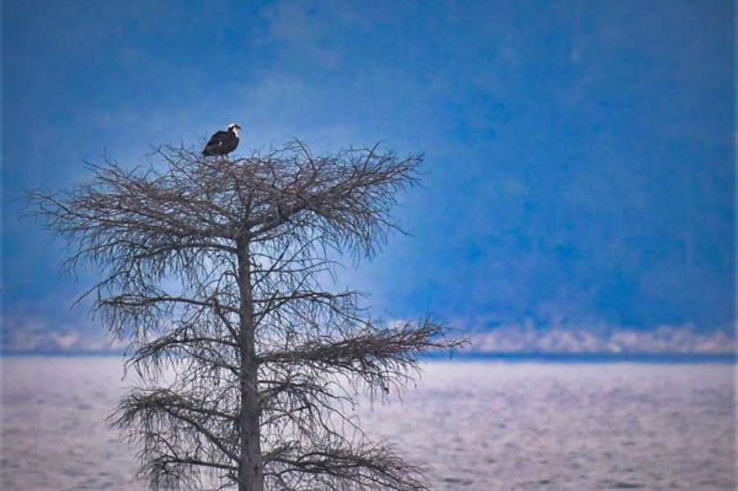
Master of My Domain
Photo by Ronald Kersey
West Point Lake, GA
This Osprey just wanted to pose for me and followed me around the lake. I liked this landscape (lakescape?) with him.
Taken with Nikon D500.

Slide 8
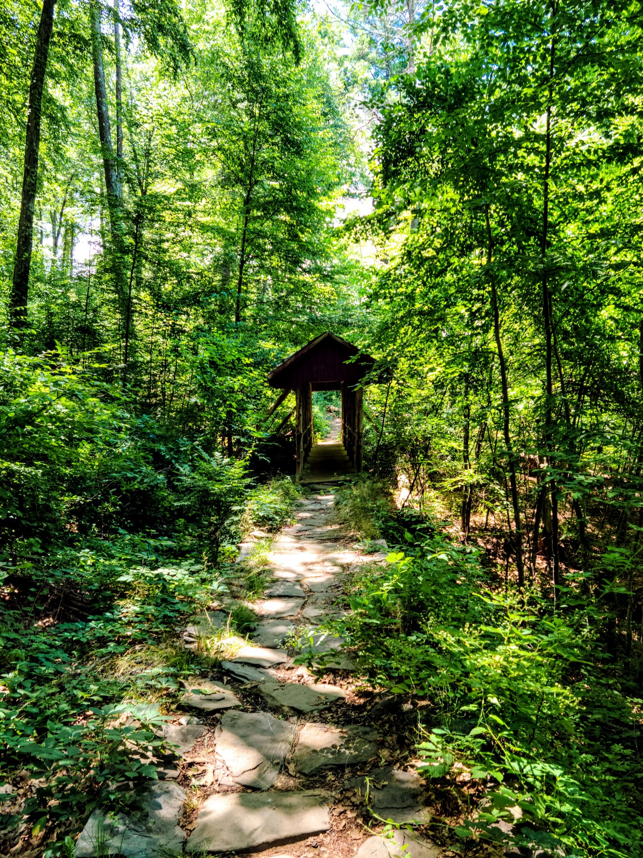
Hidden Treasure
Along the Trail
Photo by Marilyn Whitmer
Gillette Castle State Park, East Haddam, Connecticut
This photo is of one of the many trails on the 184-acre Gillette Castle State Park in East Haddam, Connecticut showing many of the hidden treasures along the trails.

Slide 9
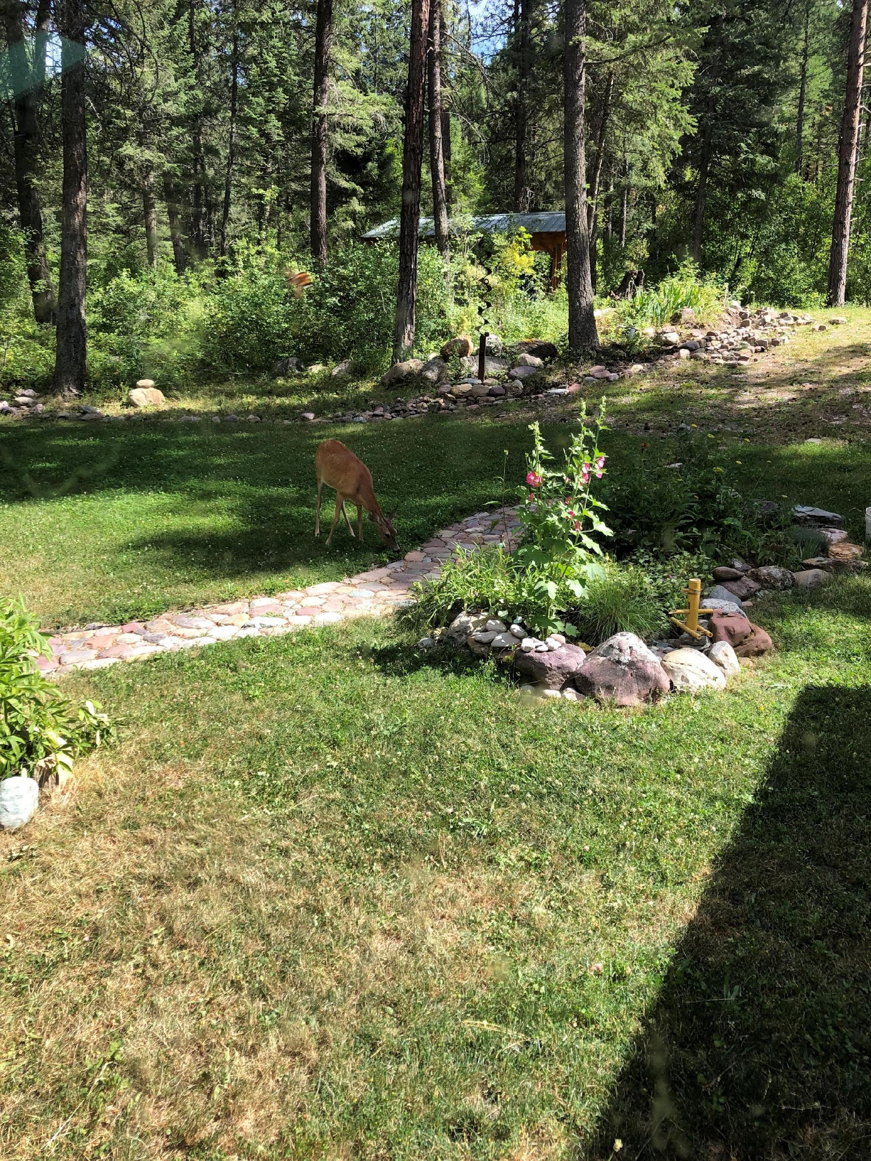
Rock Gardening for Wildlife
Photo by Martha Whitman
Arlee, MT
We used rocks the excavator dug up on our land in creating a walkway and a garden to hide the septic tank.
Taken with iPhone.

Slide 10

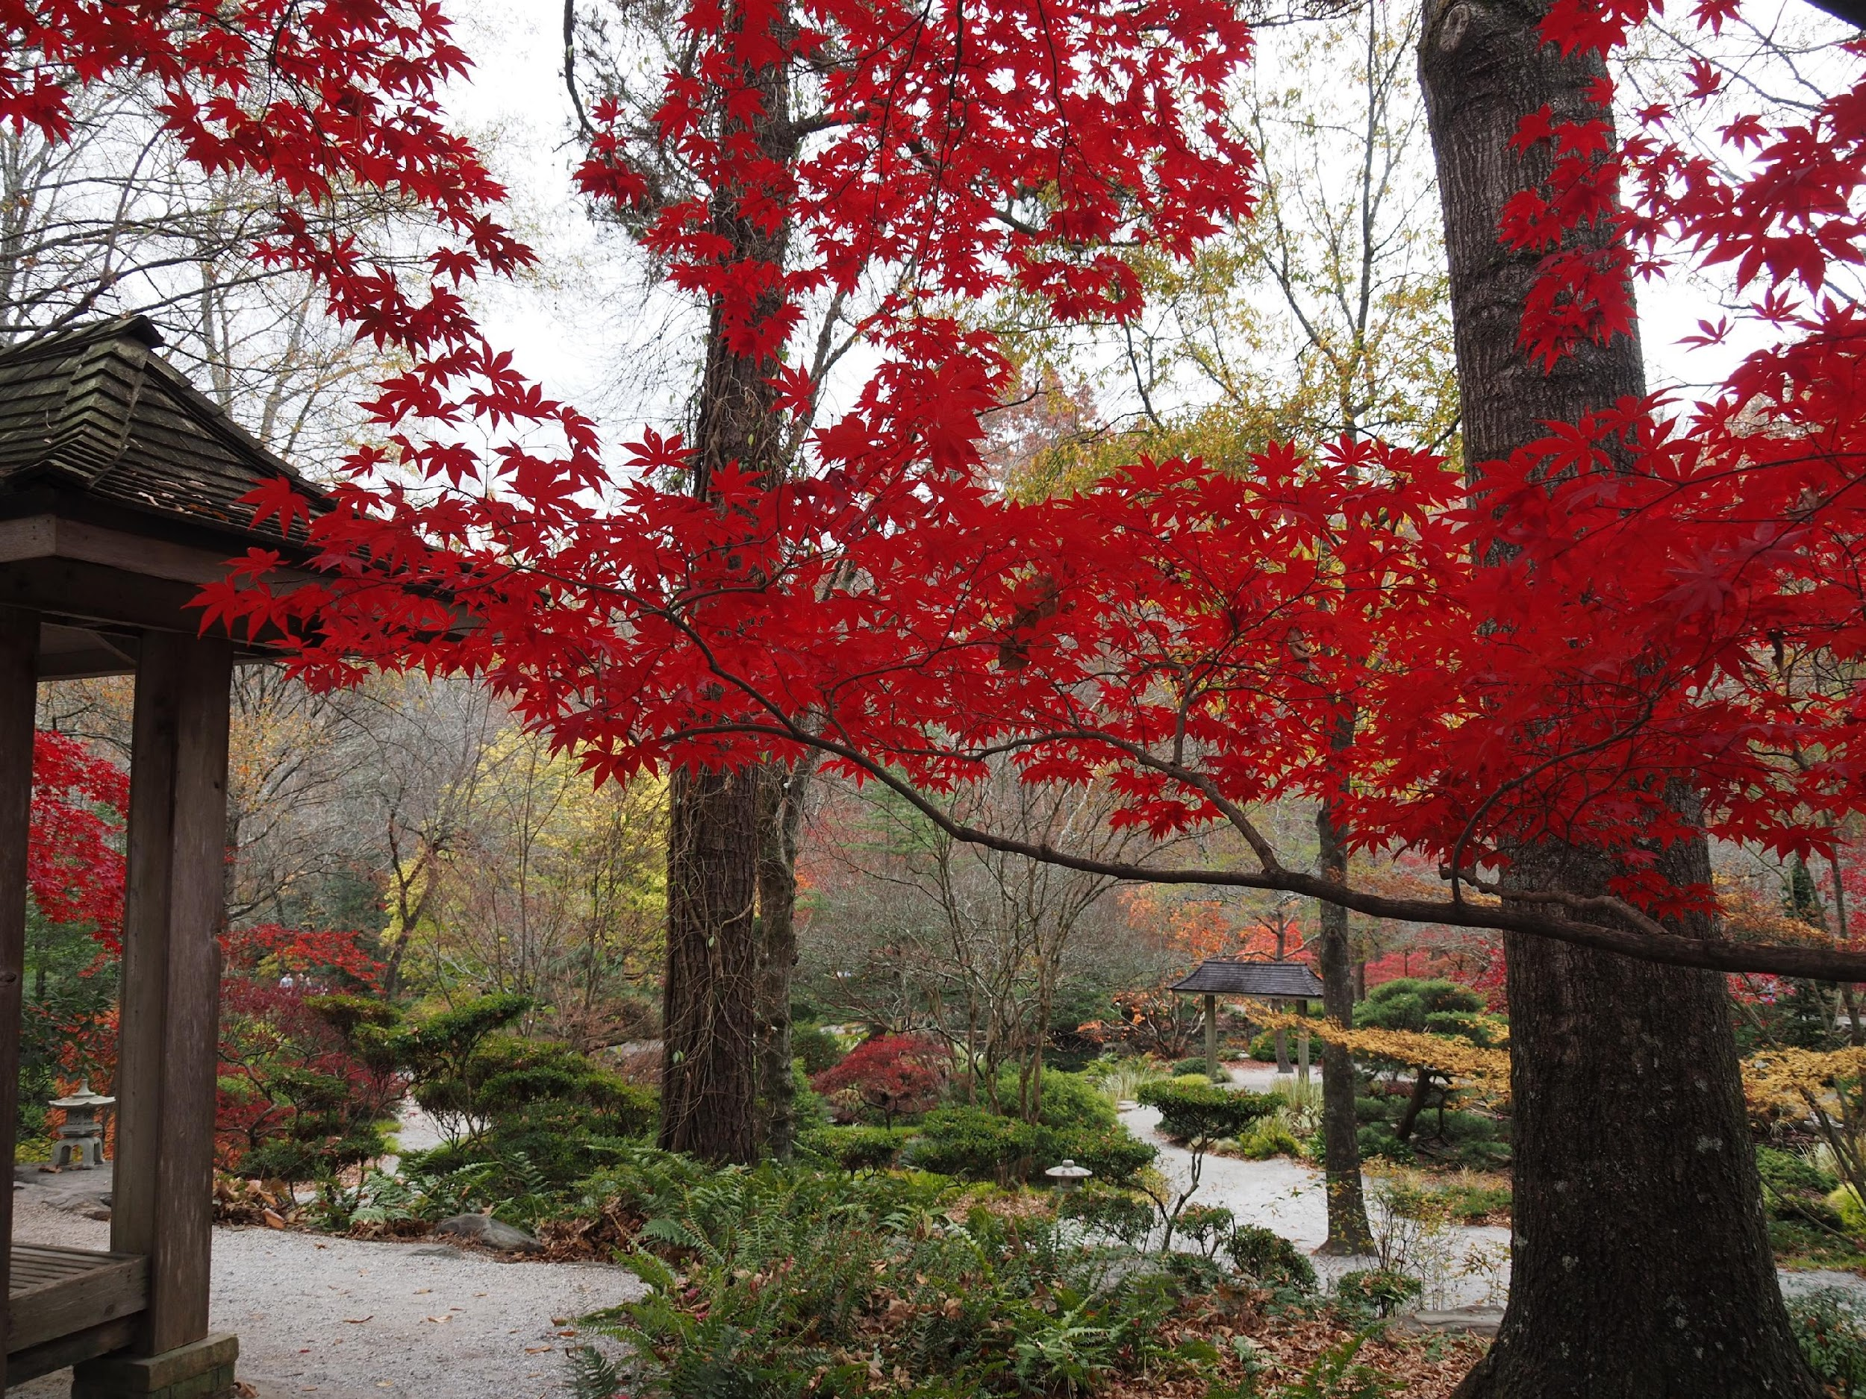
Colors of Fall at Gibbs
Photo by
Becky Panetta
Gibbs Gardens
Japanese maple in full
fall color in the Japanese
Garden
Taken with Olympus OM-D EM5III

Slide 11

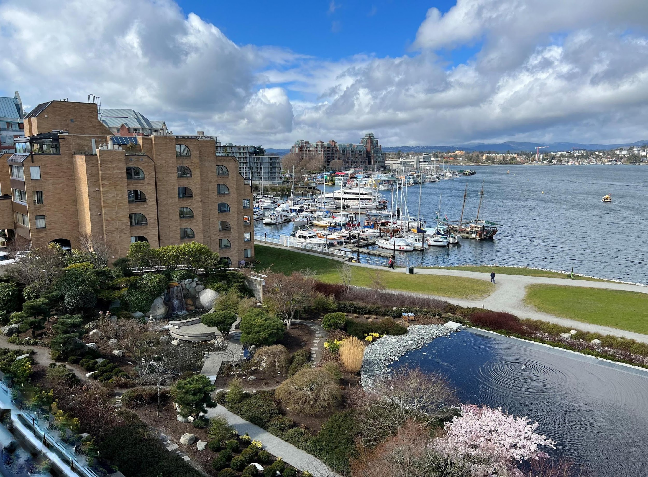
Garden View
Photo by
Lynda Pollock
Victoria,
British Columbia, Canada
The view from our balcony at the Inn at Ivy Point in Victoria. The Japanese Garden extended the theme of the hotel and the view of the waterfront and clouds was a perfect start and end to our day.

Slide 12
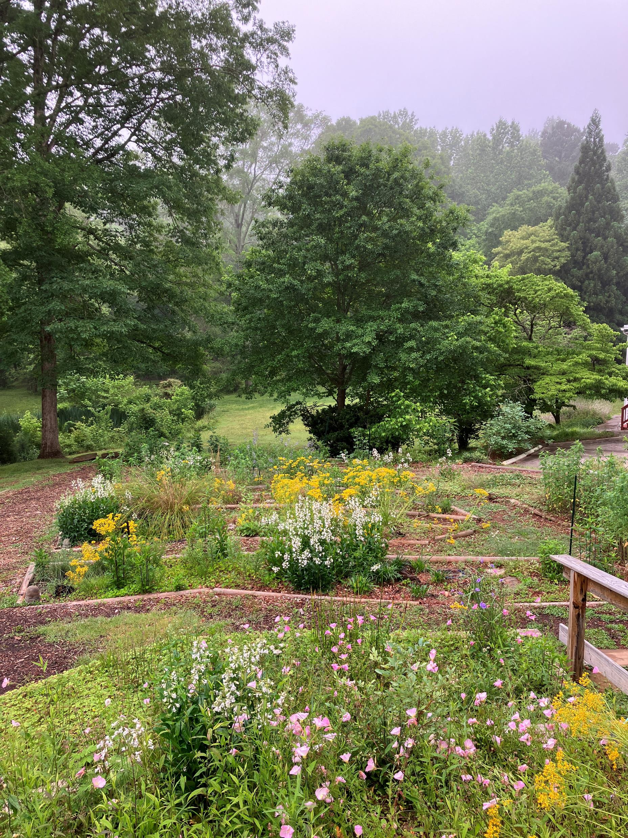

May Morning
Photo by Margaret Molyson
Margaret’s Side Yard
View across my wildflower garden
Taken with iPhone.

Slide 13

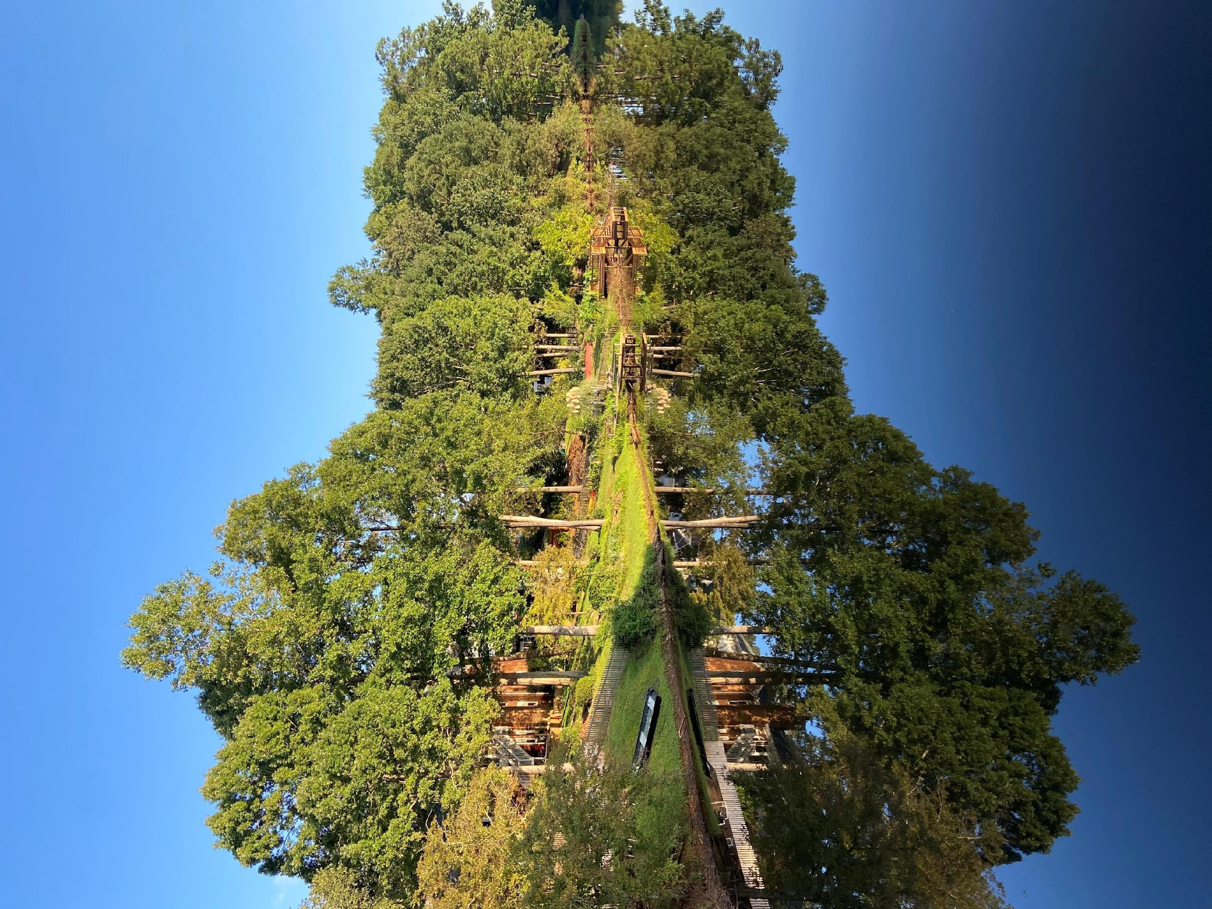
September Morning
Photo by Karen McGinty
My neighborhood
View of the neighborhood lake with reflection
Taken with iPhone.

Slide 14
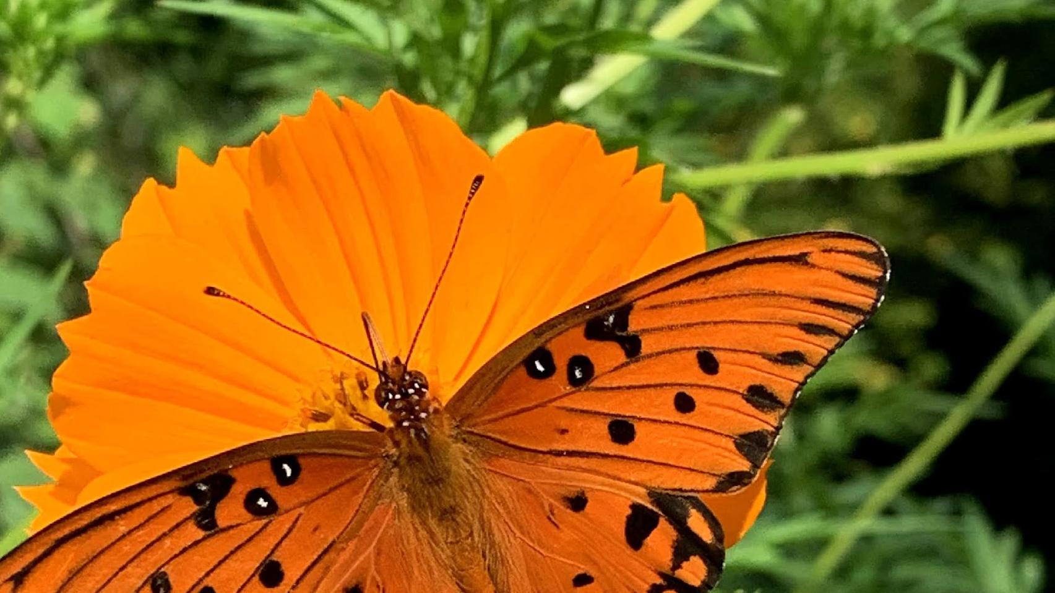
Wildlife
Wildlife at feeders, in garden or in natural settings
We had more entries in this category than last year (17 versus 14)

Slide 15
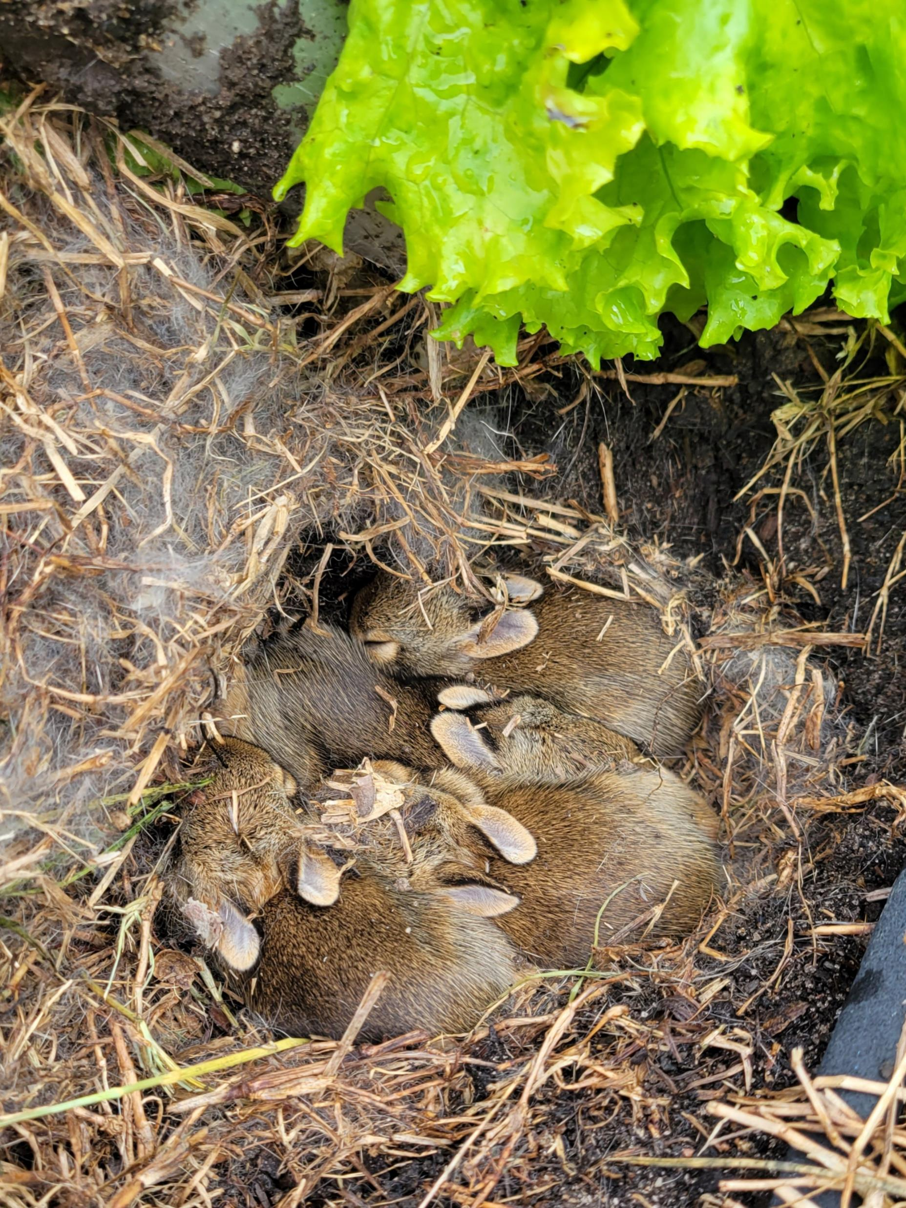
Look what we’re growing!
Photo by Peggy Moss
Location: S.E. Gwinnett Co-op garden
Baby bunnies in our lettuce bed

Slide 16
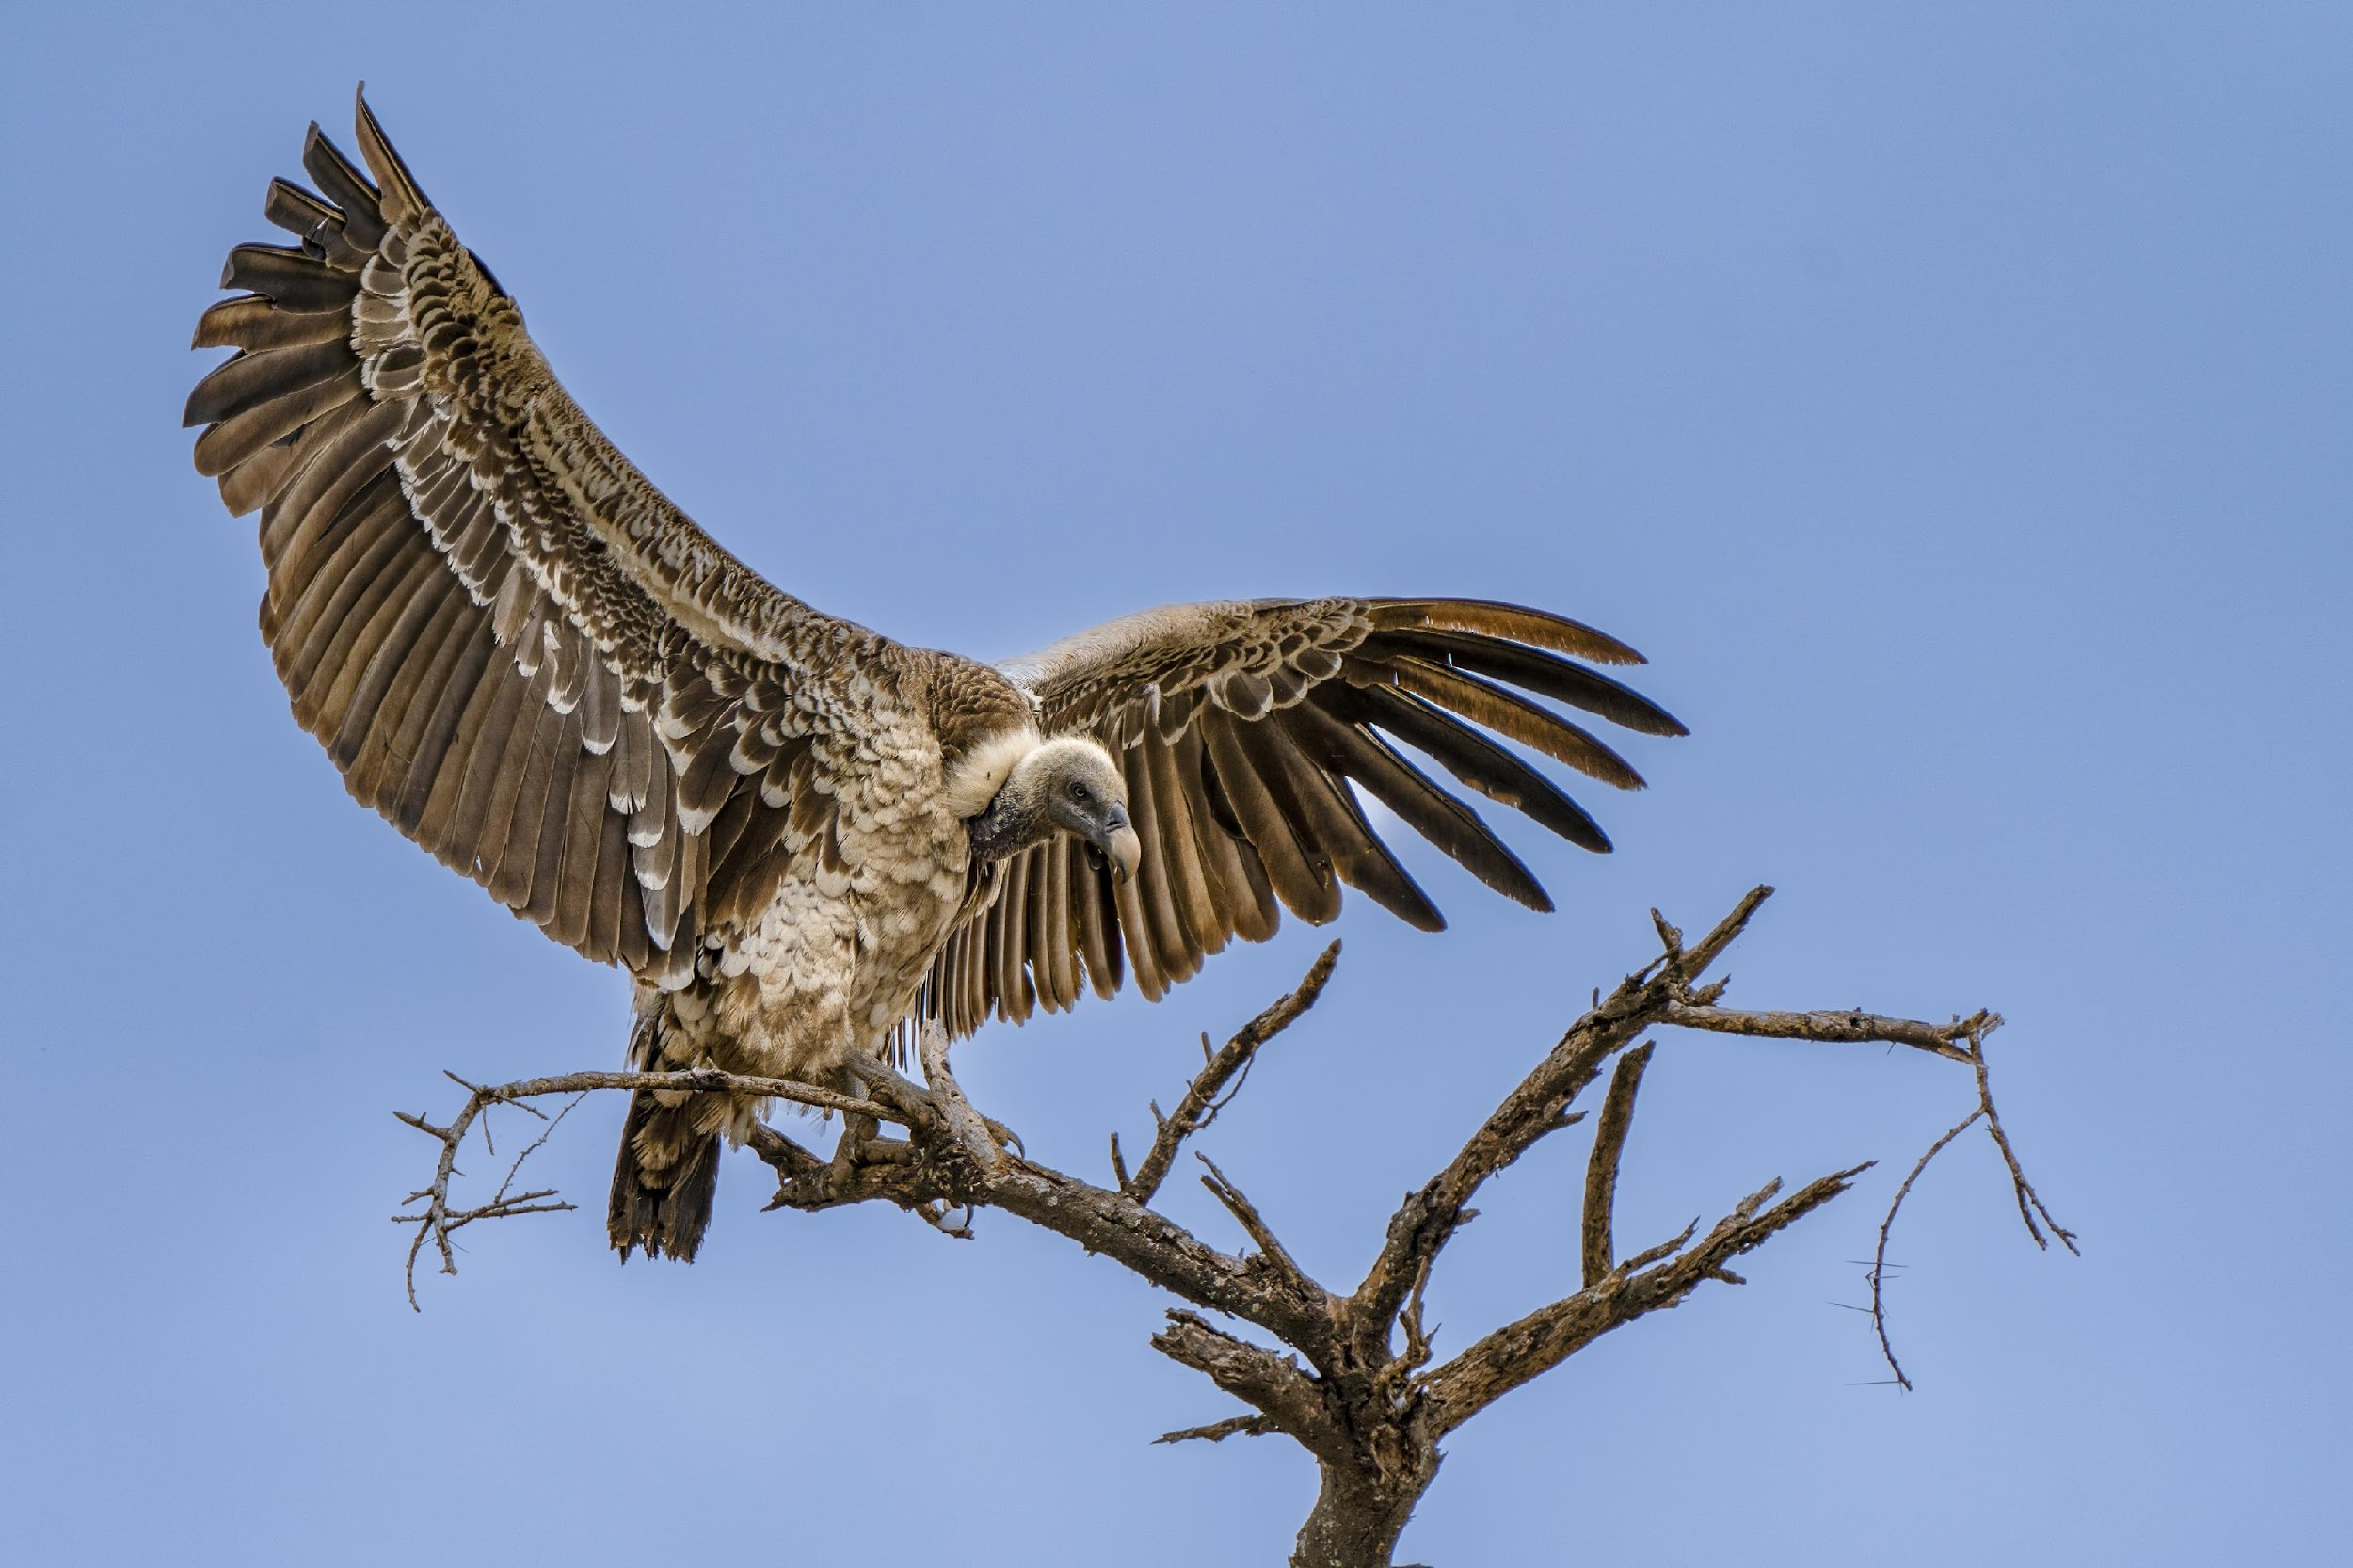
Touchdown!
Photo by Ivan Varlamoff
Tarangire National Park, Tanzania
Rüppell's vulture landing on a tree — I loved the ominous look
Taken w/ Sony Alpha 7 III (FL 600 mm)

Slide 17
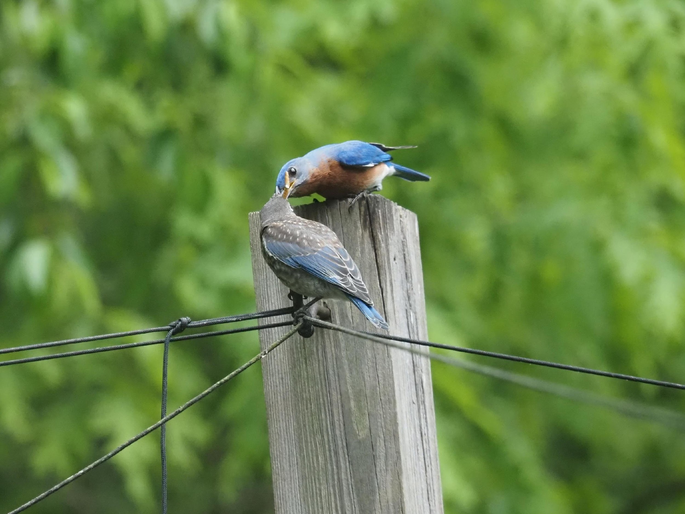
He’s Such a Good Daddy!
Photo by Becky Panetta
Location: Becky’s yard
Eastern bluebird male feeding fledgling
Taken with Olympus OM-D EM5III

Slide 18
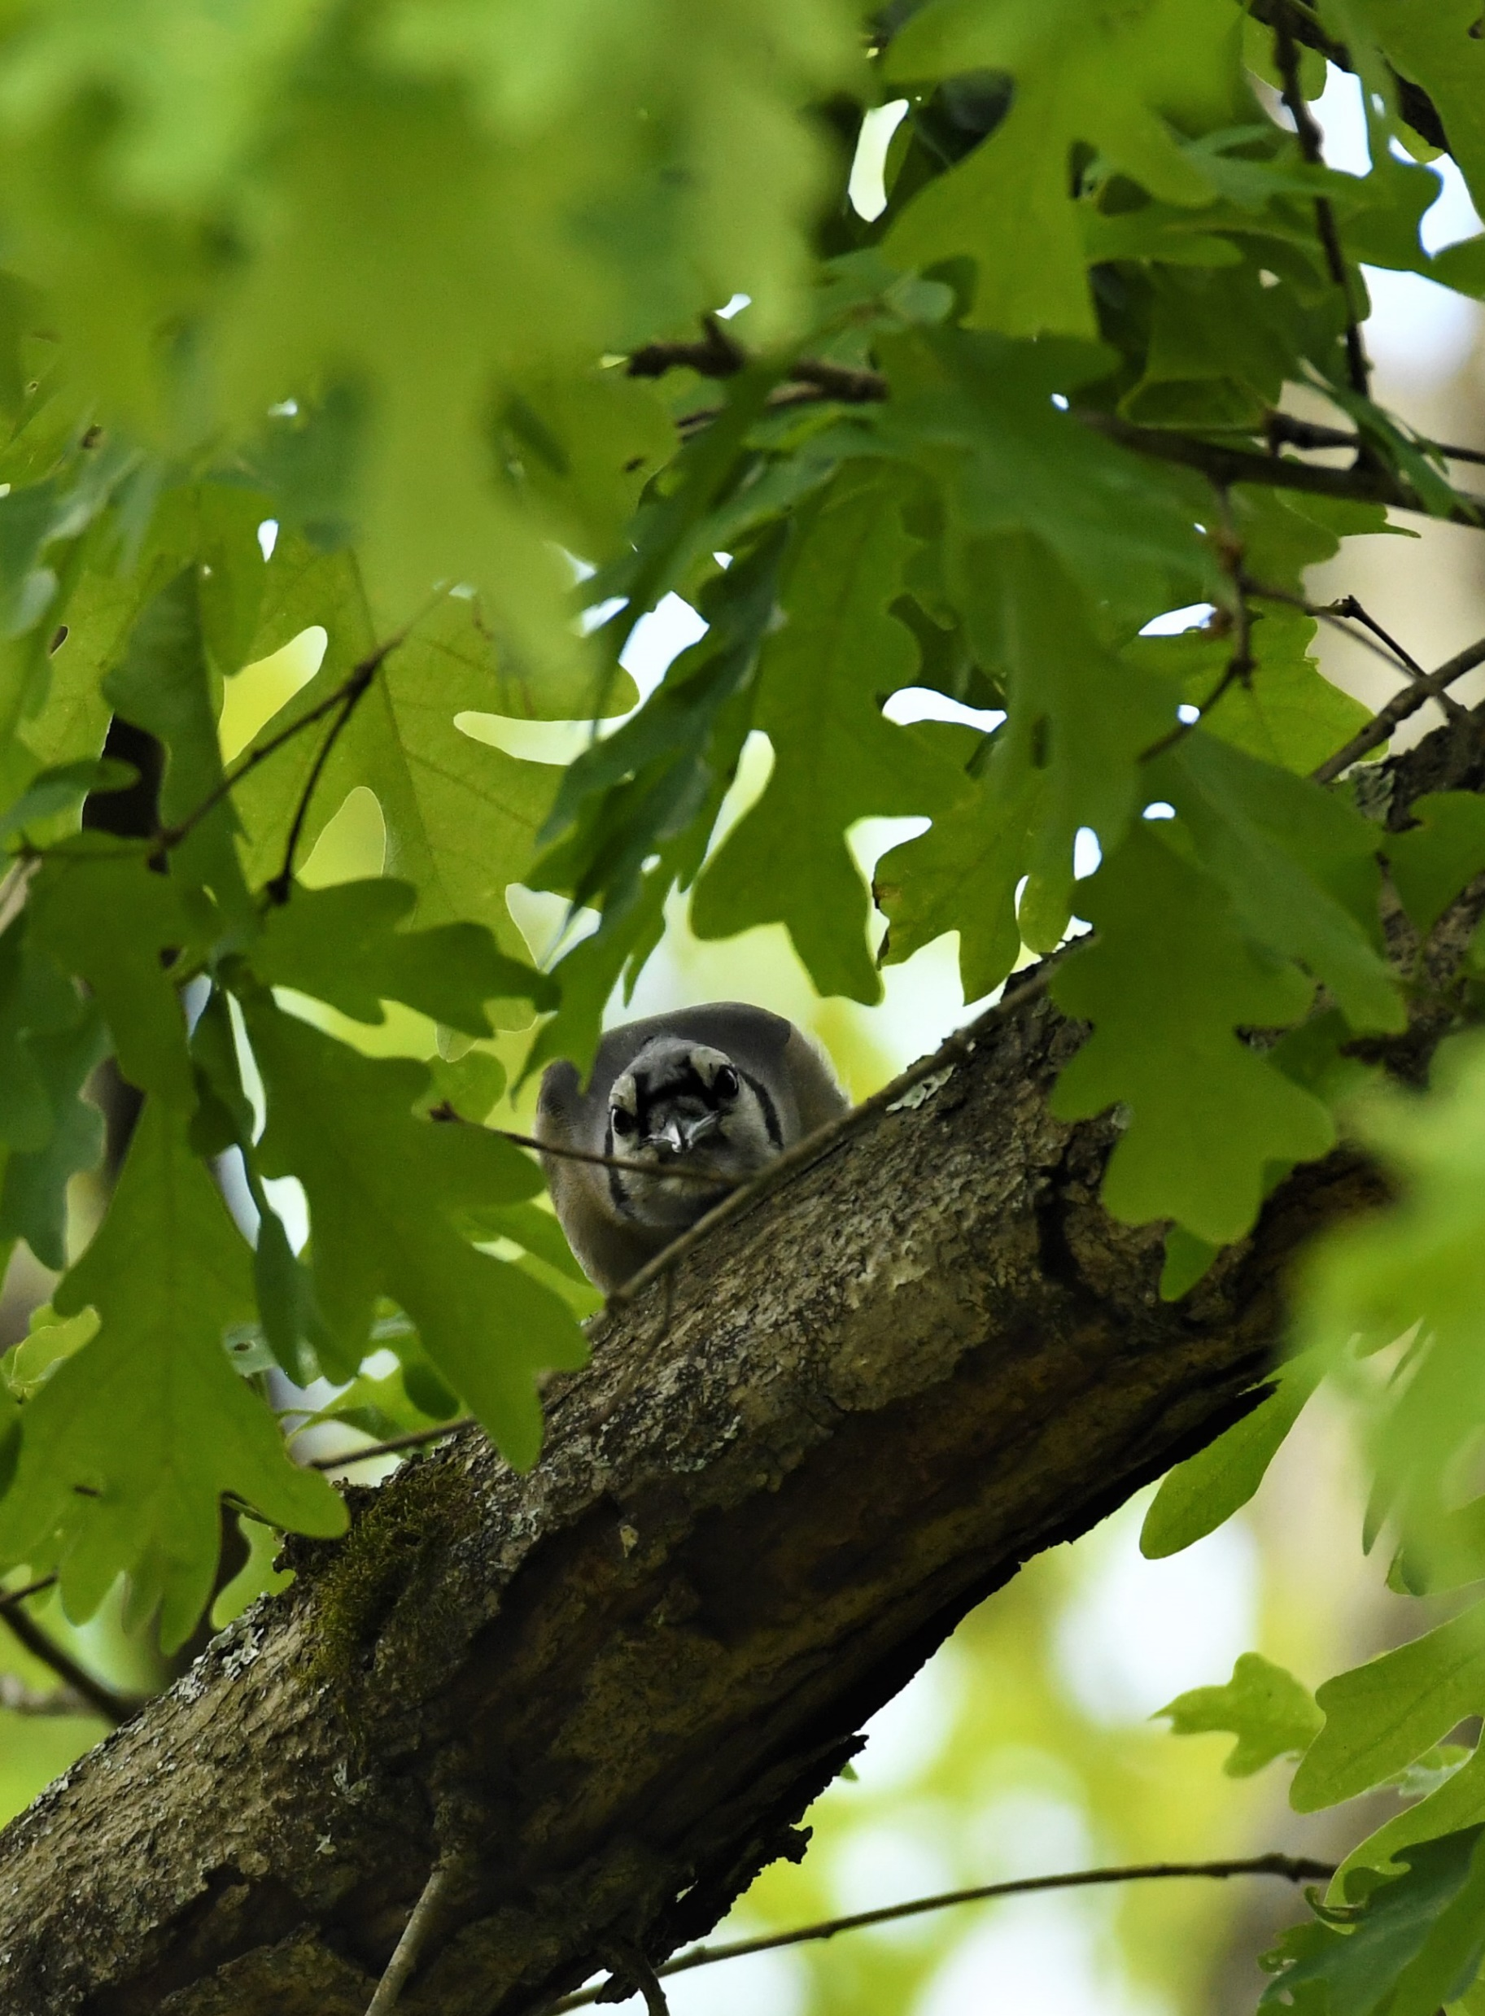
Working Hard
Photo by Ronald Kersey
Location: My Front Yard
I saw the Blue Jay peeking at me apparently trying to figure out what I was doing.
Camera: Nikon D500

Slide 19
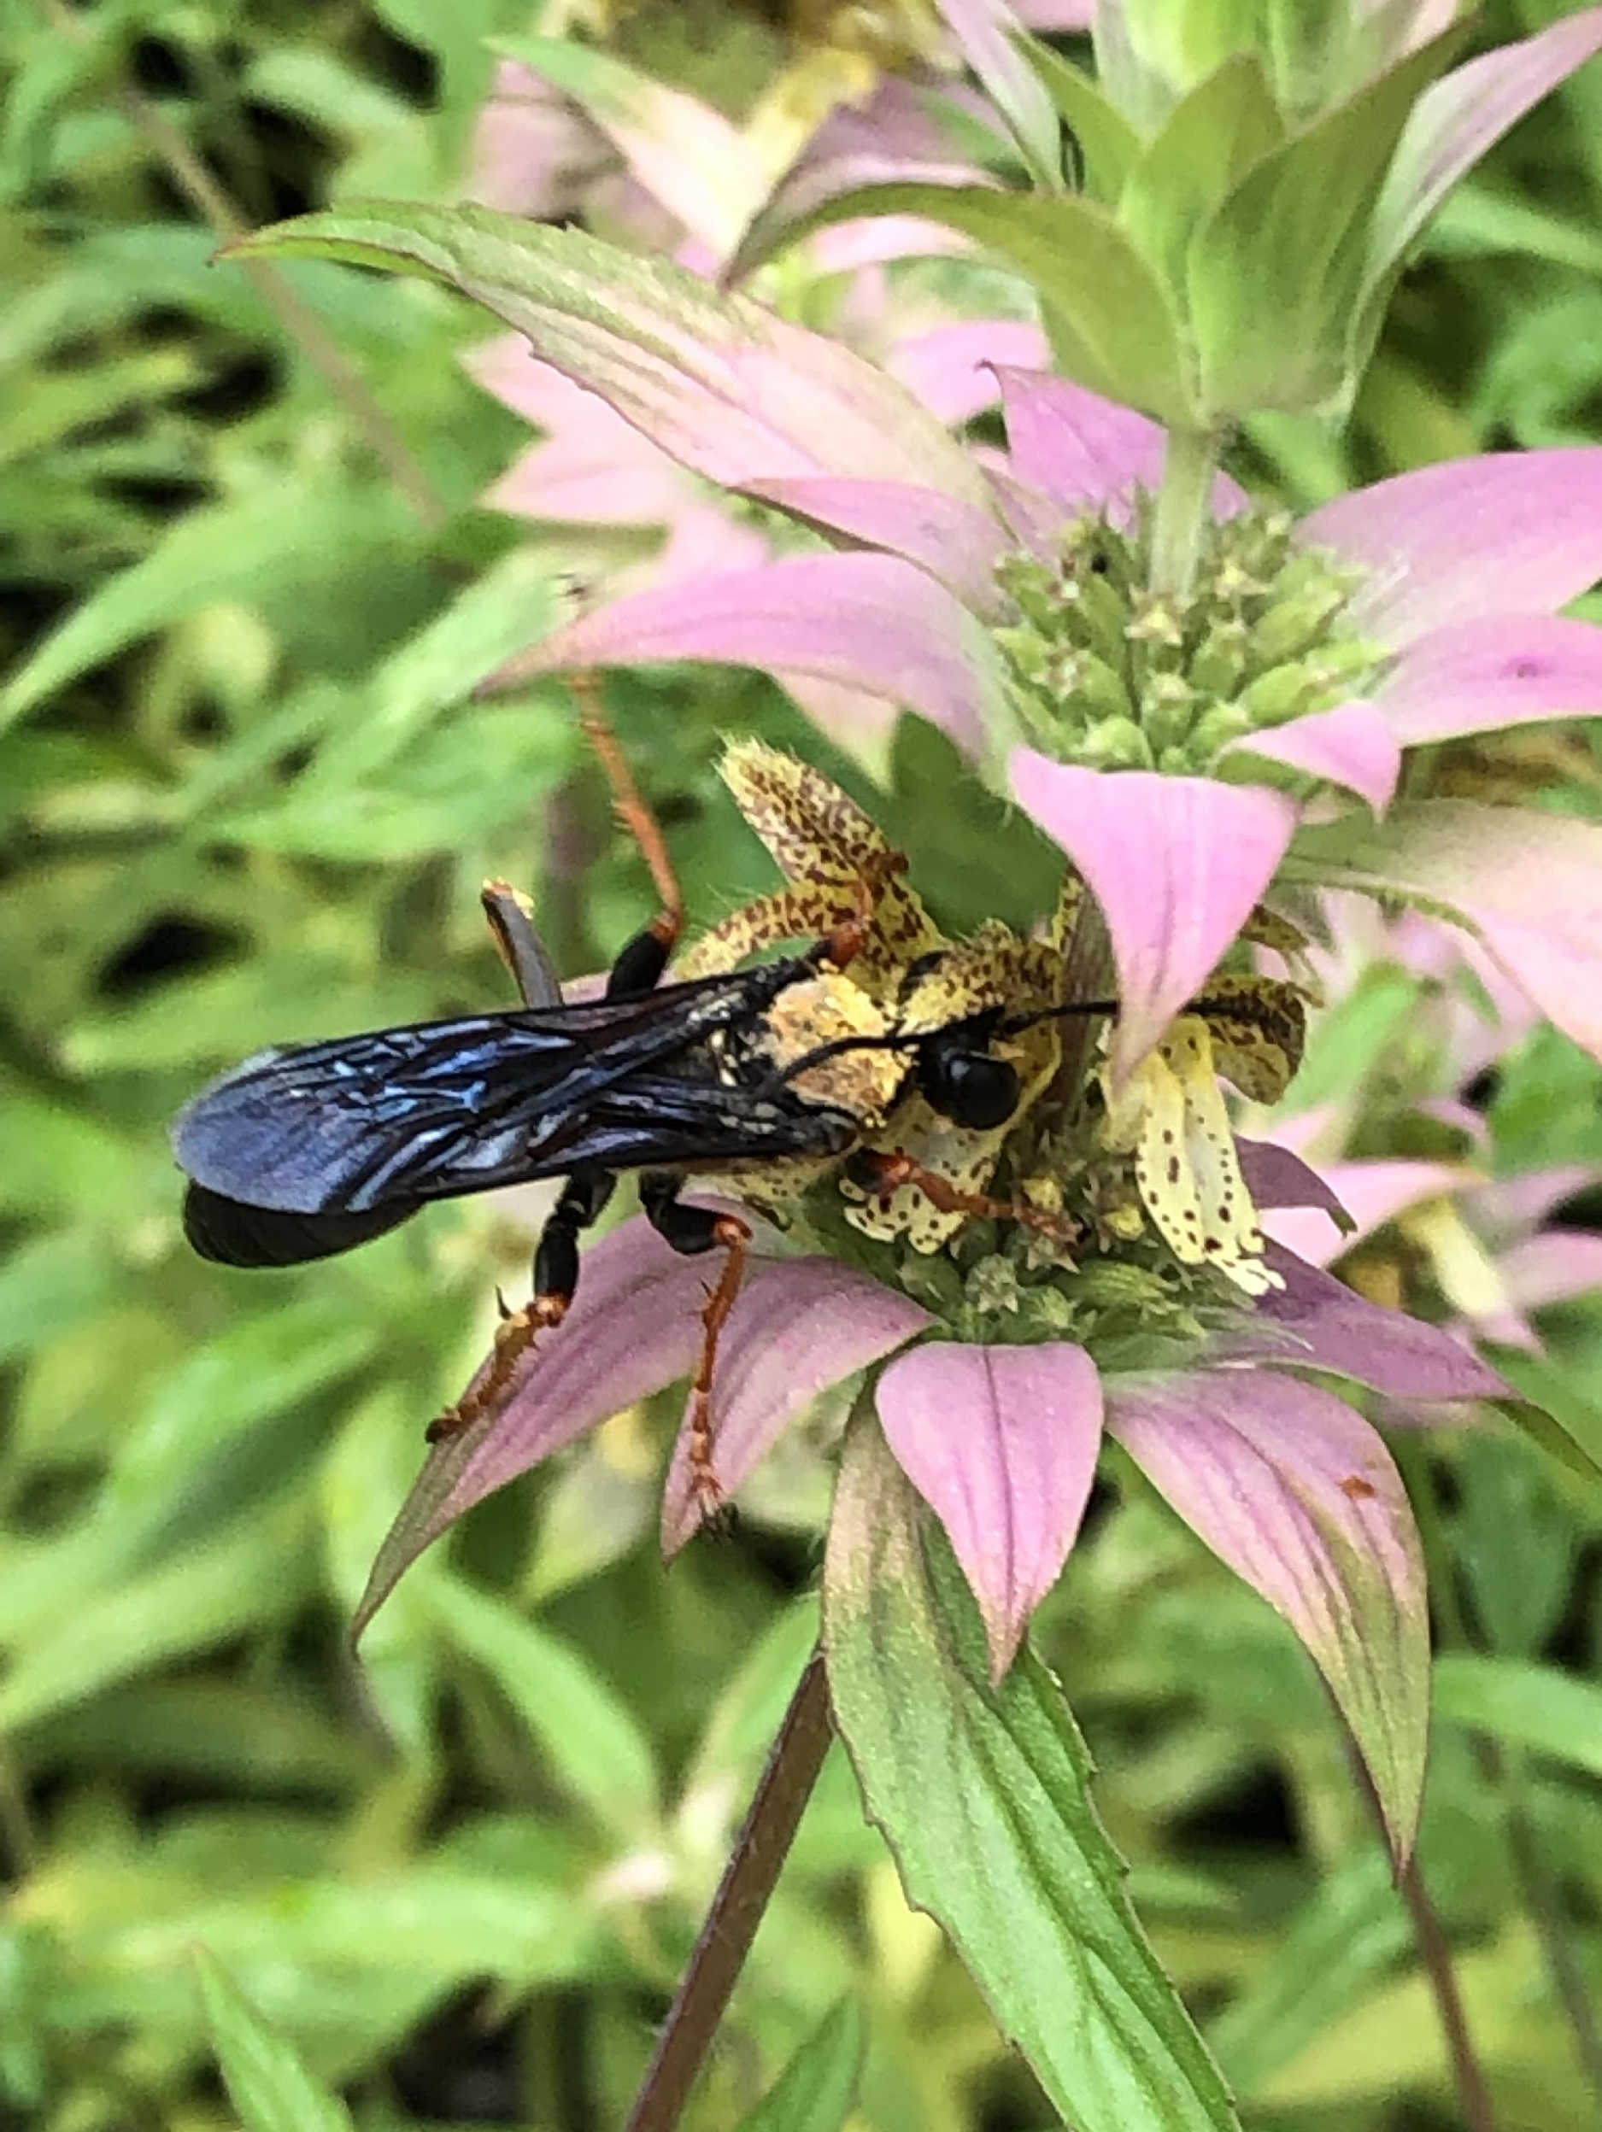
Waspering Sweet Nothings
Photo by Lynda Pollock
Location: My Garden
Blue Winged solitary wasp collecting pollen and necter on spotted beebalm. She looked like she was telling tales to the "ears" of the flower.
Taken with mobile phone camera

Slide 20
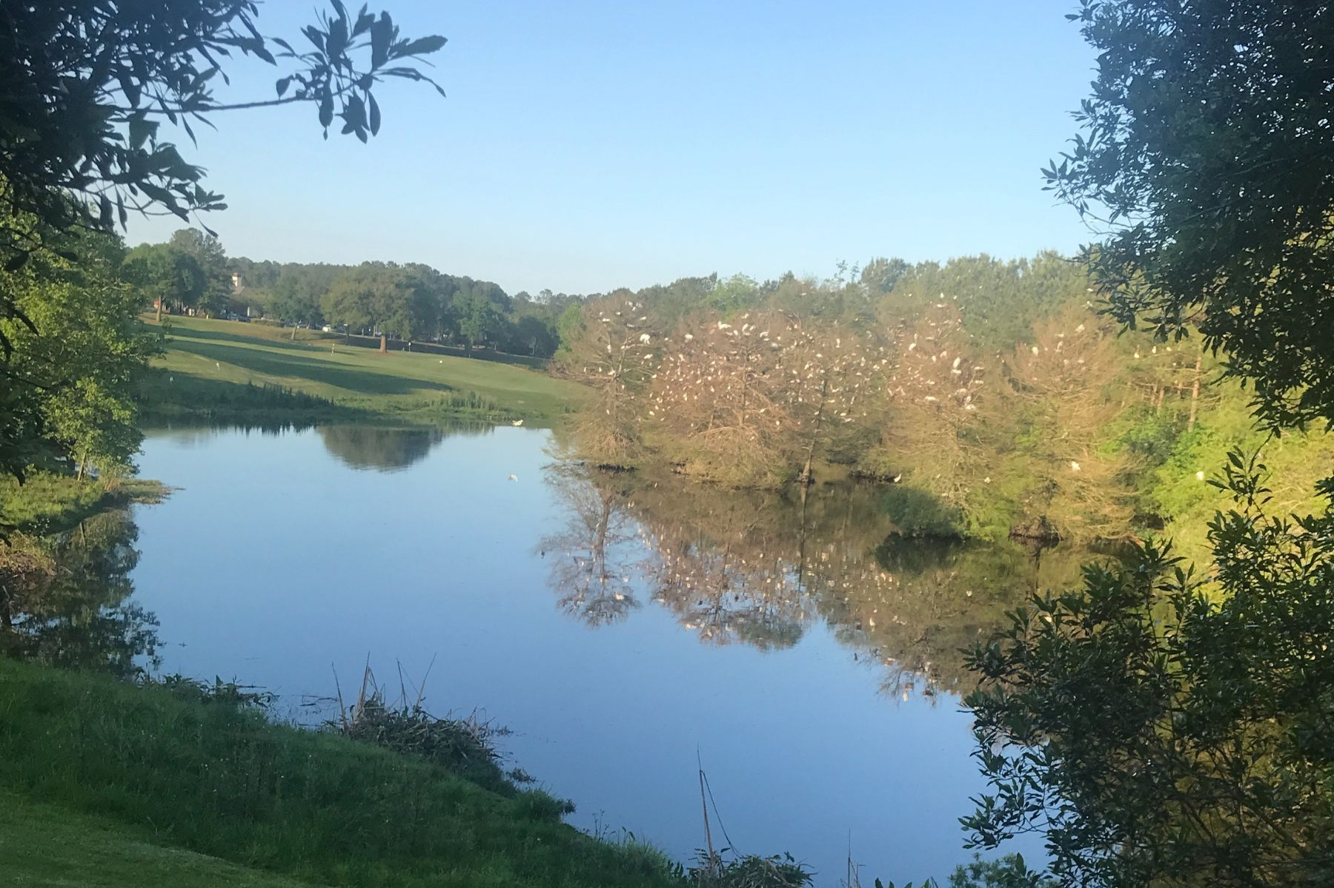
Heavenly Reflection
Photo by Dorothy Harwell
Location: Bluffton, SC
In the Del Webb Community
Taken iPhone 7

Slide 21
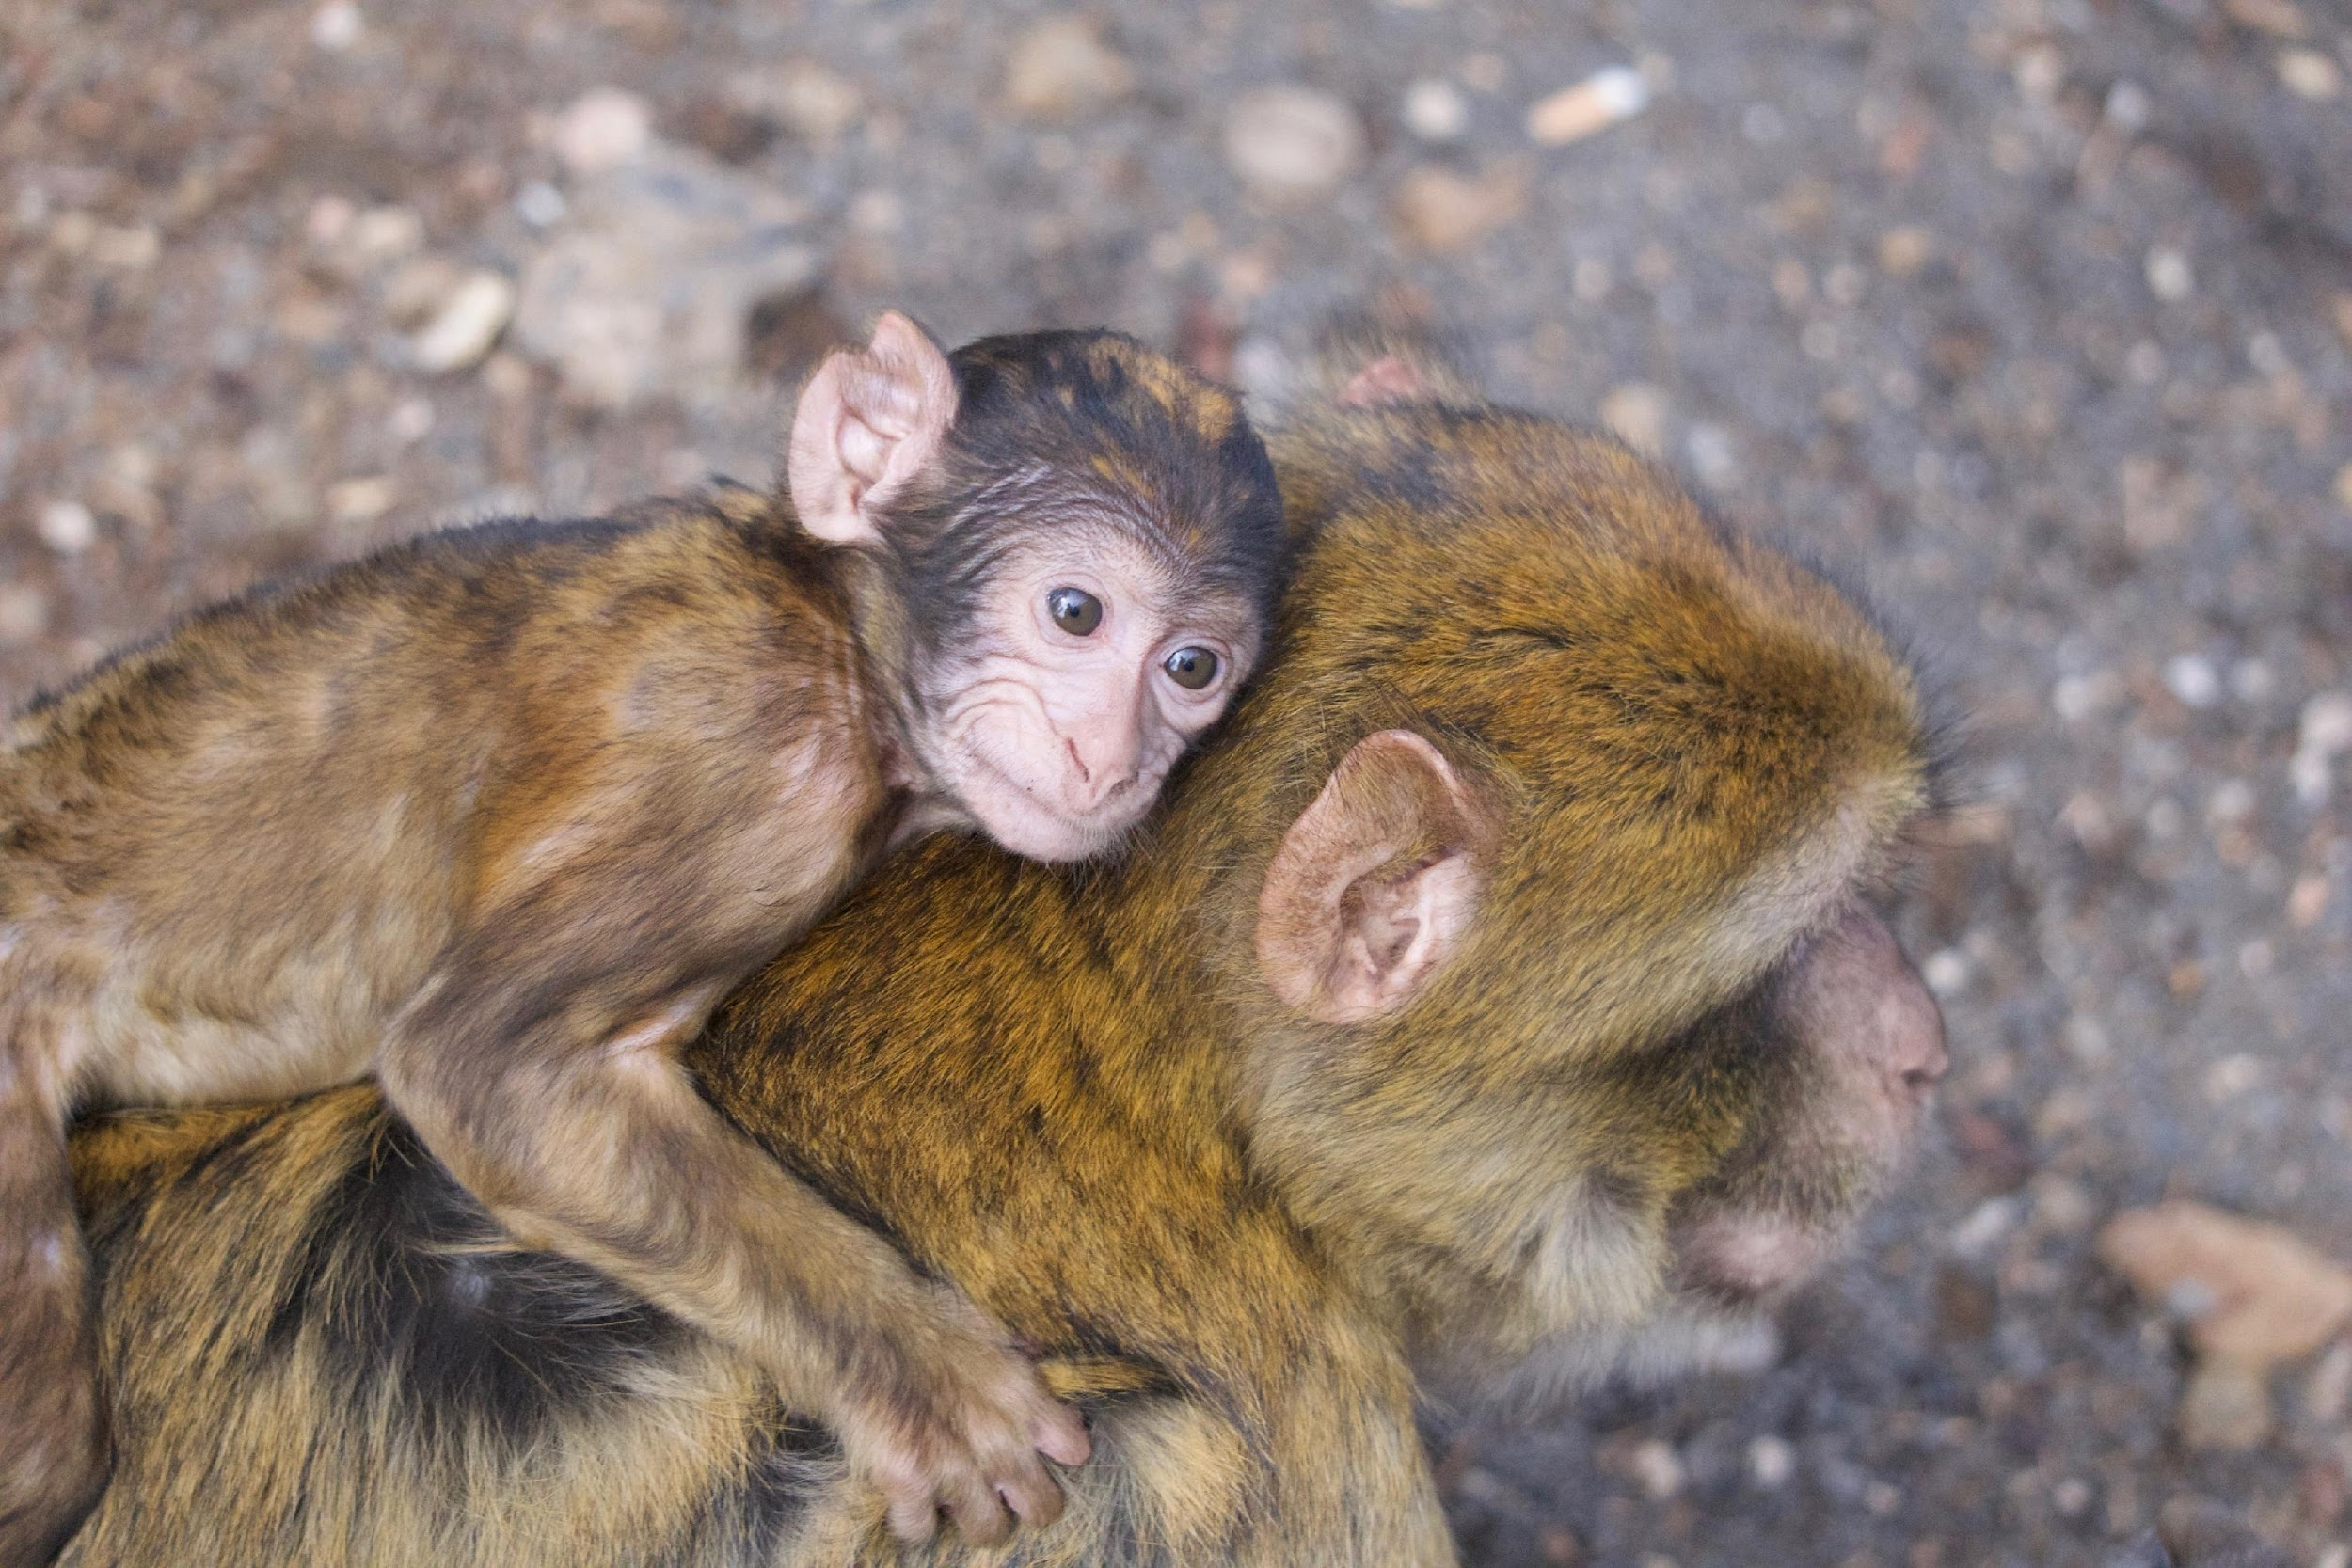
Fellow Travelers in Morocco
Photo by Martha Whitman
Location: Ilfrane National Park, Morocco
A family of Barbary macaques was near the road as we traveled south through Morocco. Later this mother stopped and groomed an adult male while the baby used them as a climbing gym.
Taken with Sony Alpha 5100

Slide 22
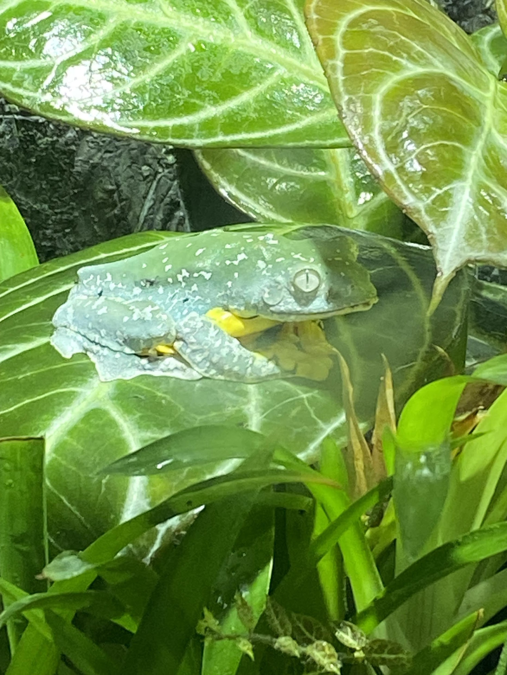
Frog’s Eye
Photo by Barbara Geier
Location: Atlanta Botanical Gardens
This little poisonous frog was sitting so still, and his gorgeous and unusual eye seemed to draw me in. His bright yellow belly was also so striking.
Taken with iPhone

Slide 23
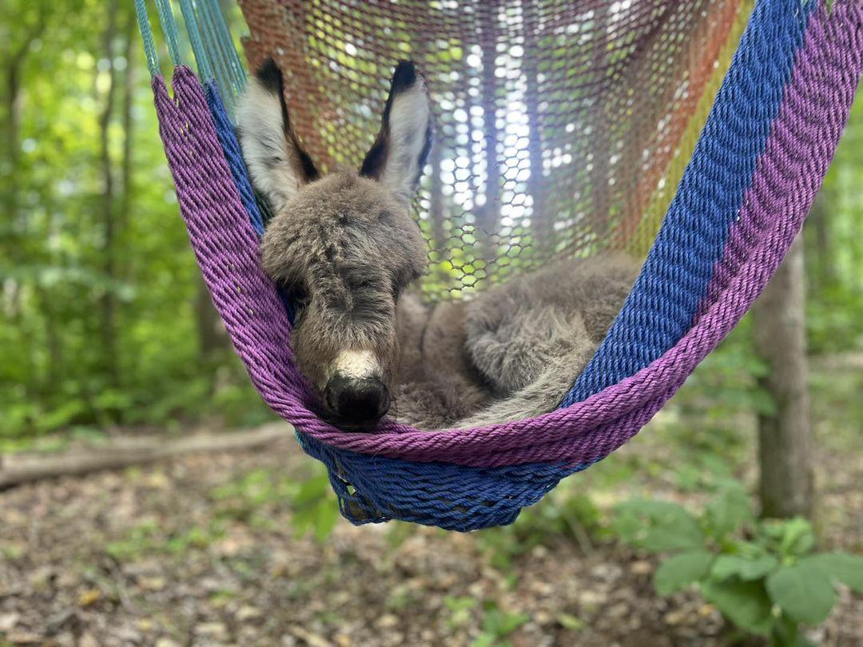
Watching the Garden, the Lazy Way
Photo by Sharon Cassidy
Location: Backyard hammock in Bethlehem, Ga
Orphan baby donkey that was rejected by his mom. He was placed in the hammock and loved to rock and swing back and forth.

Slide 24
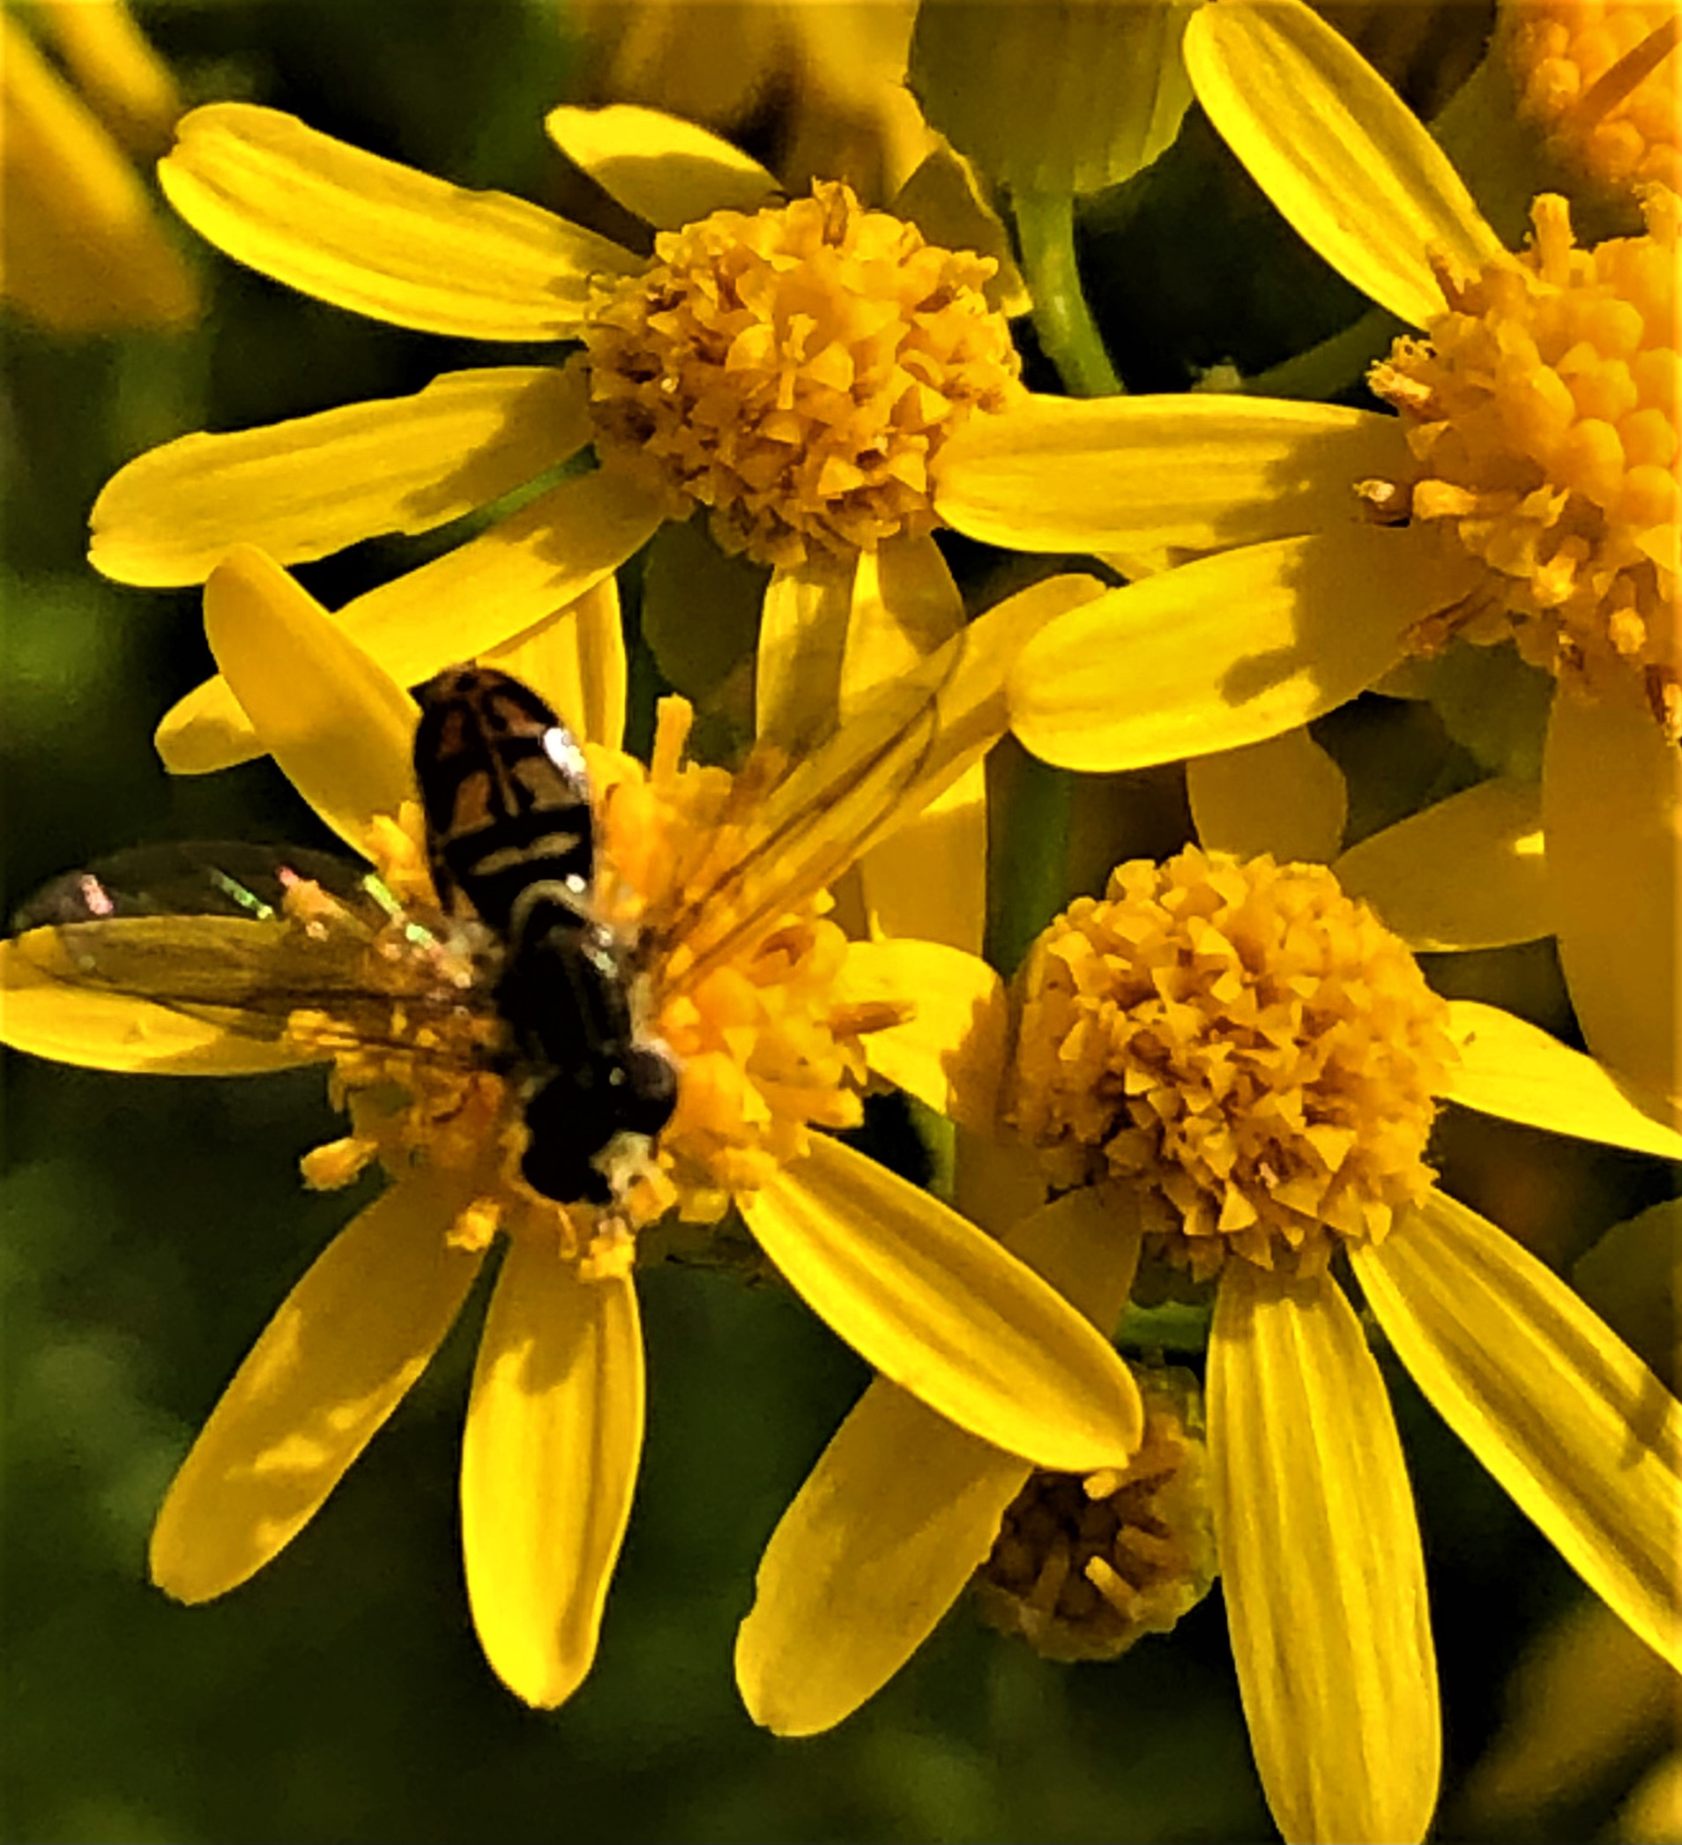
Hover Pad
Photo by Kate K. Foxwell
Location: Snellville, GA
Hoverfly on Ragwort
Taken with iPhone

Slide 25
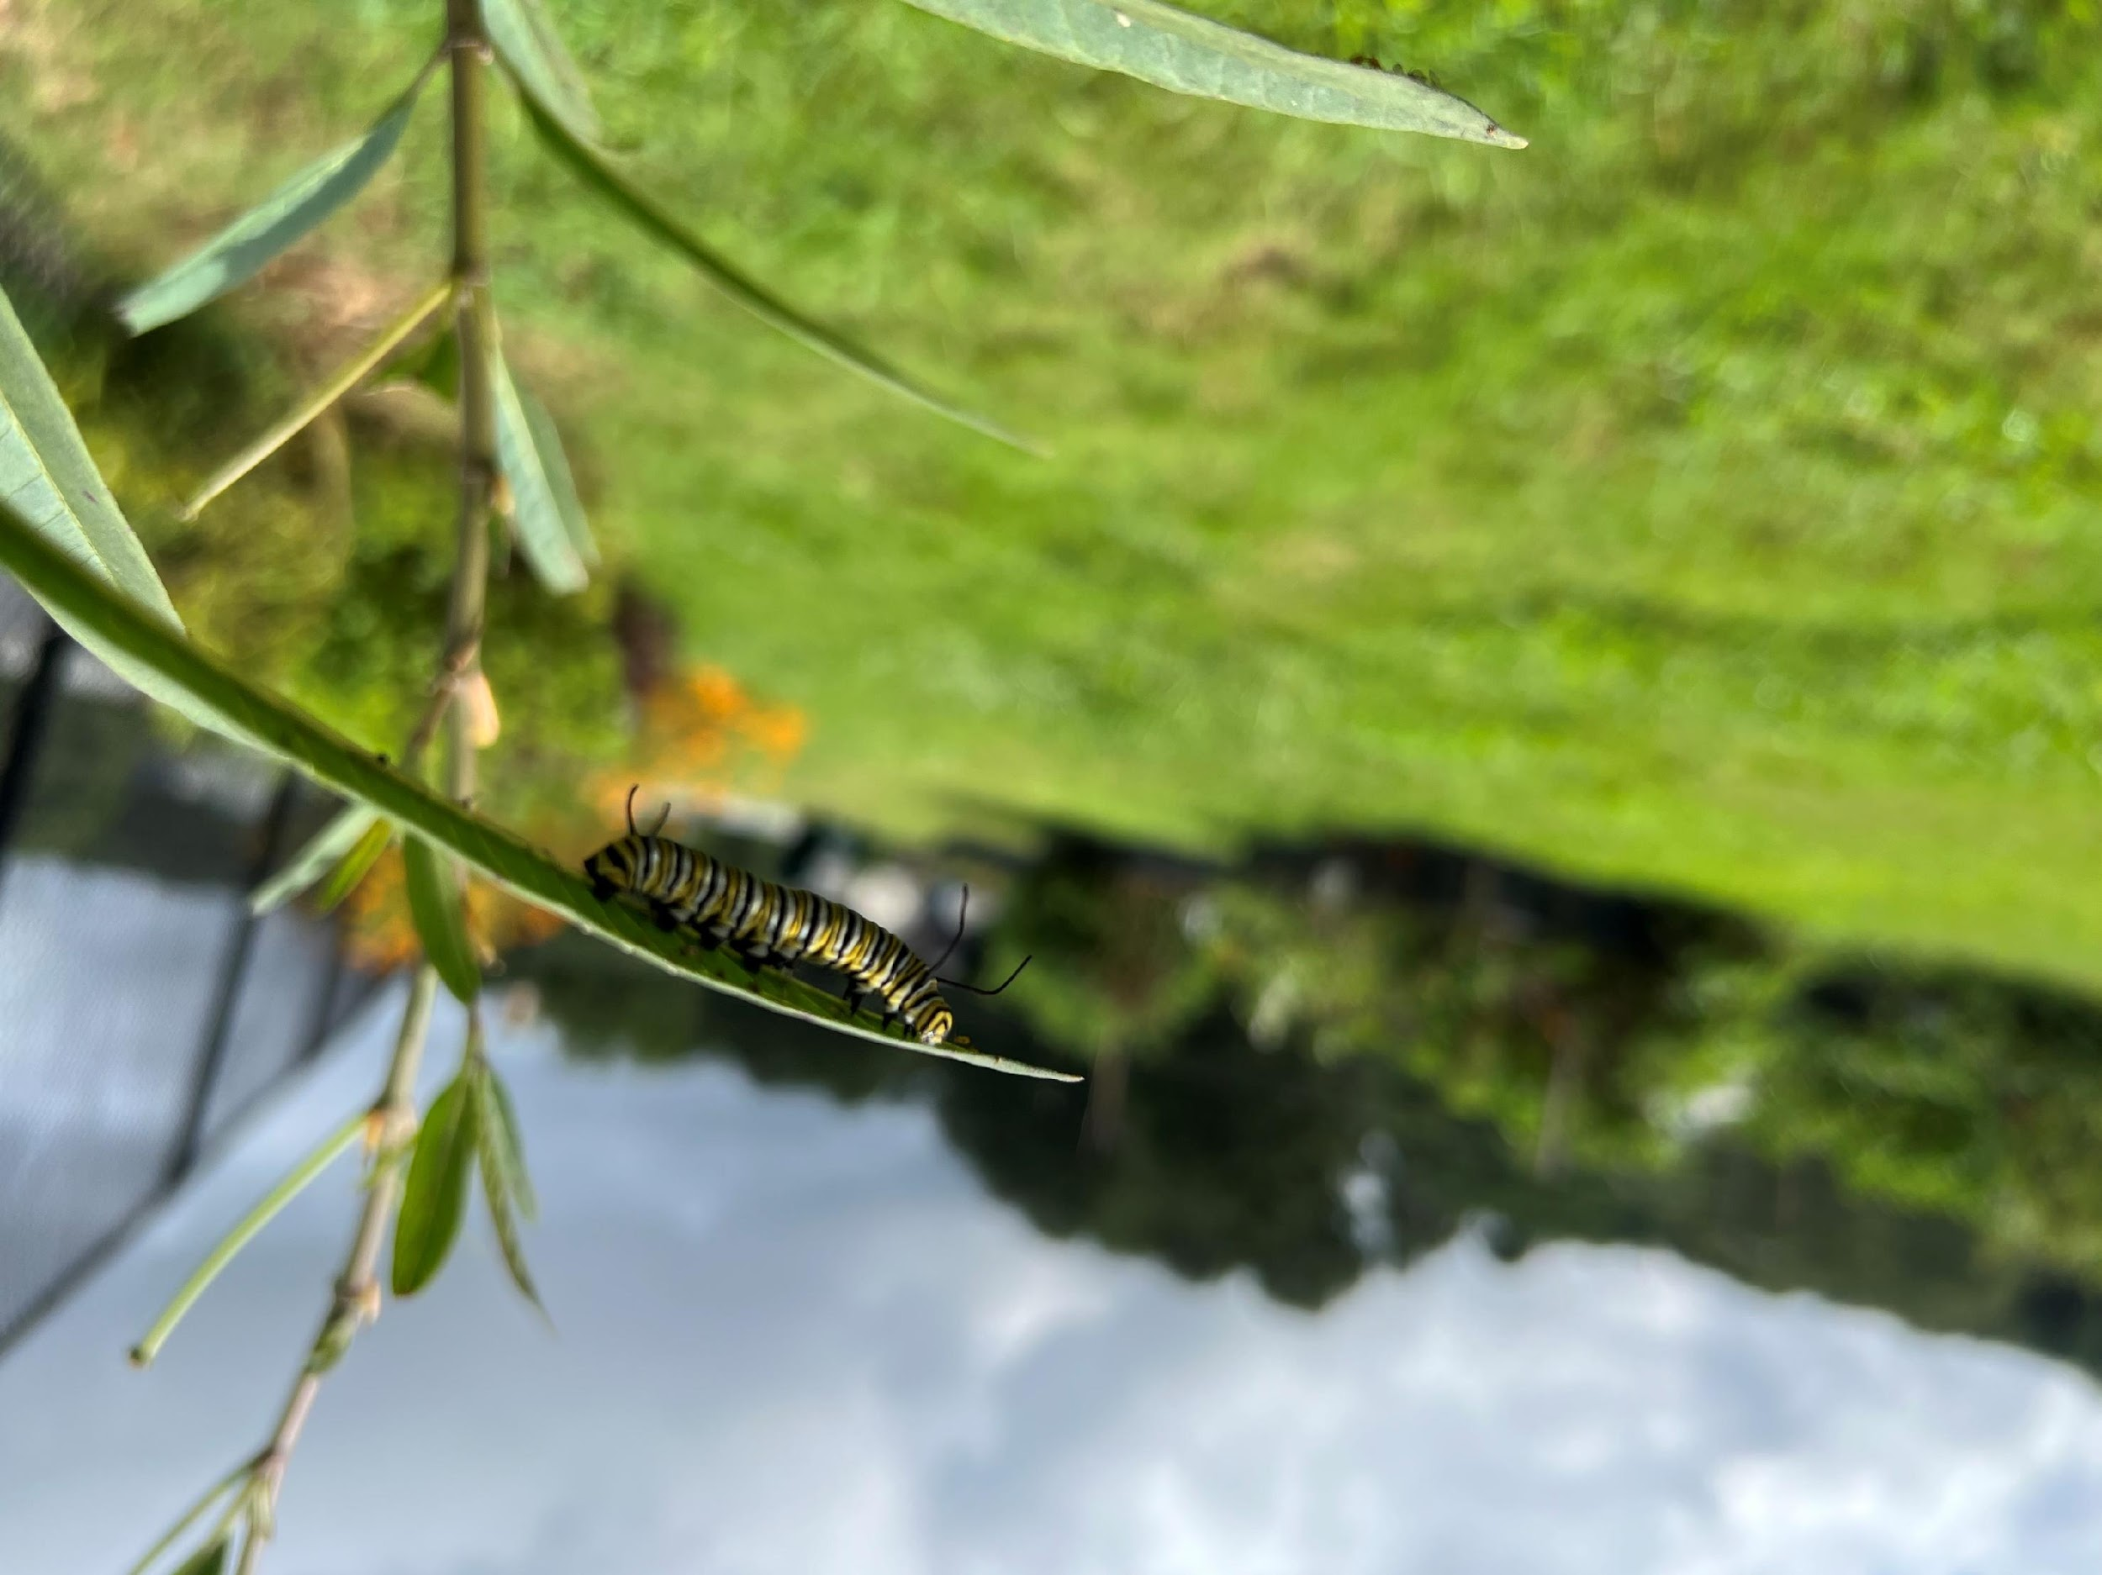
Monarch in Training
Photo by Becky Wolary
Location: Vines Community Garden
Taken with iPhone. I got luck to spot this guy!

Slide 26
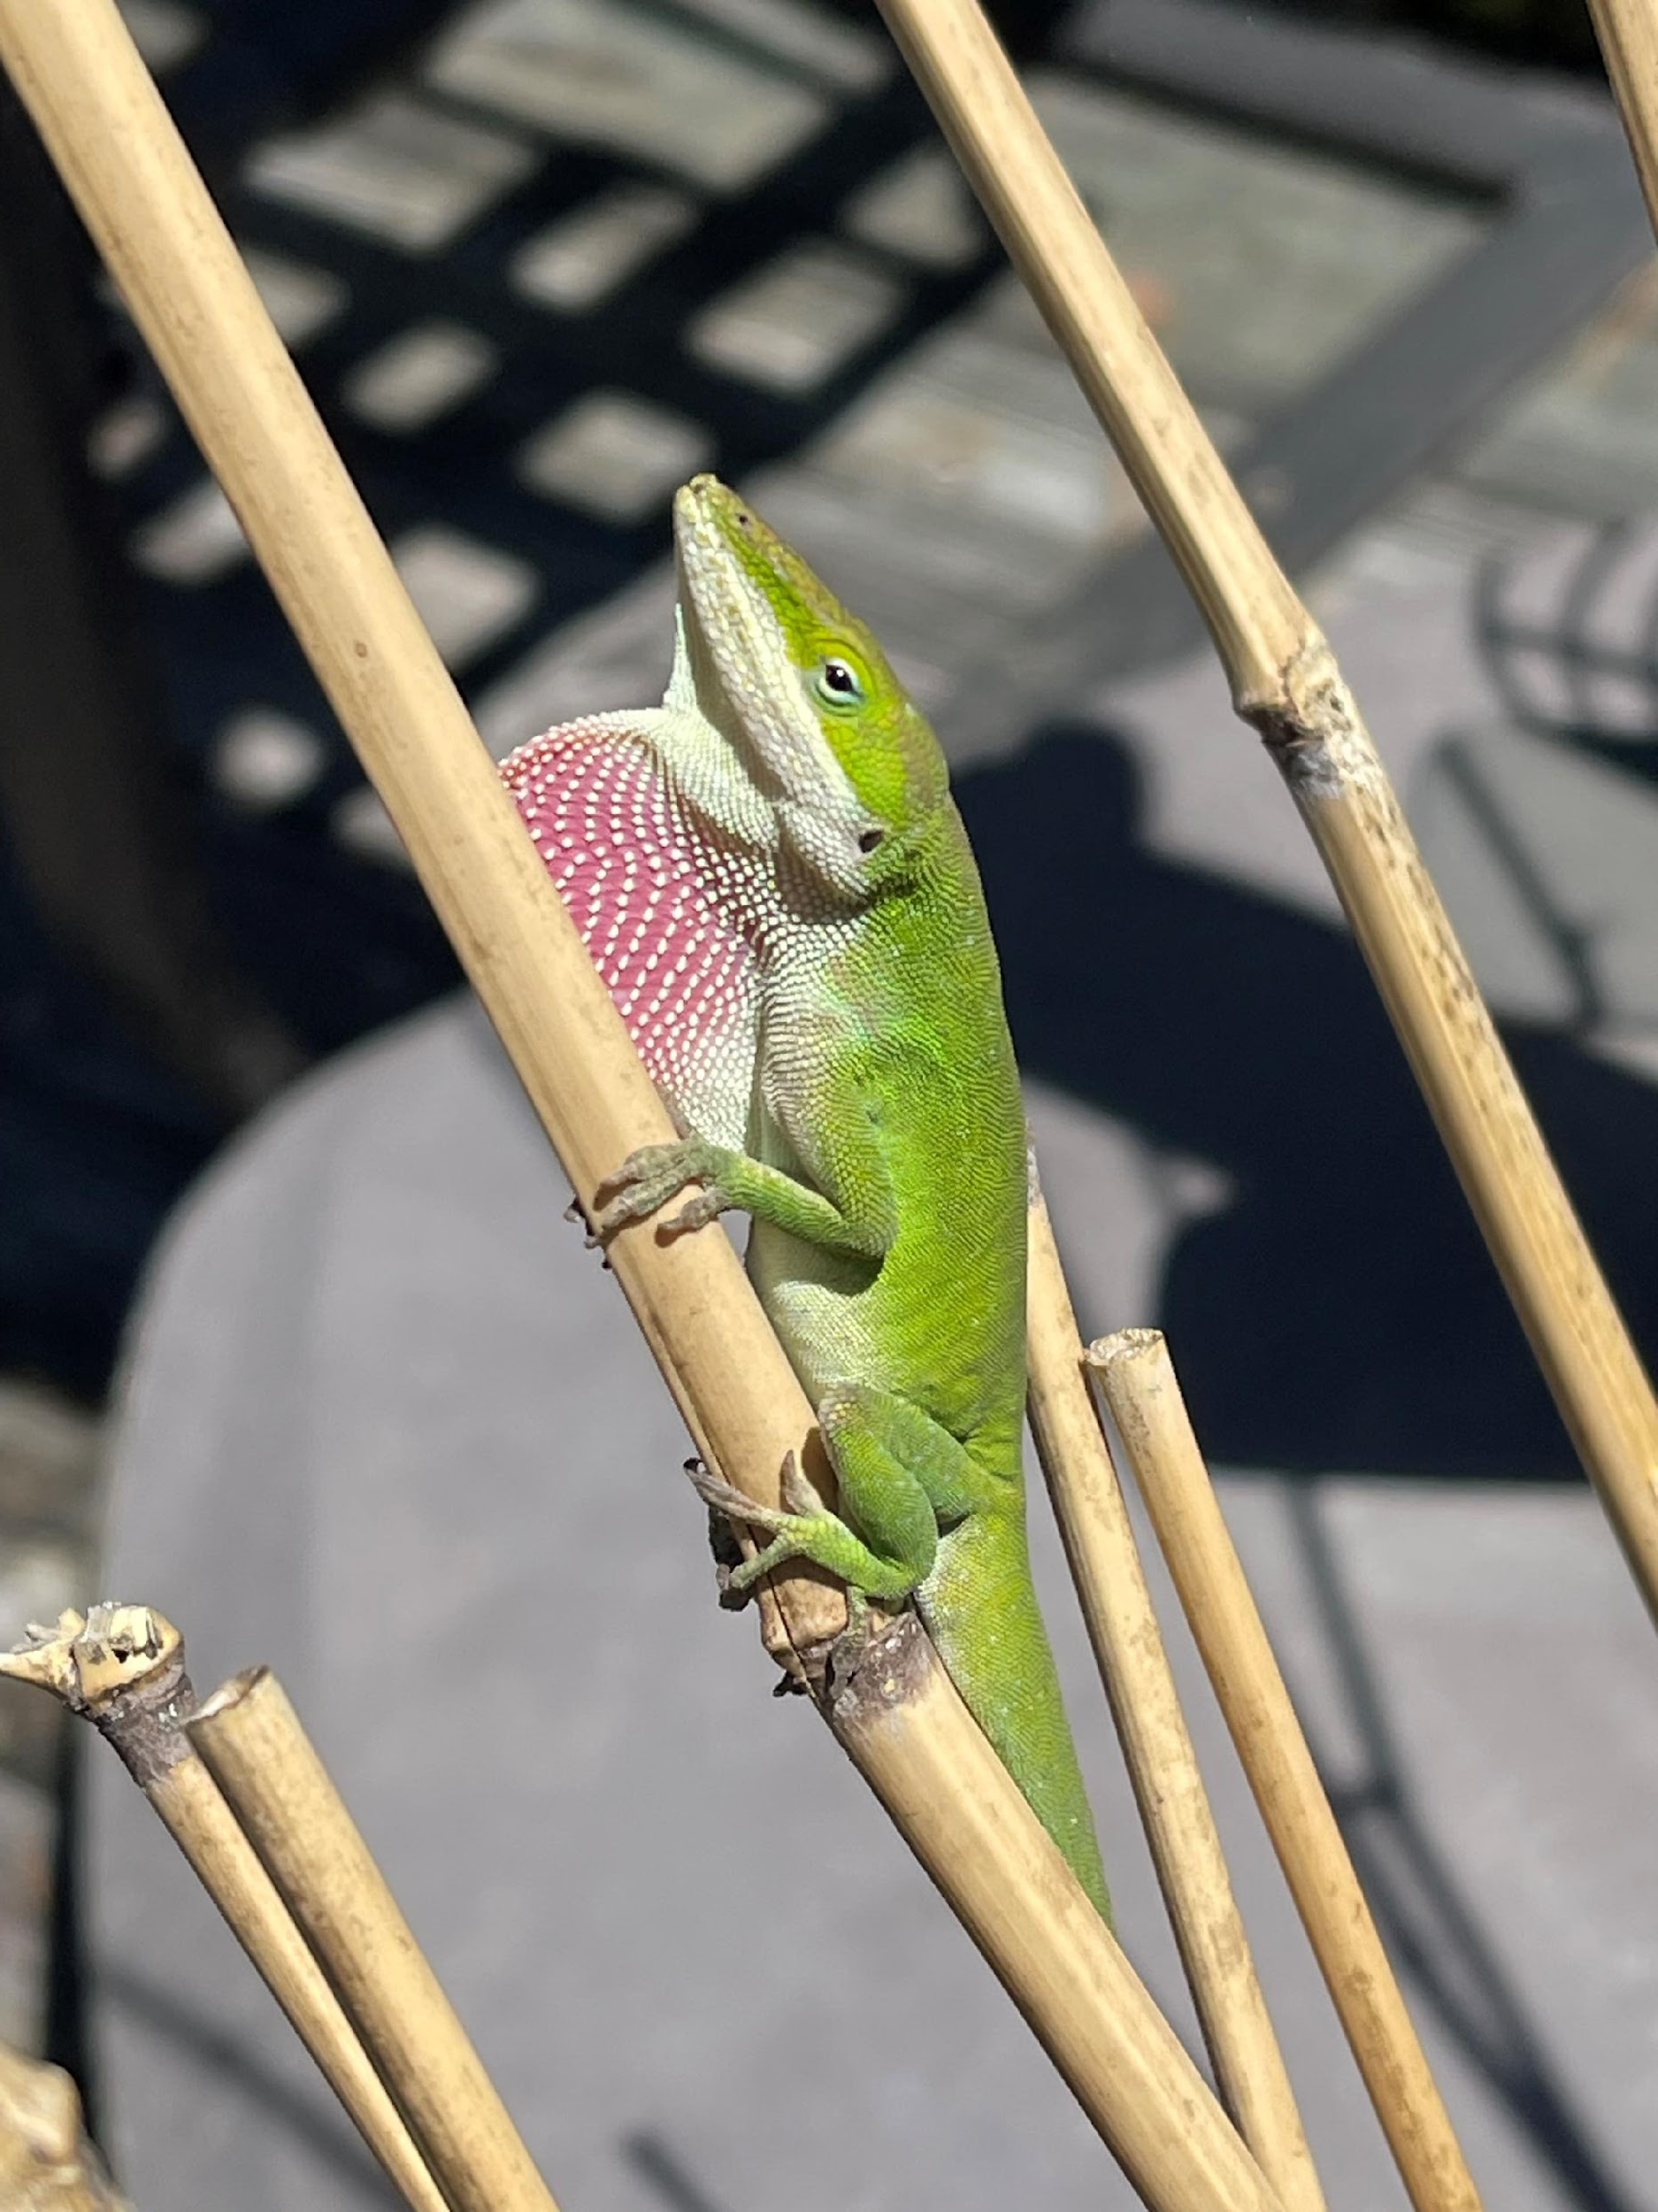
Just Chilling
Photo by Sandra Calkins
Location: My Yard
Lizard in the yard
Taken with iPhone

Slide 27
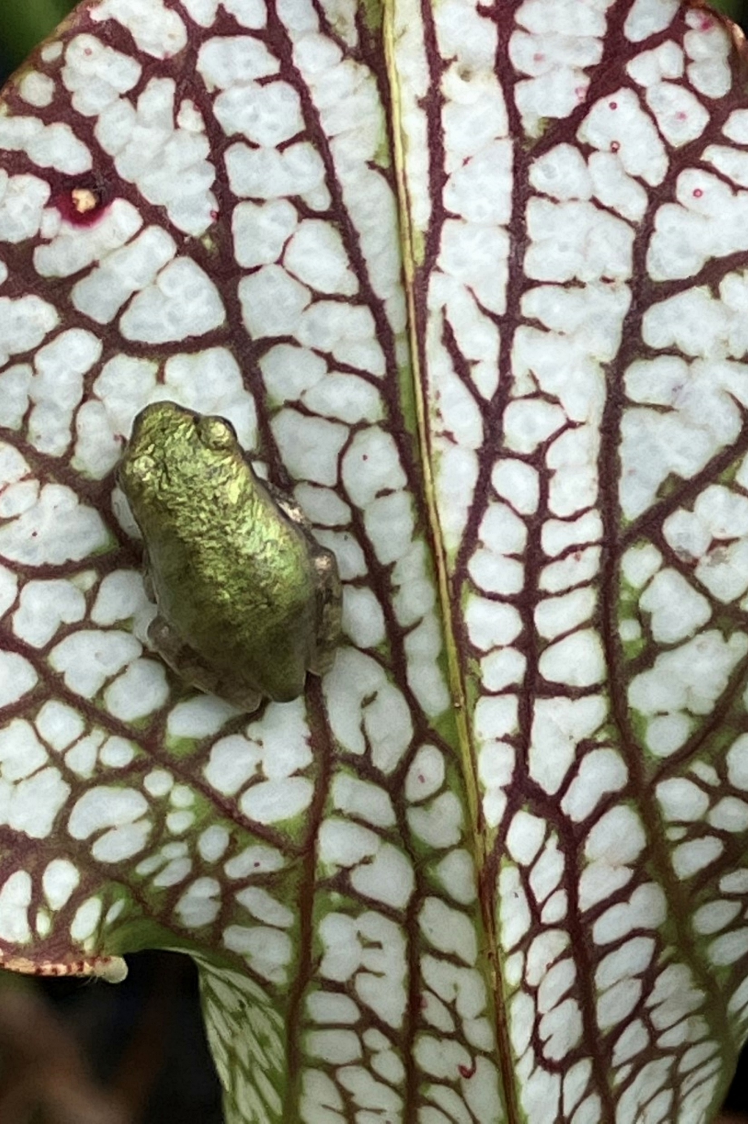
Sticking Around
Photo by Margaret Molyson
Location: Chattahoochee Nature Center
Tree frog on pitcher plant
Taken with iPhone

Slide 28
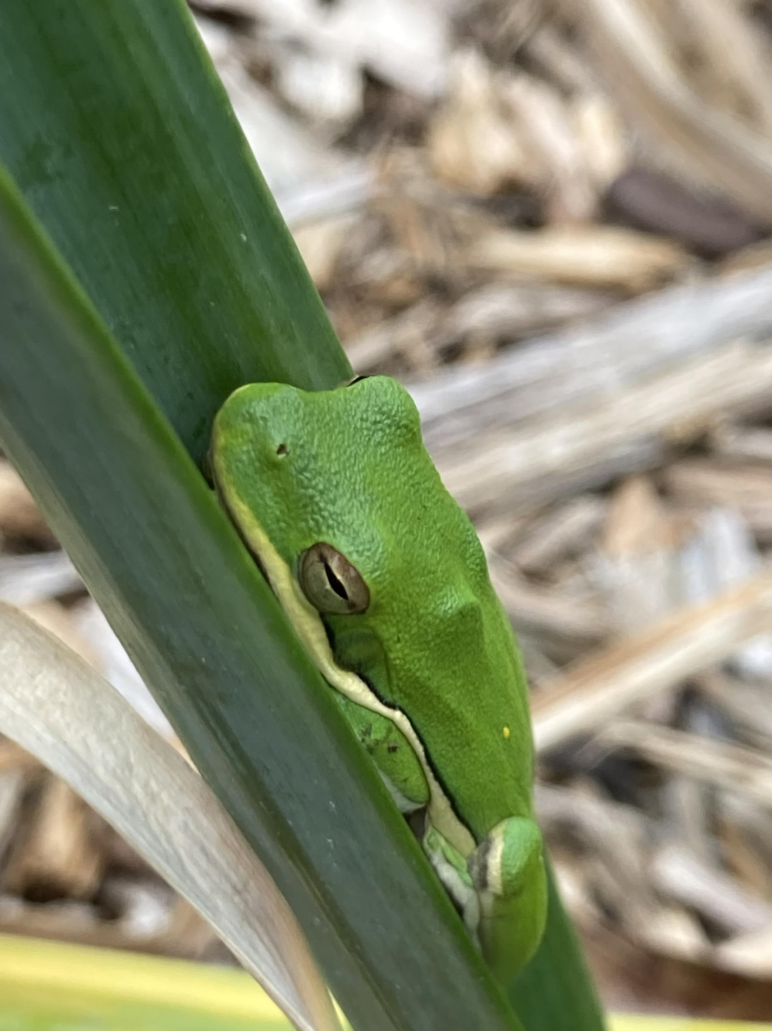
Sleepy Frog
Photo by Joanne Campbell
Location: McDaniel Farm
I was weeding a small bed at McDaniel Farms where I volunteer and saw frog on a daffodil.
** FIRST TIME ENTRY **

Slide 29
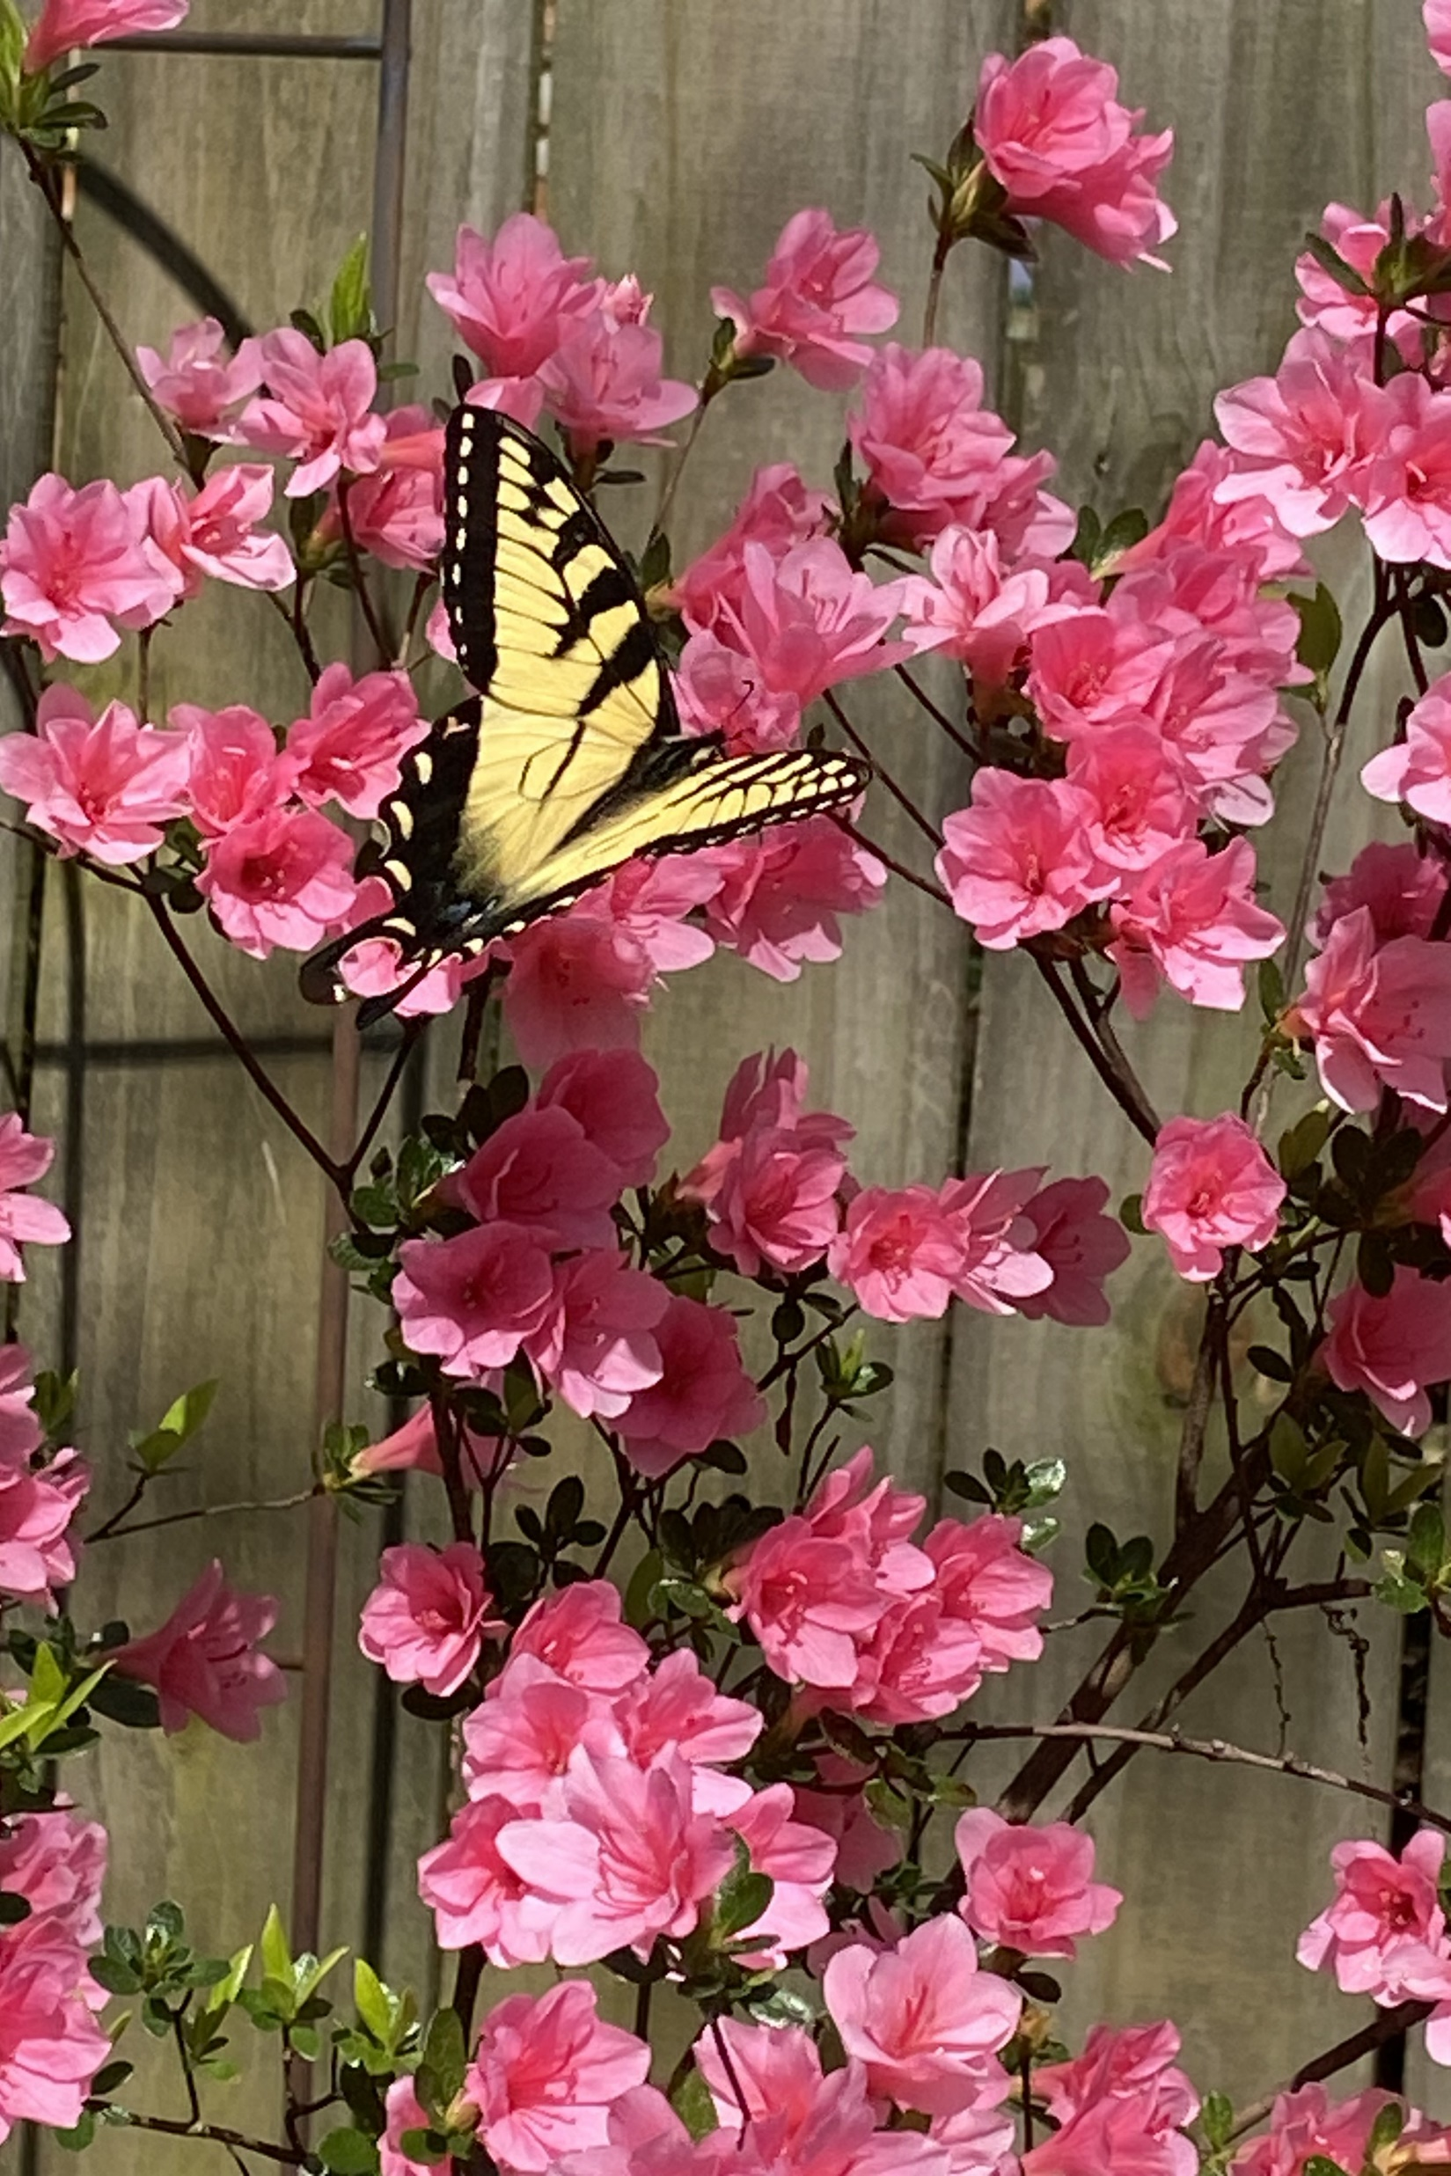
Swallowtail on Azalea
Photo by Karen McGinty
Location: Karen’s Backyard
Swallowtail on a coral pink azalea.
Taken with iPhone

Slide 30
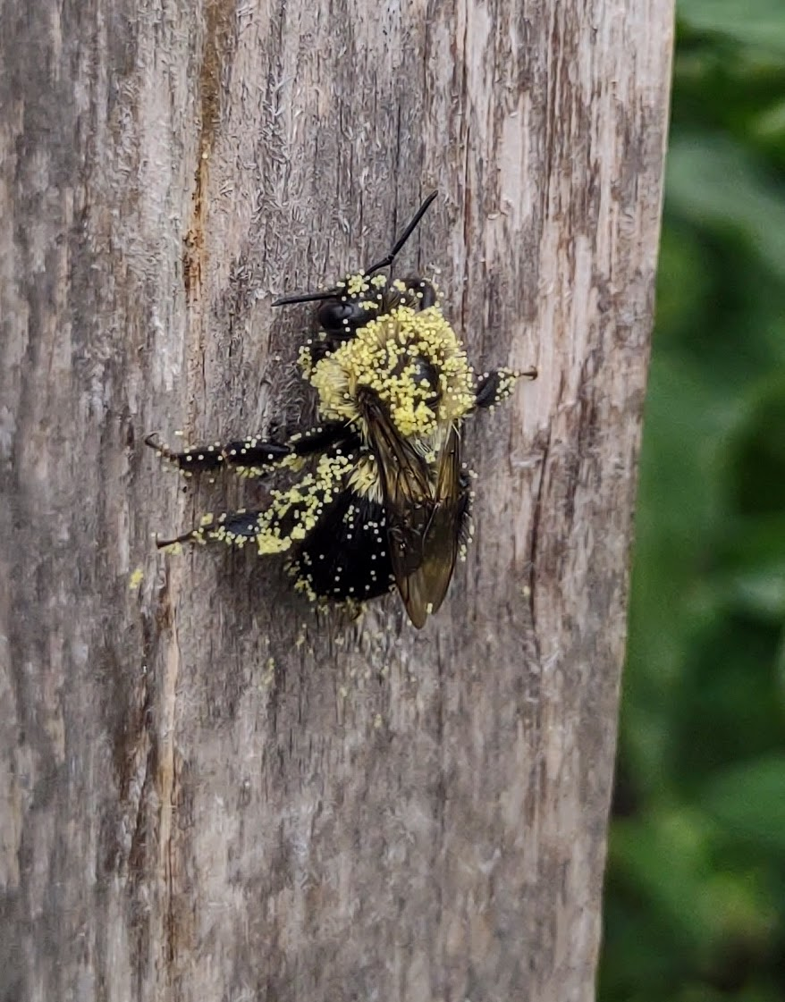
Working Hard
Photo by Diane Krish
Location: SE Gwinnett Co-op Garden
Pollen-covered bee resting on a garden stake.

Slide 31
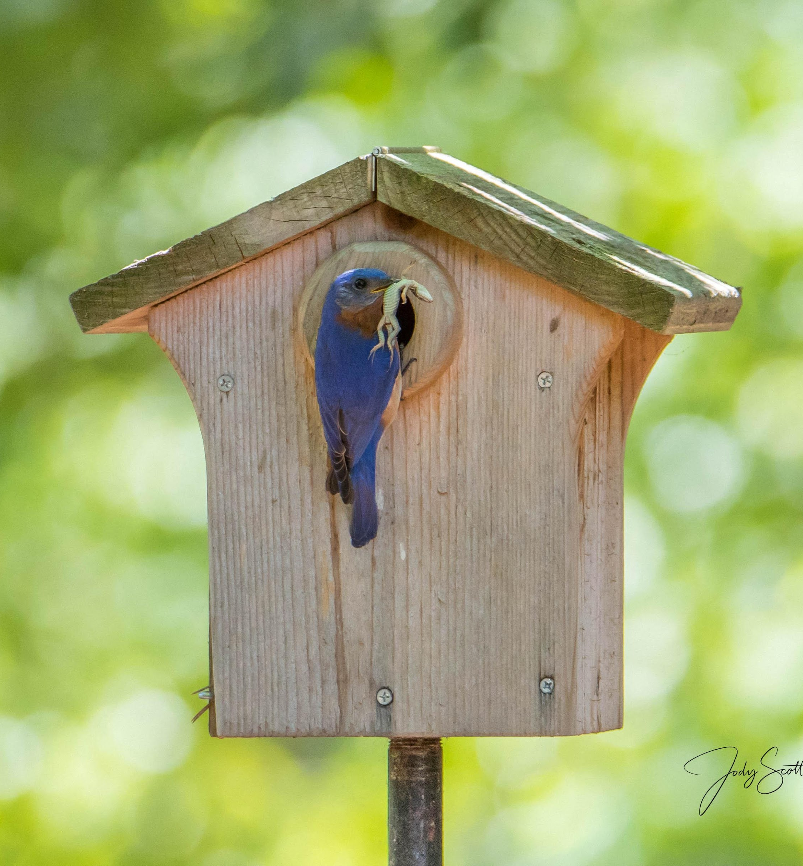

Male Bluebird Feeding the Young
Photo by Jody Scott
Location: Jody’s Backyard
Dad not messing around when it's his turn to feed the four kids
** FIRST TIME ENTRY **

Slide 32
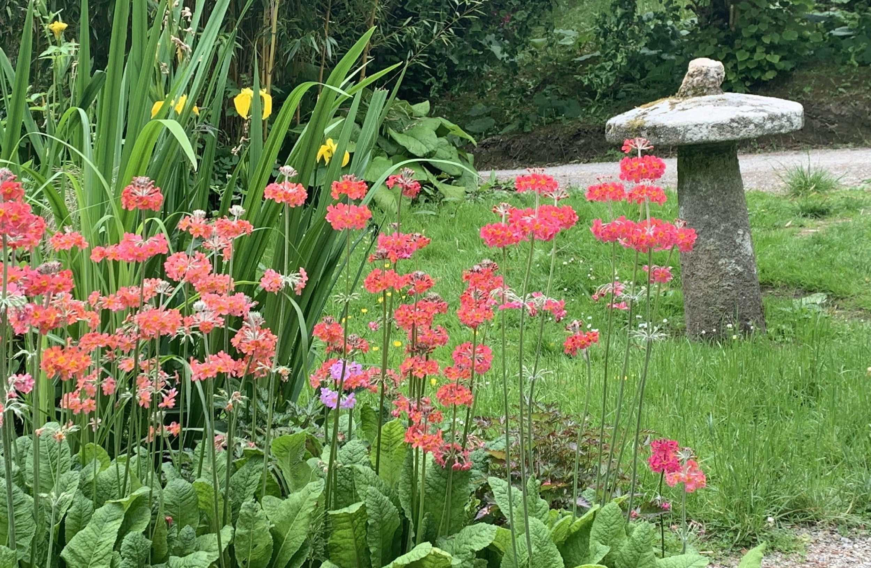
Small Gardens and Plant Groupings
garden rooms or artfully arranged plantings
Ten entries in this category

Slide 33
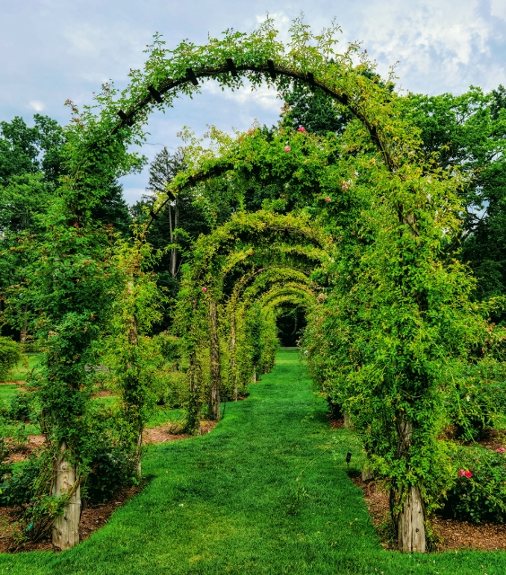
Rose Covered Path
Photo by Marilyn Whitmer
Location: Elizabeth Park Rose Garden, Elizabeth Park Conservancy, Hartford, CT
This rose covered arbor path was a highlight of the Elizabeth Park Rose Garden.
Taken with a S22 Galaxy phone.

Slide 34
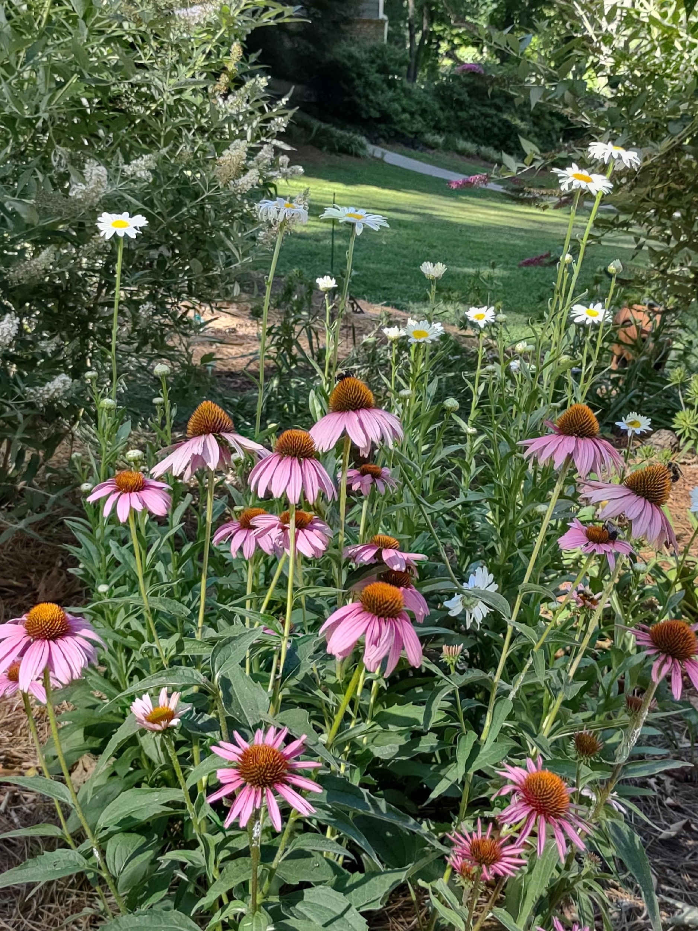
View Through the Garden
Photo by Diane Krish
Location: Home Pollinator Garden
Picture taken while standing in my pollinator garden looking back toward my house.
Taken with Motorola one 5G

Slide 35
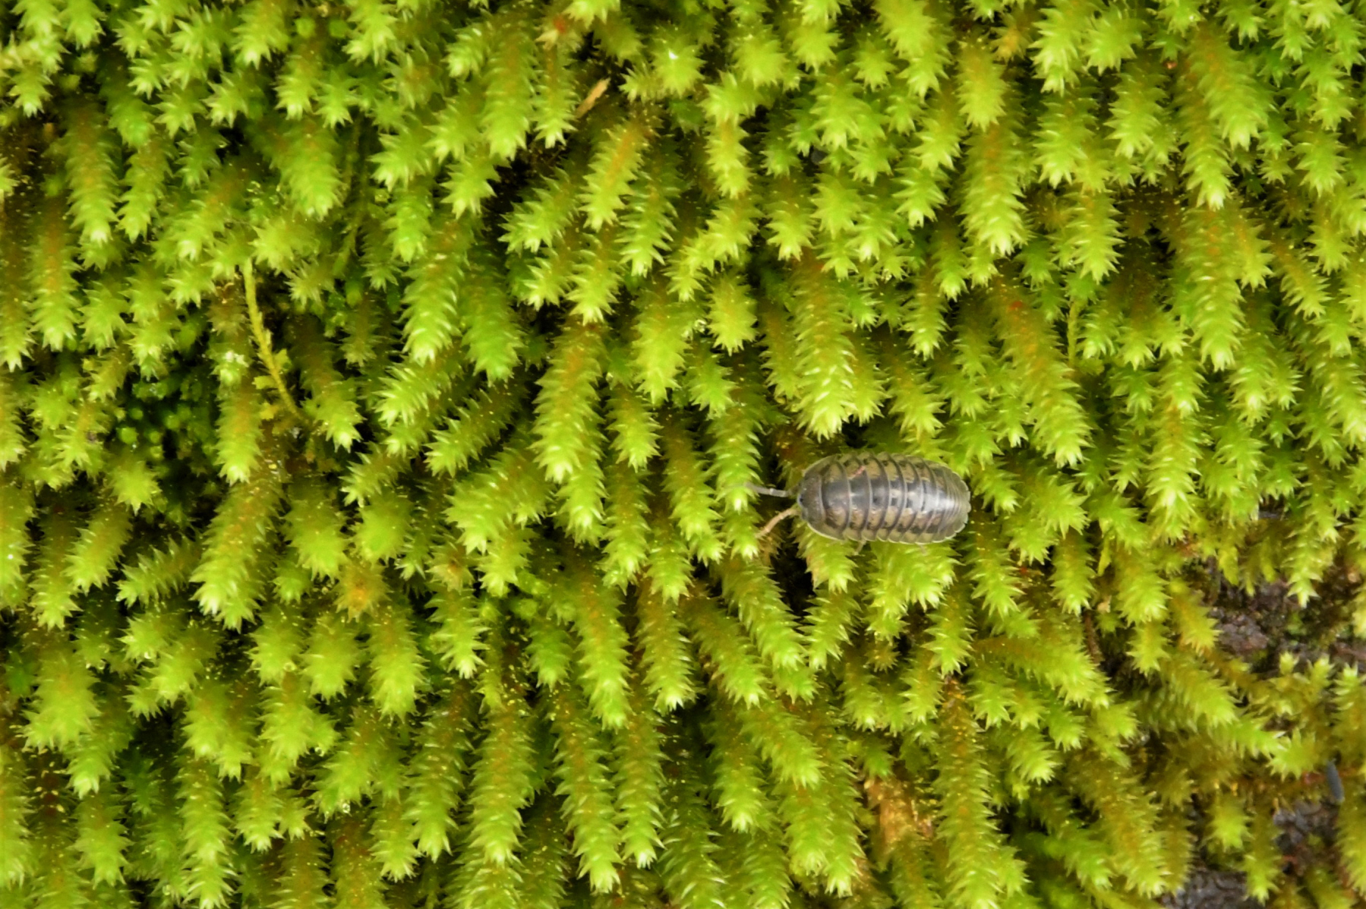
The Smallest Things
Photo by Ronald Kersey
Location: Tribble Mill, Gwinnett County, GA
Sometimes the smallest things can make a garden special. This spreading moss filled in gaps around the plantings and highlighted everything.
Camera: Nikon D500

Slide 36
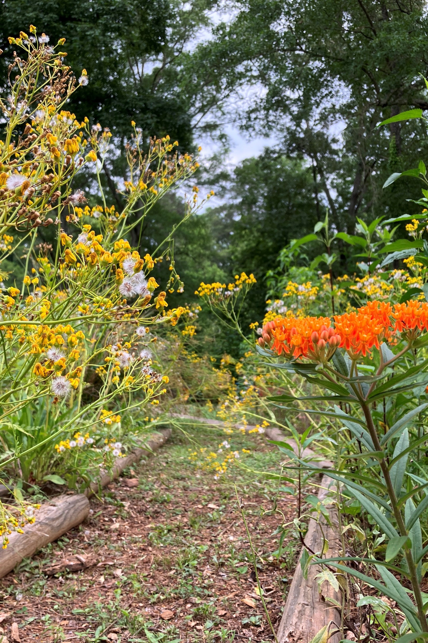
Transitions
Photo by Margaret Molyson
Location: Margaret's Sideyard
Fading balsam going to seed as butterfly milkweed comes into full bloom
Taken with iPhone

Slide 37
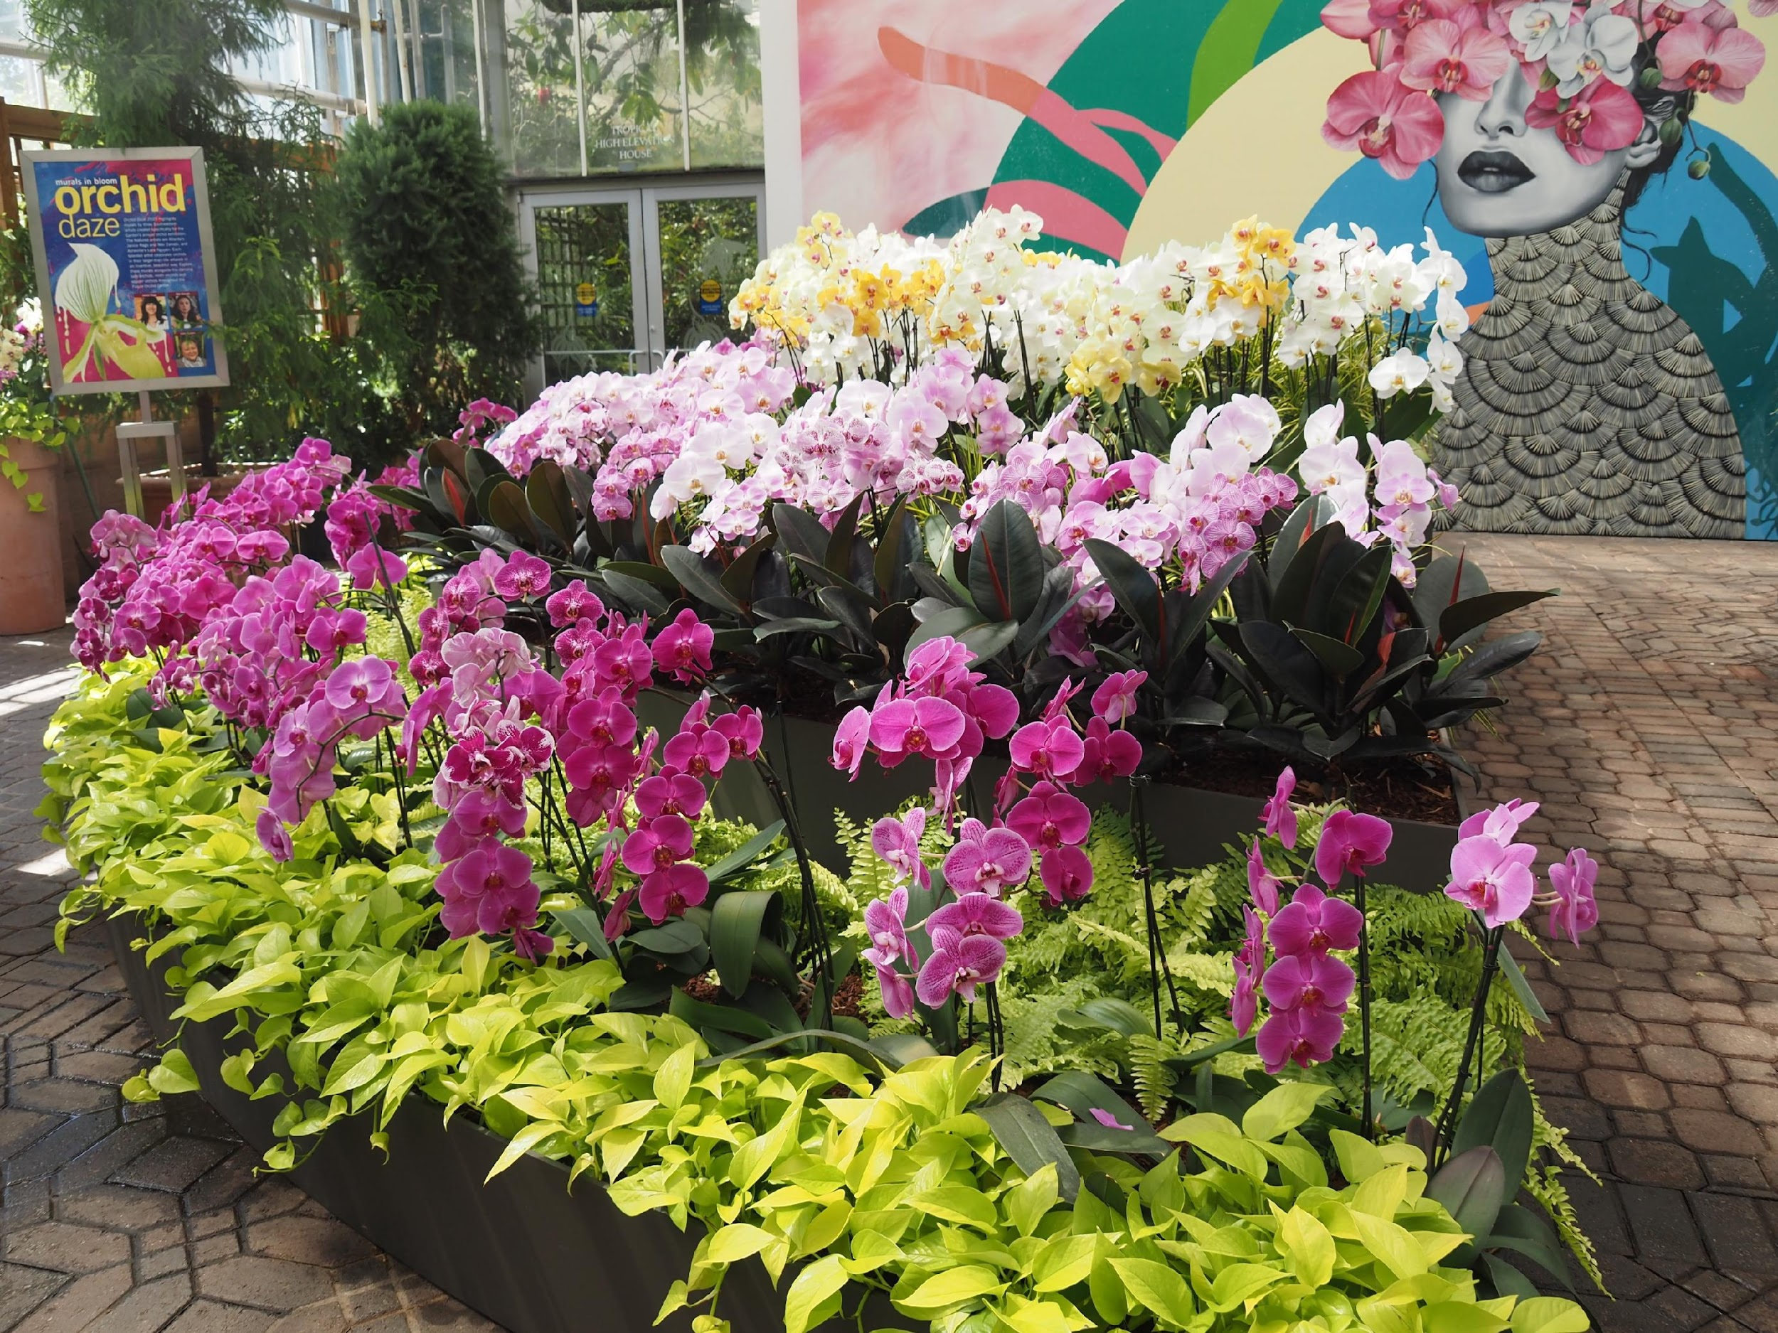
Mass of Phals
Photo by Becky Panetta
Atlanta Botanical Garden
Part of the phalaenopsis orchid display at Orchid Daze.
Taken with Olympus OM-D EM5III

Slide 38
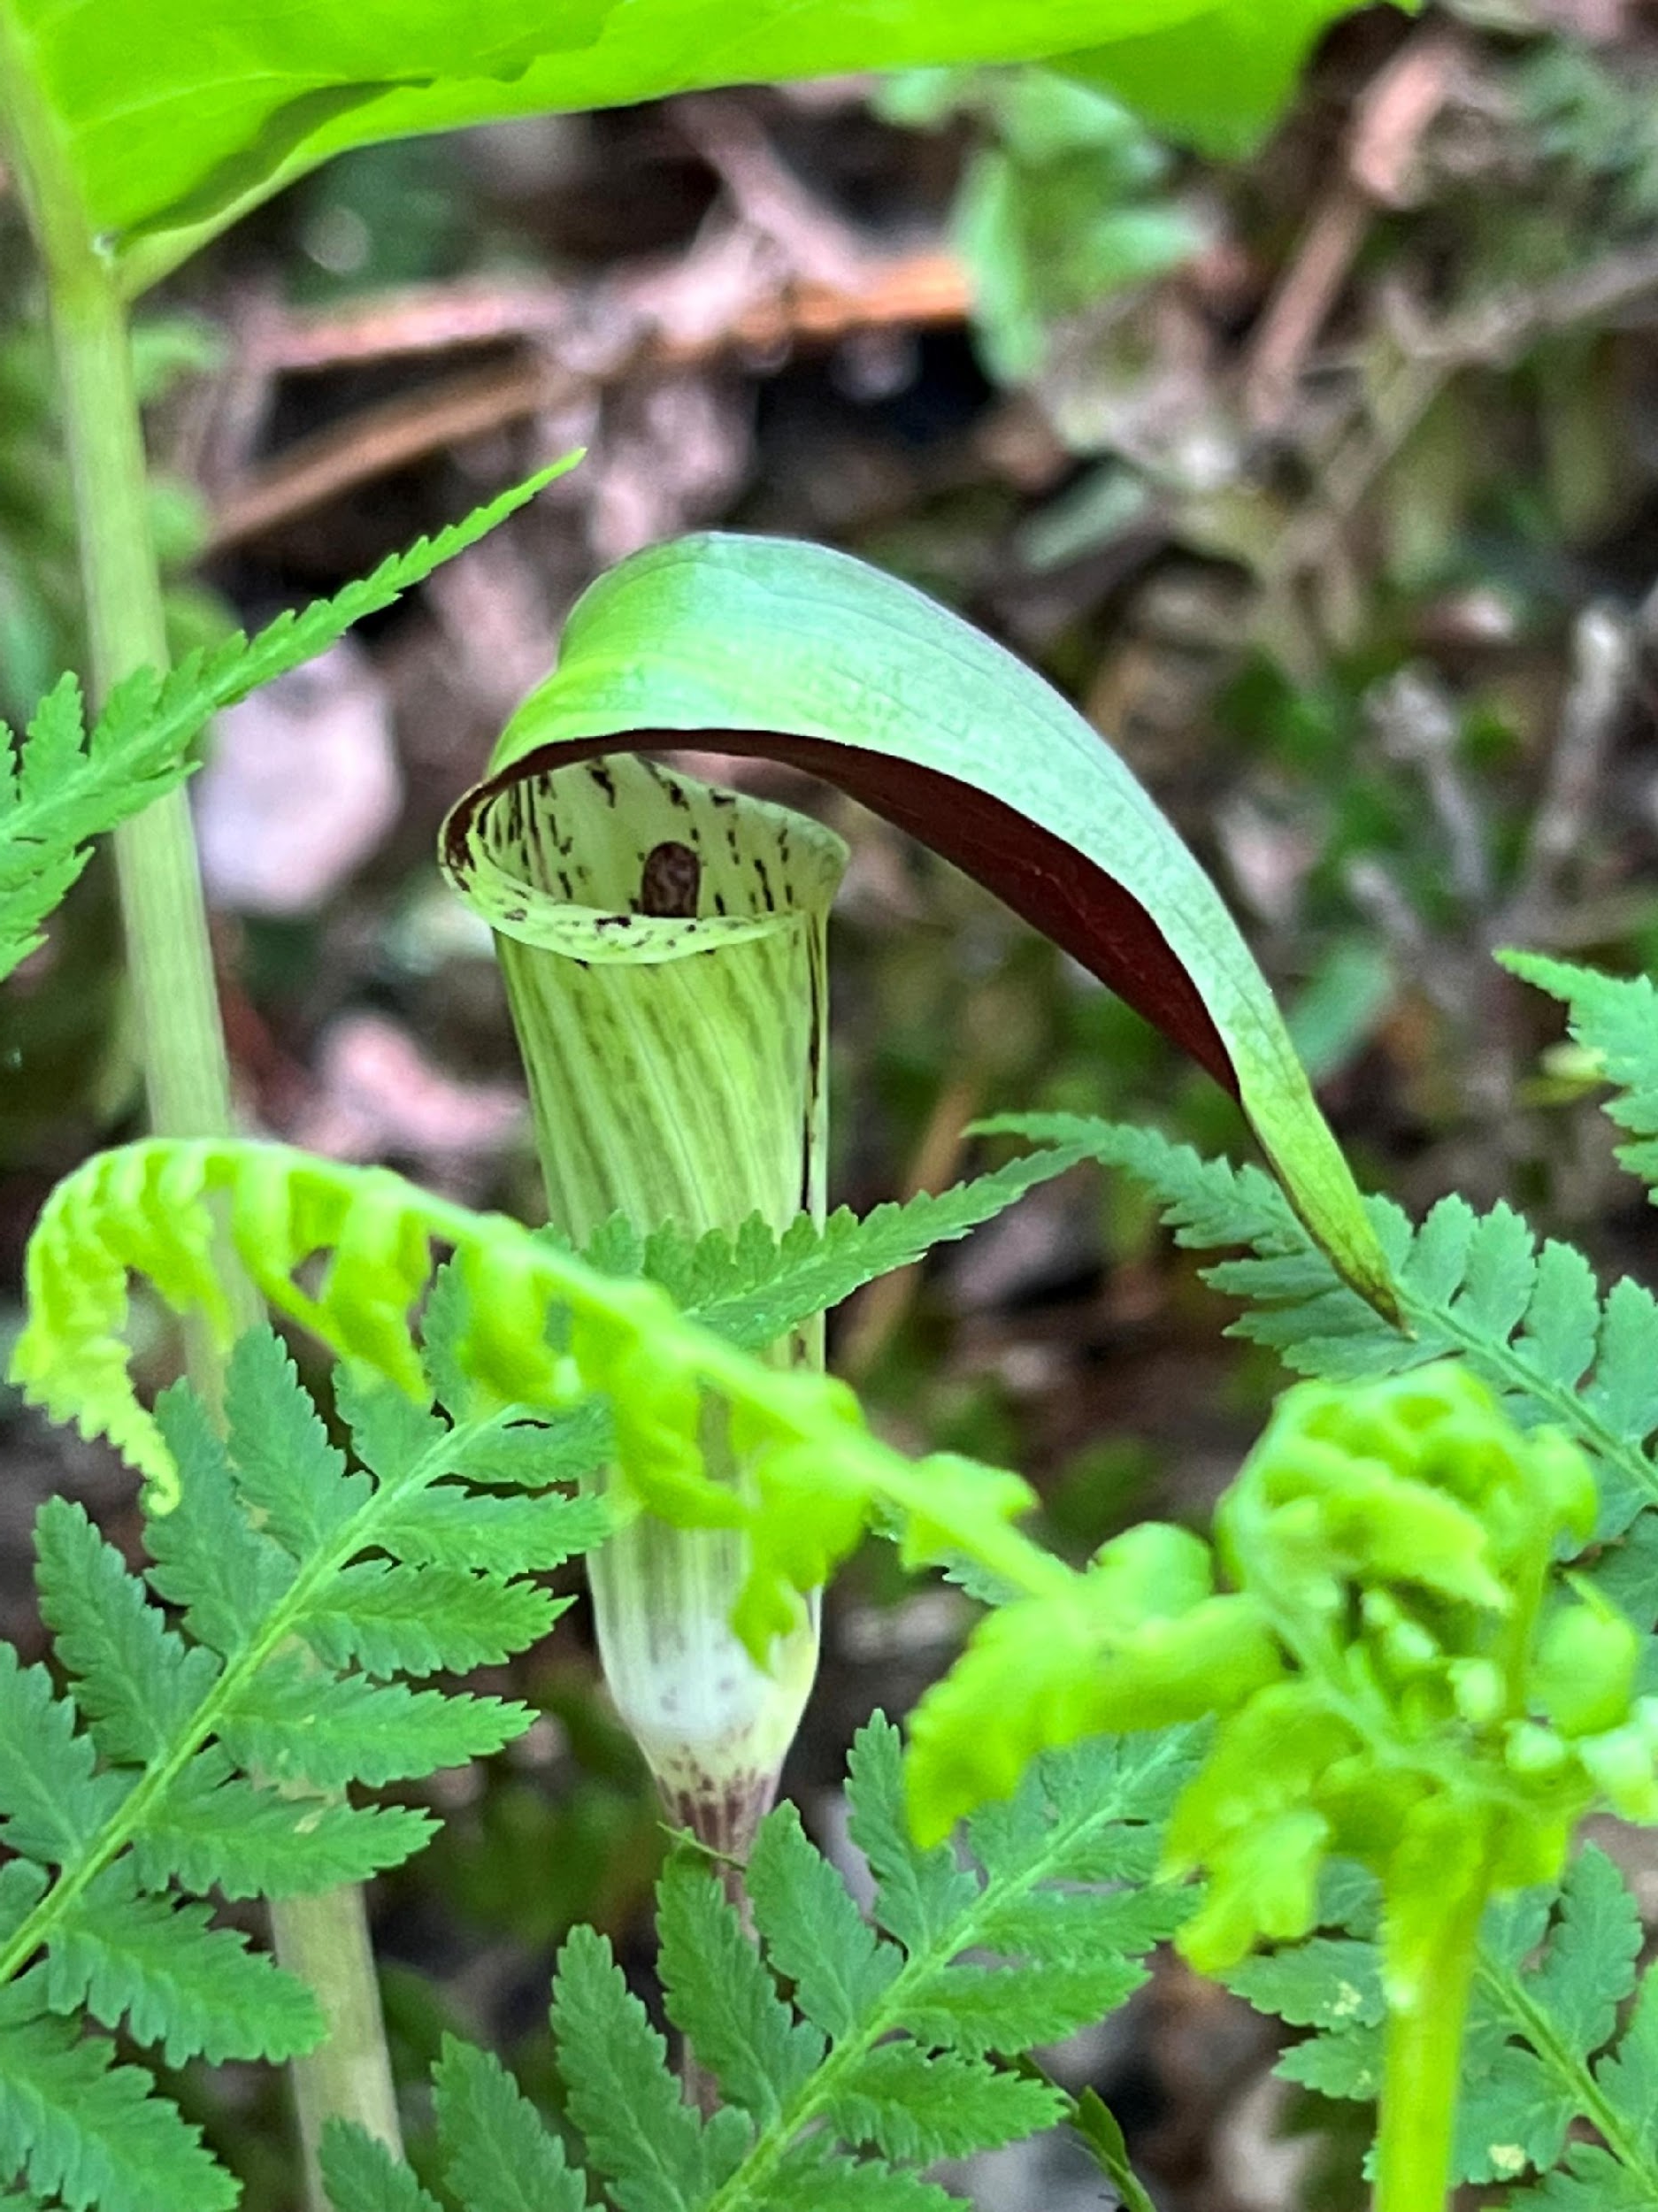
Preaching to the Choir
Photo by Lynda Pollock
Location: Lynda’s Garden
Jack in the Pulpit bloom in fern bed.
Taken with mobile phone camera

Slide 39
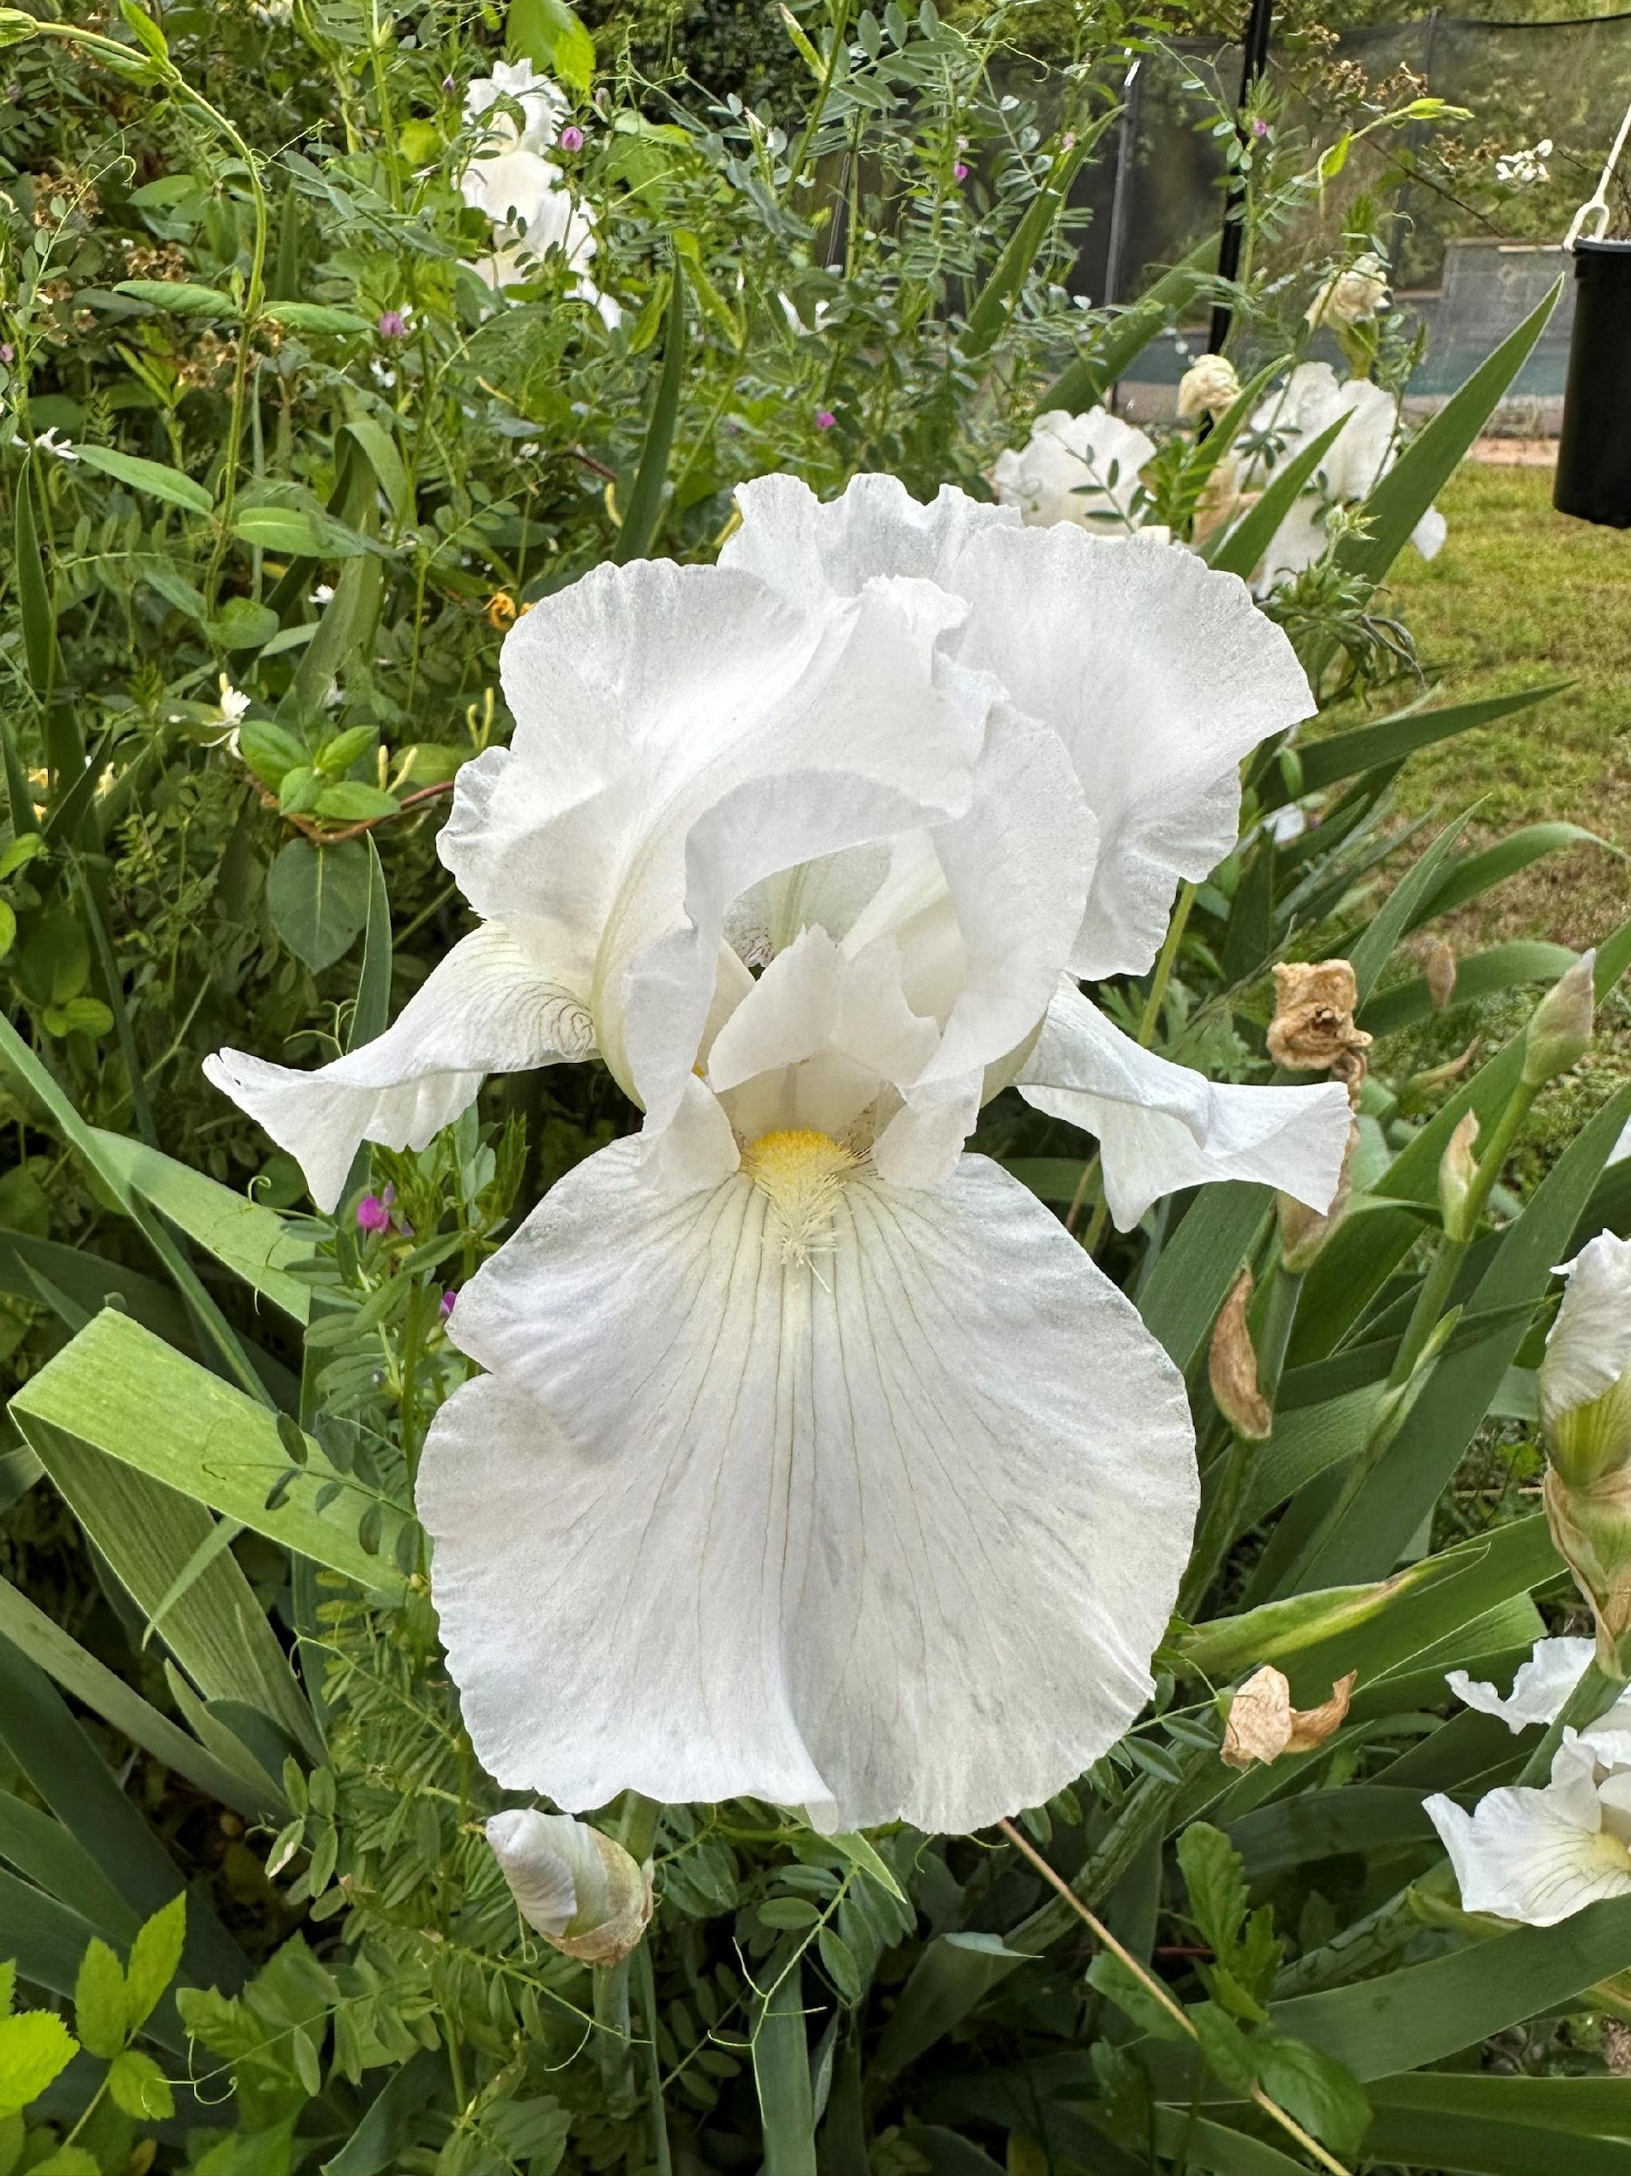
“Lady M” makes her grand entrance at the Dom Francesca Annual Garden Party.
Photo by Robert Ayer
Location: My daughter-in-law’s
backyard garden in Waxhaw, NC
A Bearded Iris is instantly recognized during a visit to the backyard garden.
Taken with iPhone 14 Pro Max

Slide 40
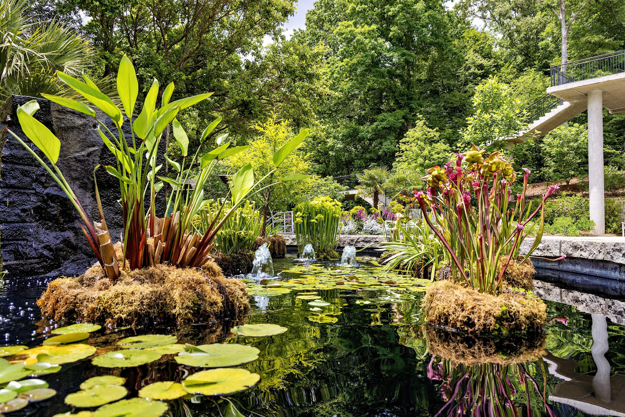
Luxuriance
Photo by
Ivan Varlamoff
State Botanical
Gardens, Athens
Small oasis of shades of green and different shapes and textures contrasting with the red spot of pitcher plants.
Taken with Canon EOS R6, FL 24mm

Slide 41
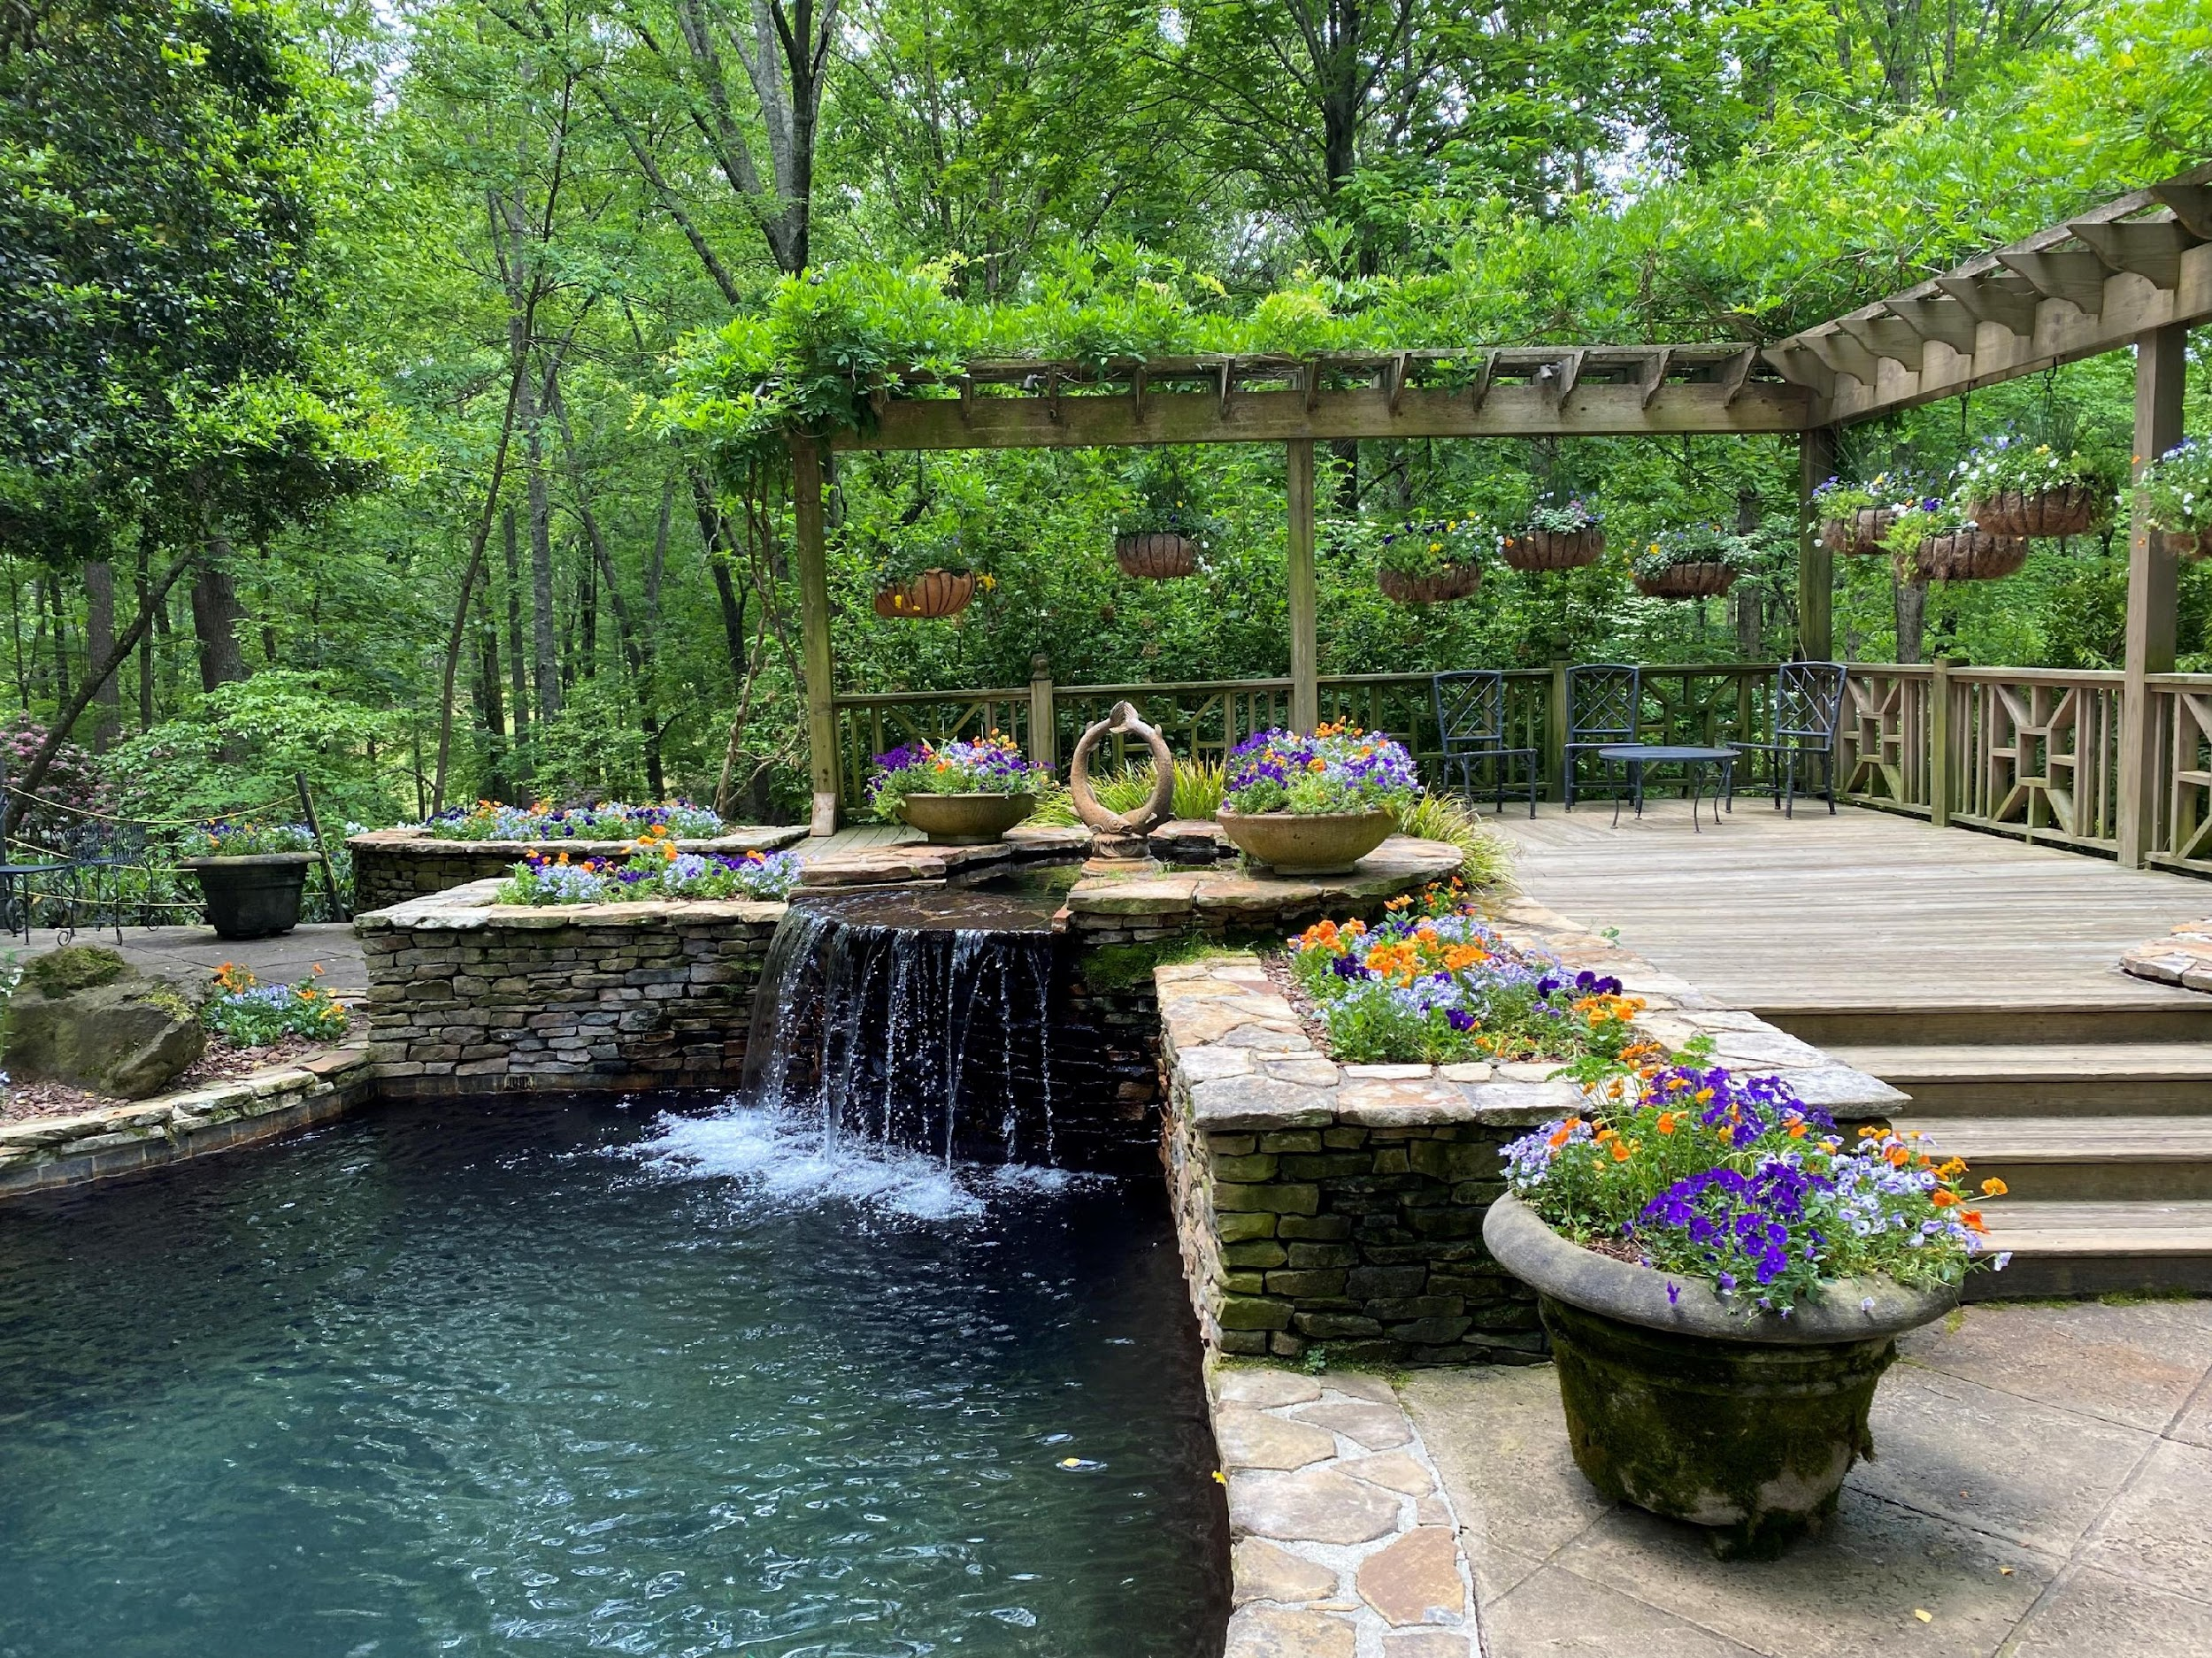
Zen Retreat
Photo by
Barbara Geier
Gibbs Gardens
This is a serene pool and sitting area by the Manor House at Gibbs Gardens. It seemed to be the perfect place to relax and chill out.
Taken with iPhone.

Slide 42
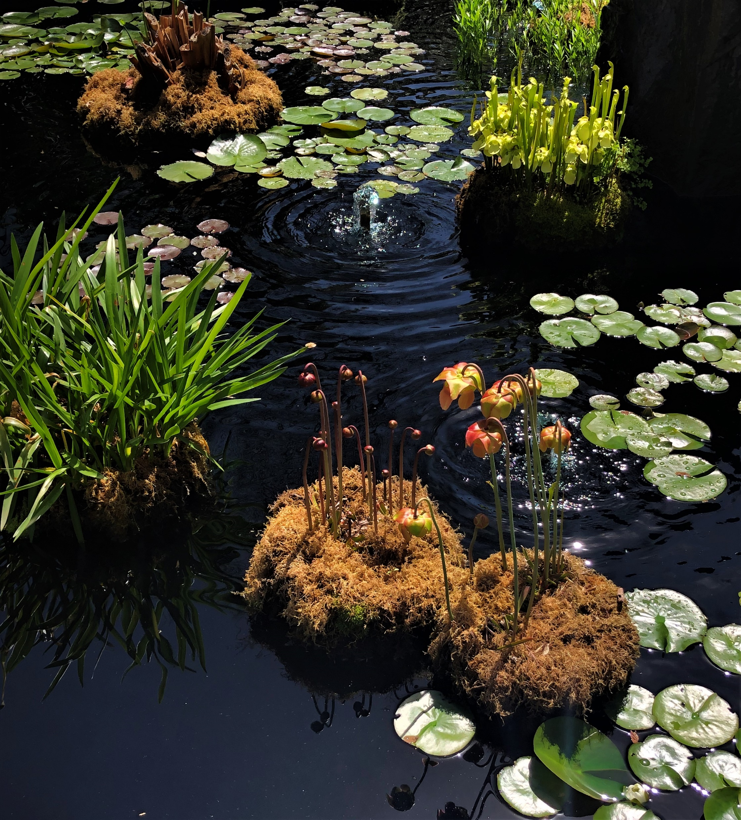

Bog of my Dreams
Photo by Kate K. Foxwell
Location:
State Botanical Gardens,
Athens, GA
Water garden with pitcher plants
Taken with iPhone.

Slide 43
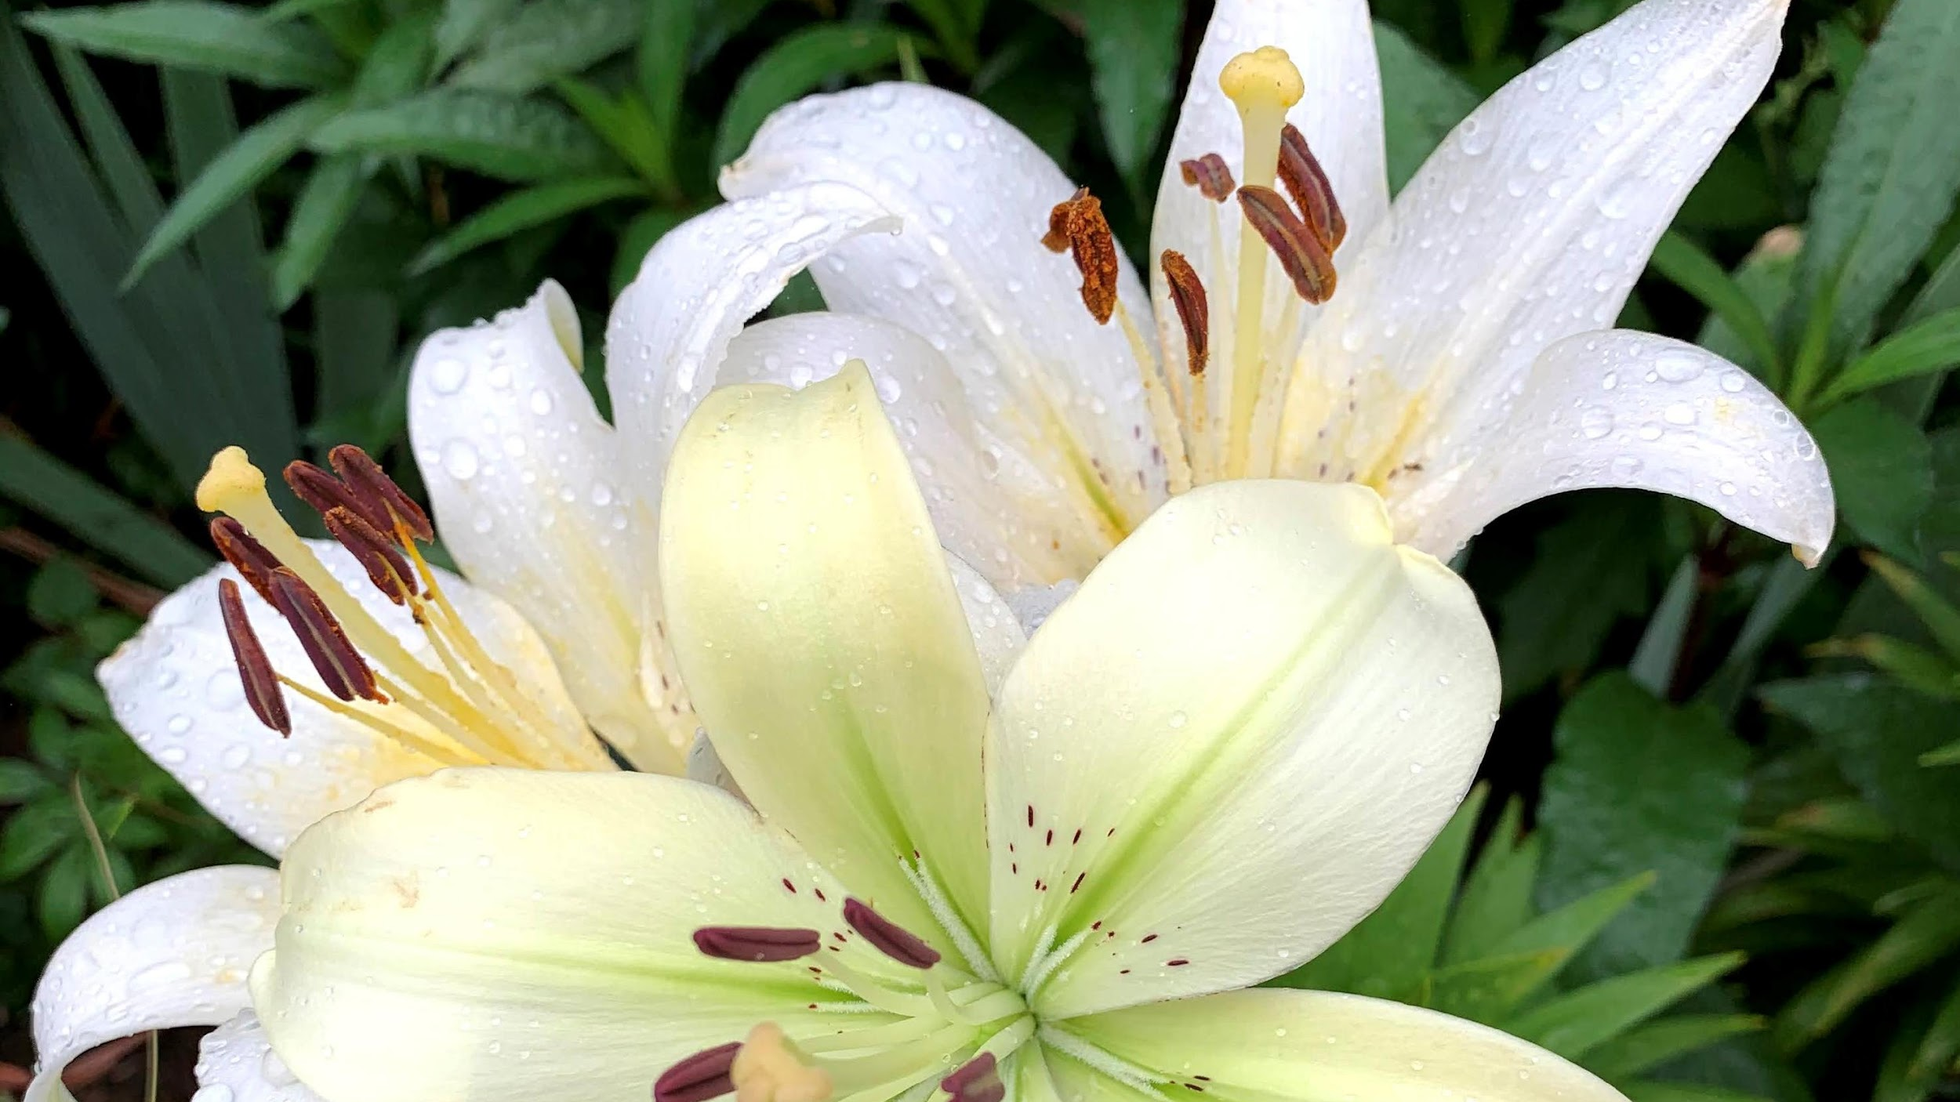
Specimen
a single individual plant or group of a single species
17 entries in this category

Slide 44
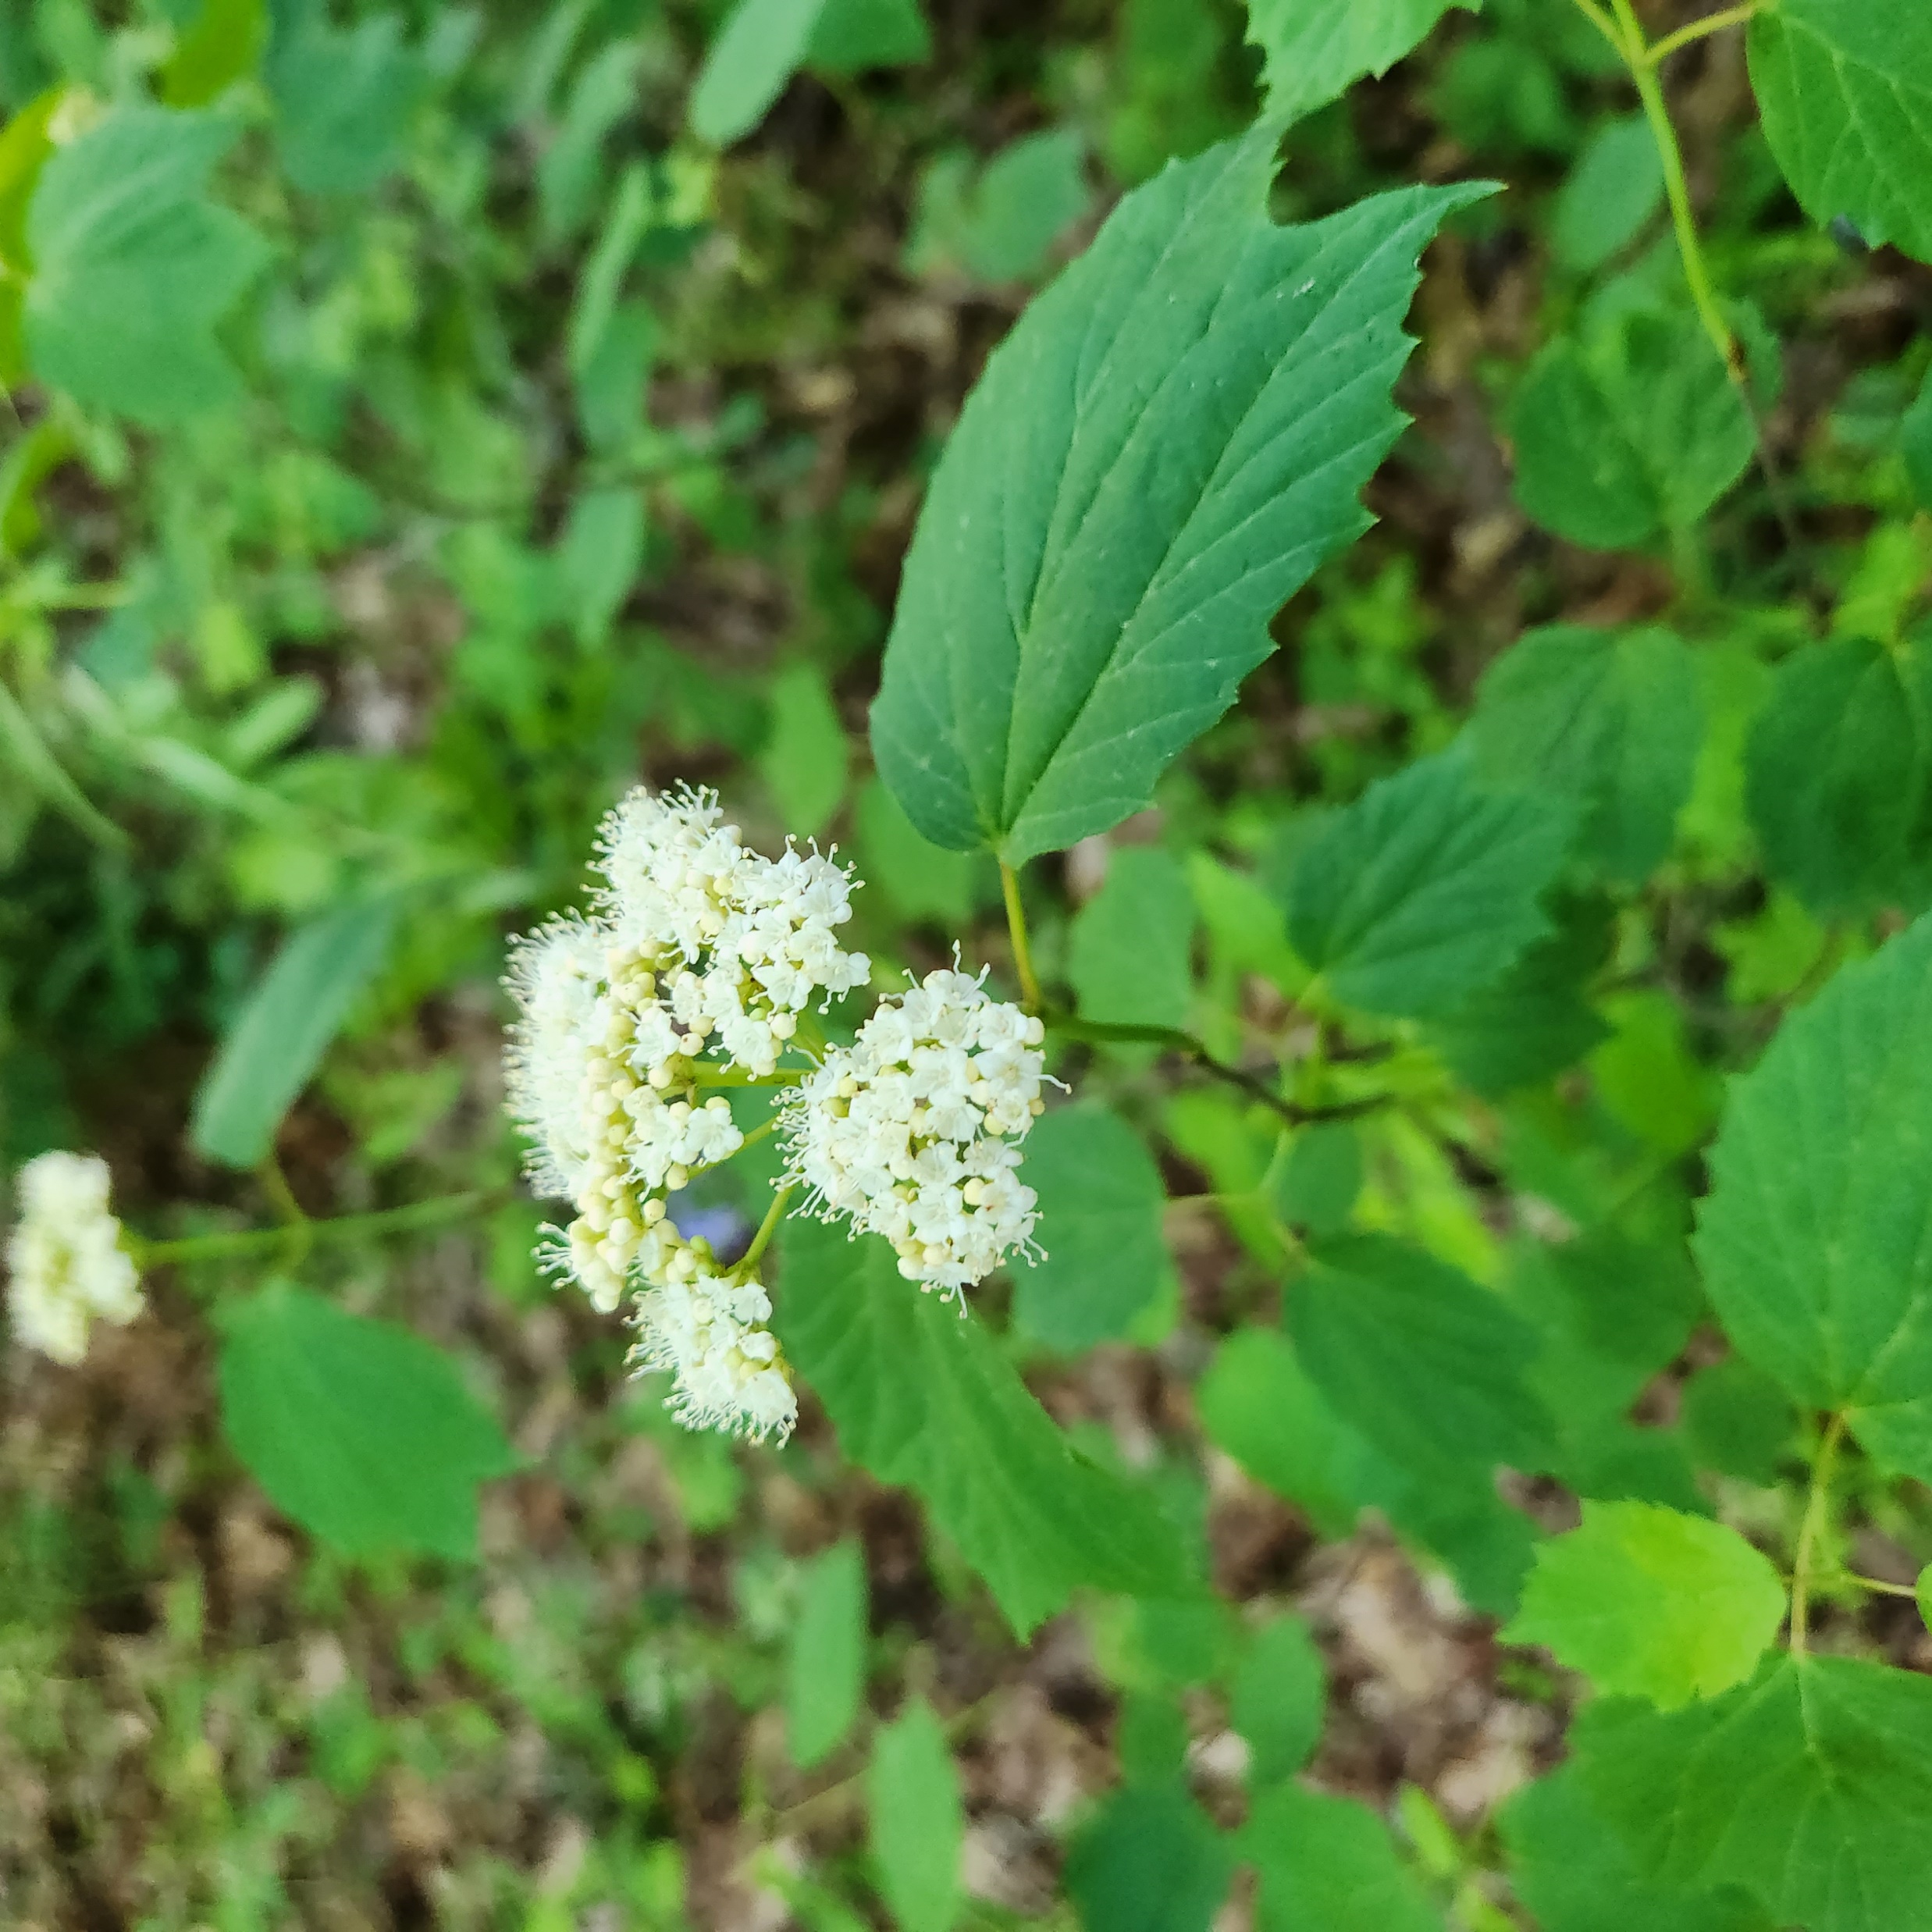
Maple Leaf Viburnum
Photo by Jane Trentin
Location: Lilburn, GA
In my yard because it was in full bloom

Slide 45
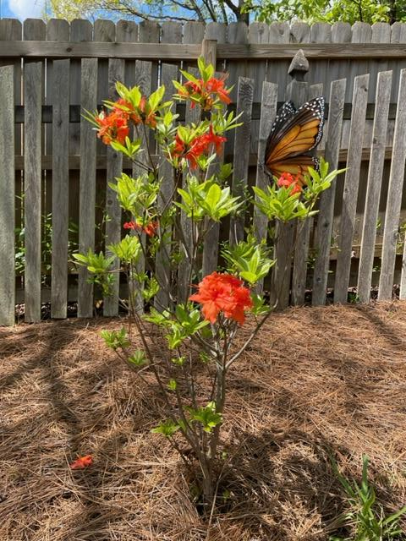
Native Azalea in Bloom
Photo by Amy Mock
Location: Amy’s Yard
My azalea bloomed even through the frost!
Taken with iPhone
** First-time Submitter **

Slide 46
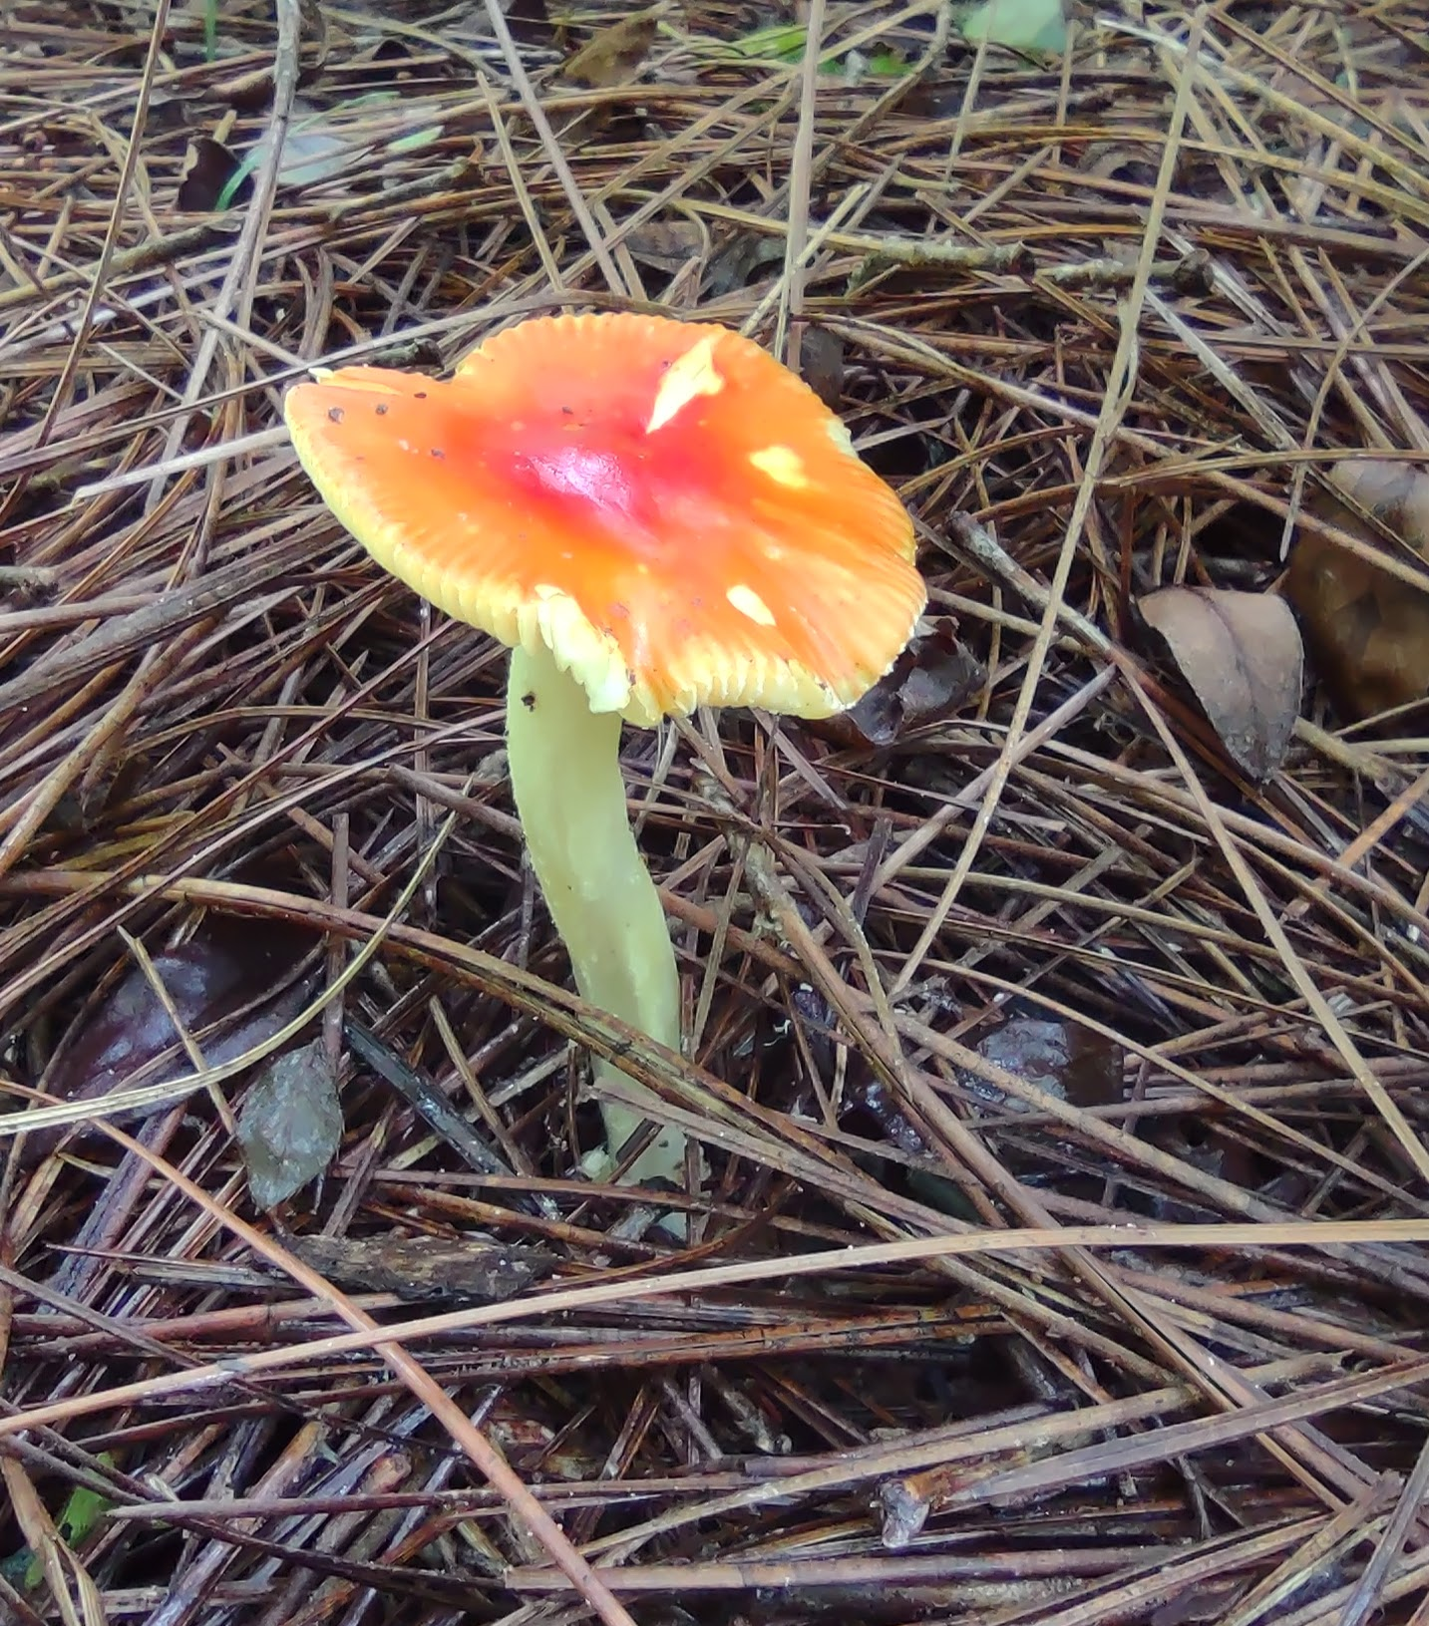
Mushroom
Photo by Diane Krish
Location: Diane’s Backyard
Small mushroom growing in woods behind my house.
Taken with Motorola one 5G

Slide 47
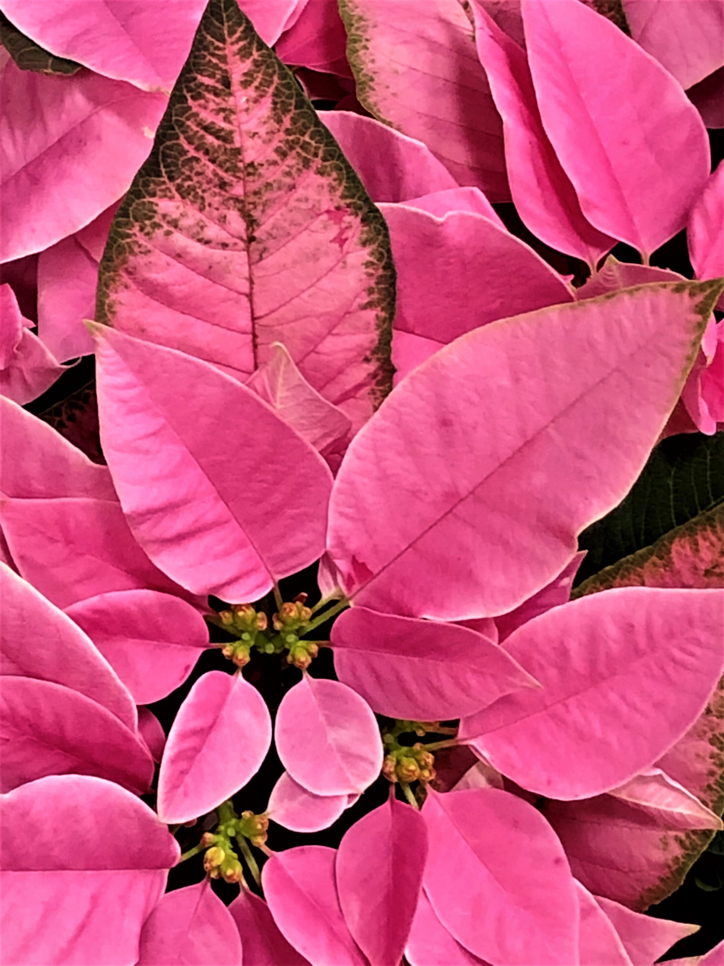
Pretty in Pink
Photo by Kate K. Foxwell
Location: Lowe’s, Snellville, GA
Pink variety of Poinsettia
Taken with iPhone

Slide 48
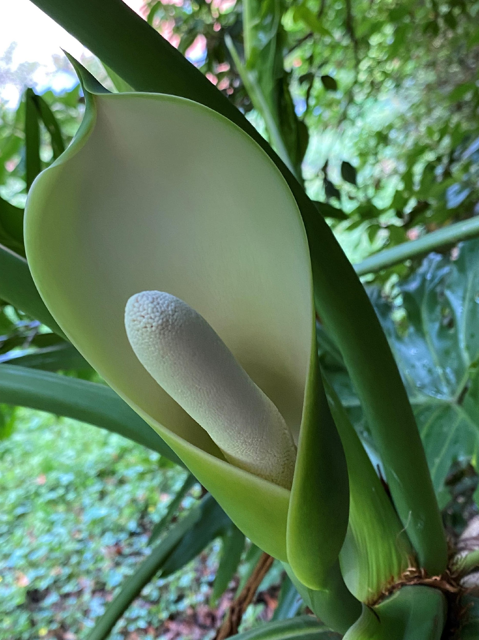
Rare Philodendron Blossom
Photo by Barbara Geier
Location: Barbara’s Backyard
This is a very rare bloom from my 40-year-old Split Leaf Philodendron. These plants do not bloom until they are at least 15-16 years old. I originally got this plant when I lived in North Carolina and have brought it with me as a valued member of my household whenever I have moved. It lives in the house during the winter but goes outside for what I call “summer camp” which it loves, and I was rewarded last summer with this most unusual bloom.

Slide 49
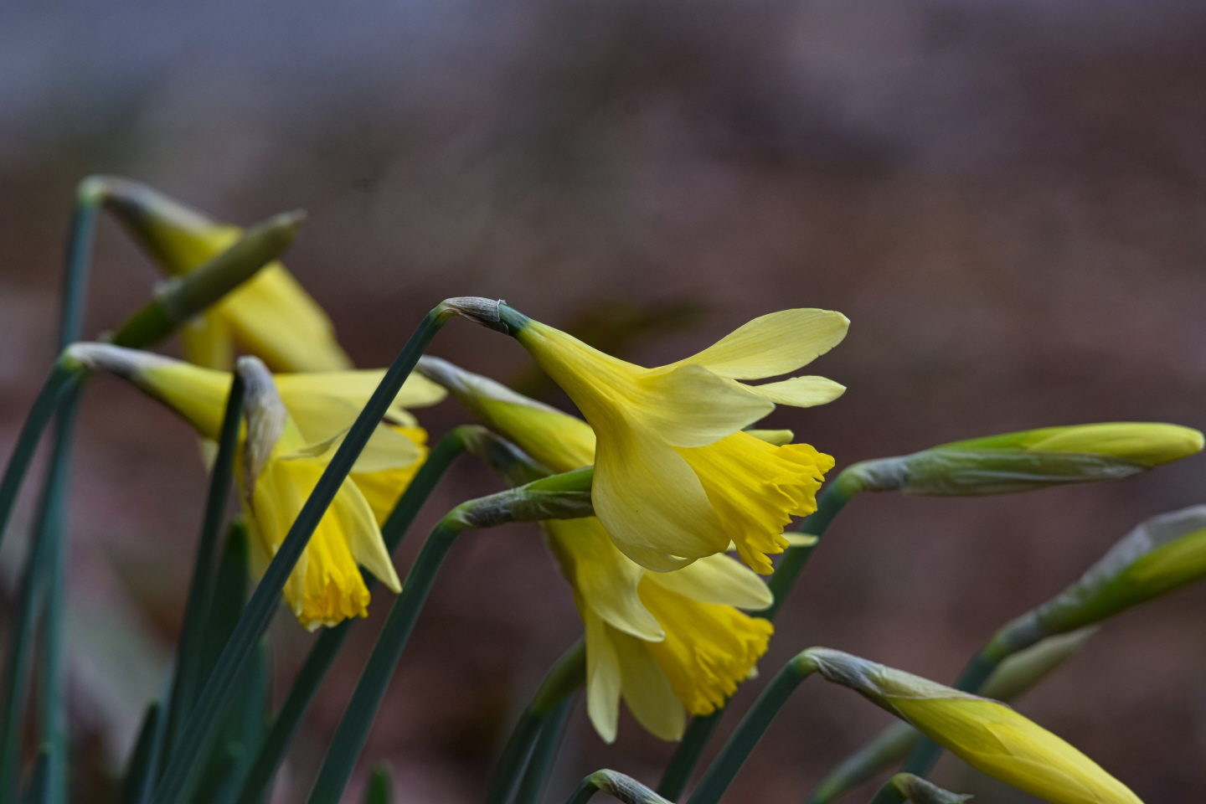
Spring’s Heralds
Photo by Ronald Kersey
Tribble Mill
Gwinnett County, GA
These beautiful flowers were waving in the spring breeze. I couldn't resist
Taken with Nikon D7200

Slide 50
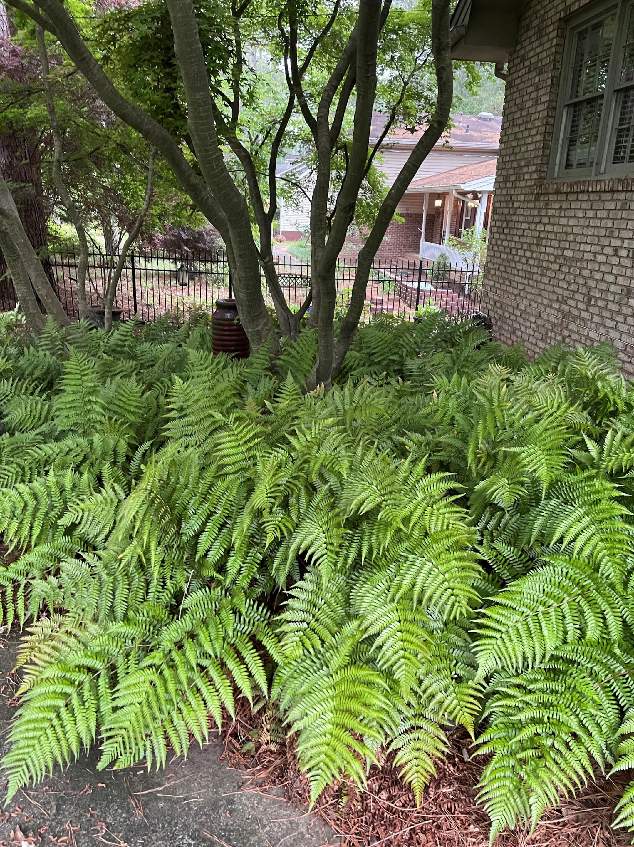
Ferns
Photo by Sandra Calkins
Location: Sandra’s Front Yard
Autumn Ferns
Taken with iPhone

Slide 51

Ready to Bloom
Photo by Karen McGinty
Location: Karen’s Yard
Native azalea about to bloom
Taken with iPhone

Slide 52

The Light Beckons
Photo by Margaret Molyson
Location: Margaret’s Front Garden
Obedient Plant
Taken with Nikon D5600

Slide 53

It’s four o’clock somewhere
Photo by Becky Panetta
Becky’s Yard
Blossom of Four O’clock (Mirabilis jalapa)
Taken with Olympus OM-D EM5III

Slide 54

Standing Proud
Photo by Ivan Varlamoff
Serengeti National Park, Tanzania
Umbrella Thorn Acacia (Vachellia tortilis) — I loved the majesty of this iconic tree in this setting.
Taken with Canon EOS 80D (FL 27 mm)

Slide 55

Purple Path
Photo by Marilyn Whitmer
Location: North Avenue Apartments complex, Georgia Tech, Atlanta, GA
This is a small garden of irises located inside the North Avenue Complex at Georgia Tech.
Taken with S22 Galaxy phone.

Slide 56

Arrowleaf balsamroot splendor
Photo by
Martha Whitman
Western Montana
near Bean Lake
On a spring wildflower ride to the 'front range' of Western Montana, Arrowleaf balsamroot filled a valley and the hillsides
Taken with iPhone 8

Slide 57

Raindrop Rose
Photo by Susan Smith
Location: Susan’s Front yard
My Rainbow Sorbet hybrid tea rose after a gentle rain.

Slide 58

Rosy Morning Friends
Photo by Lynda Pollock
Location: Atlanta Botanical Garden Rose Garden
Roses in the ABG Rose Garden - the color of the flowers were so saturated and rich in the early sun I had to stop weeding and take their photo and just admire.
Taken with iPhone

Slide 59

Cloudy with a Chance of Snowballs
Photo by Robert Ayer
Location:
Robert’s frontyard in
Snellville, GA
A Snowball Viburnum rises up for a better view of the blanket of clouds above.
Taken with iPhone 14 Pro Max

Slide 60

Buttercups!
Photo by Becky Wolary
Location: Becky’s Yard
These only bloom in the spring and I love them.

Slide 61

Master Gardener Projects
New category added to this year’s contest to showcase our amazing Master Gardener efforts.
We had five entries in this category.

Slide 62

Stairway to Heaven
Photo by Margaret Molyson
Location: St. John Neumann Parking Lot Island
Shrubs and perennials on parking lot island.
Taken with iPhone

Slide 63

Tuber Harvest
Photo by Tim Ledford.
One of the raised beds I rent in the Harvest Gwinnett Community Garden, Dacula Park. From left to right: parsnips, various types of carrots, and avalanche beets. December 2022. Submitted this photo since it is shows the quality and condition of the tuber (root) vegetables in my raised beds just prior to the December deep freeze.
Taken with iPhone. ** FIRST-TIME SUBMITTER **

Slide 64

Pollinator Playground
Photo by Barbara Geier
Berkeley Lake Elementary
School in Berkeley Lake
Taken with iPhone
This photo shows a lovely section of the Berkeley Lake Elementary School Pollinator Gardens that we have been working on for 3 years. It has finally gotten past its sleep and creep years and is now into its leap year!

Slide 65

Look at Me!
Photo by Ronald Kersey
Bethesda Park,
Gwinnett County, GA
The MG have created a beautiful garden at Bethesda and these flowers are so showy that everyone stops to see them!
Camera: Nikon D500

Slide 66

Yummy
Photo by Joanne Campbell
Location: McDaniel Farm
A beautiful box of carrots going to the food bank.
**First-time submitter**

Slide 67


Our finalists for Best in Show!
And the winner is…

Slide 68

Buttercups!
Photo by Becky Wolary
Congratulations!!

Slide 69


And congrats to all participants and winners!
An extra round of applause for our judge, Eric Bowles!
https://bowlesimages.com/

